Slide 1

Claiming Employee Retention Credit (ERC) in 2023 For Wages Paid in 2020 and 2021
And Tidying Up for ERC Claims You’ve Already Made
Faculty: Bradley Burnett, J.D., LL.M. (Taxation)
bradley@bradleyburnett.com
1717 Pennsylvania Avenue NW, Suite 1025
Washington, DC 20006 USA
Email: cpe@cpewarehouse.com

Slide 2


Slide 3
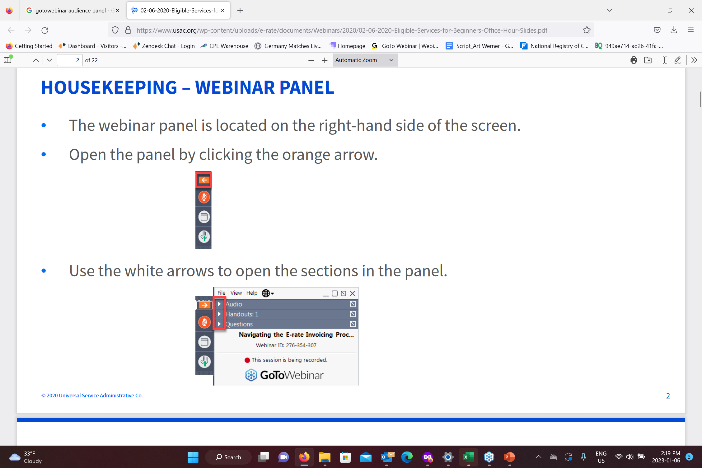
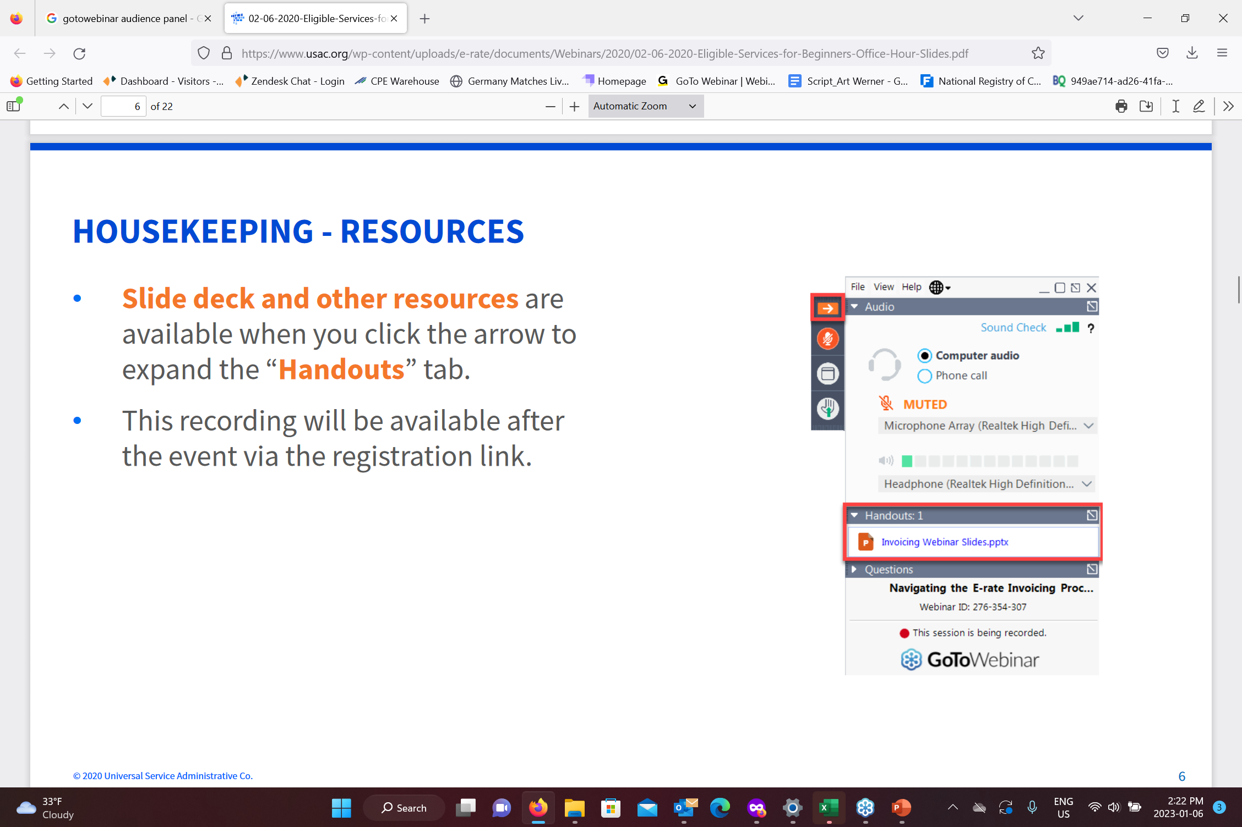
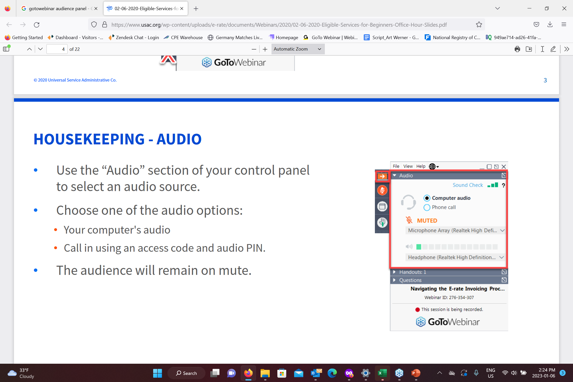
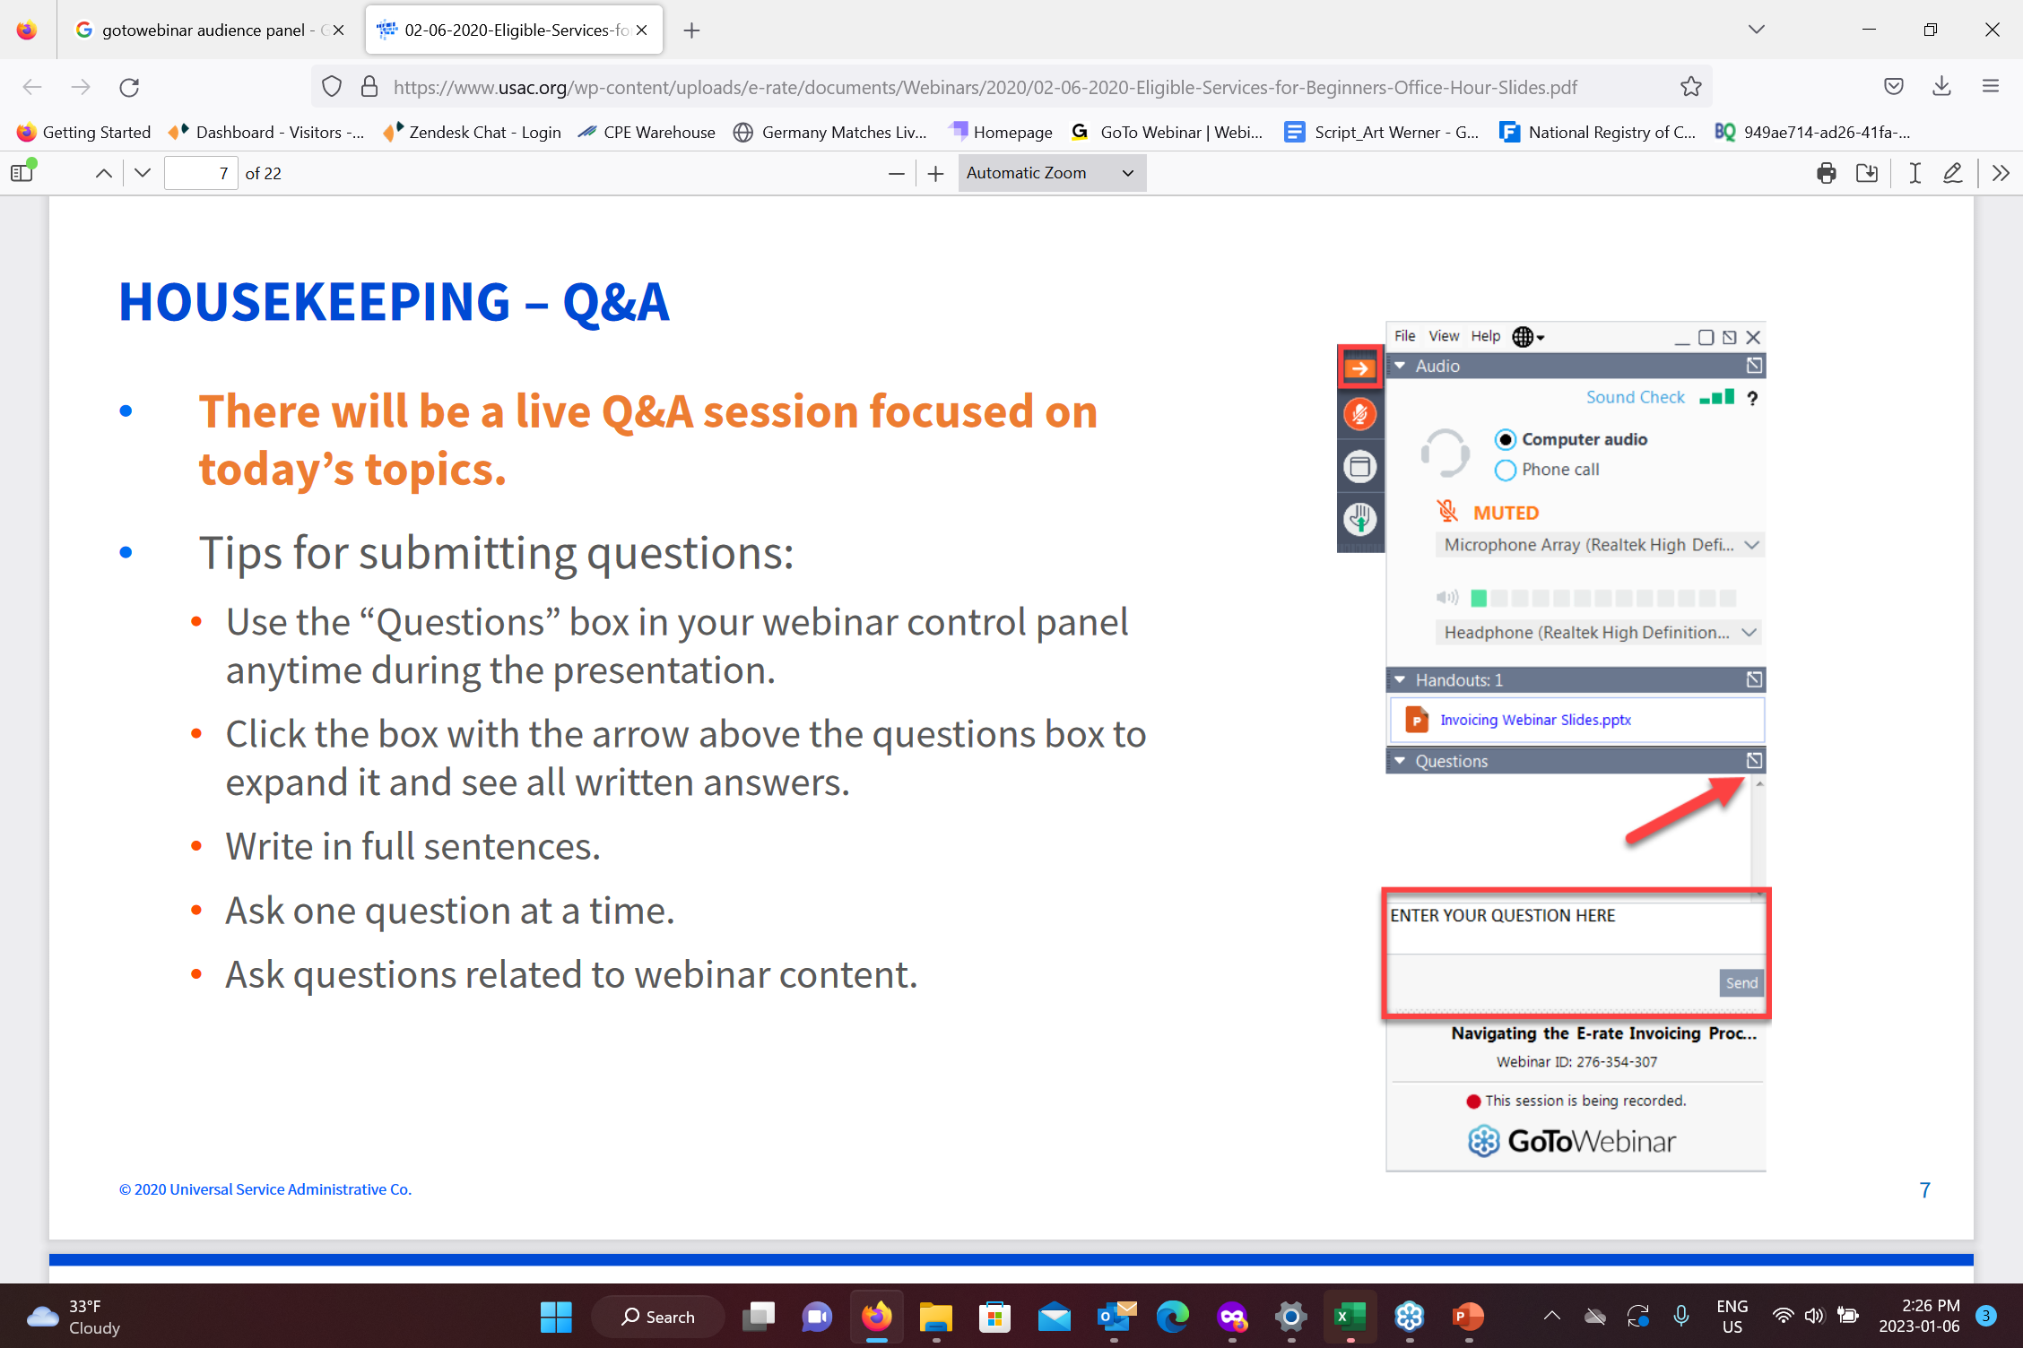
Navigating this webinar
1
2
3
4

Slide 4

Today’s Speaker: Bradley Burnett, J.D., LL.M.
Practicing Colorado tax attorney
39 years of tax practice experience
Emphasis on tax planning and tax controversy resolution
Prepares a handful of tax returns
Delivered more than 3,600 presentations on U.S. tax law in 5 countries
Authored texts of 40+ CPE courses, including for CCH
Served as adjunct professor at University of Denver School of Law Graduate Tax Program – Pioneered Employment Tax course and pinch hit for IRS Practice and Procedure course
Quoted in Tax Notes Today in feature article on S Corp shareholder basis
Awarded Illinois Society of CPAs Instructor Excellence Award
Appeared on Denver NBC television affiliate KUSA Channel 9 answering tax questions for call-in viewers
Top-rated, most requested instructor for CPA Society annual tax conferences 7 times

Slide 5
Disclaimer
Asterid Group Inc (dba CPE Warehouse) and Bradley Burnett, J.D., LL.M., make no representations or warranties about the accuracy or suitability of any information in the webinars and related materials (such as handouts, presentation documents, and recordings); all such content is provided to webinar registrants on an “as is” basis.
ASTERID GROUP INC (DBA CPE WAREHOUSE) AND BRADLEY BURNETT, J.D., LL.M., HEREBY DISCLAIMS ALL WARRANTIES AND CONDITIONS EXPRESS, IMPLIED, STATUTORY, OR OTHERWIESE REGARDING THE CONTENTS OF THESE MATERIALS, INCLUDING WITHOUT LIMITATION ALL WARRANTIES OF TITLE, NON-INFRINGEMENT, MERCHANTABILITY, AND FITNESS FOR A PARTICULAR PURPOSE.
Asterid Group Inc (dba CPE Warehouse) and Bradley Burnett, J.D., LL.M., are not liable for any claims, losses, or damages of any kind arising out of or in any way related to this information provided by presenters of these webinars. Asterid Group Inc (dba CPE Warehouse) and Werner-Rocca Seminars, Ltd., hereby disclaims all liability for any claims, losses, or damages of any kind in connection with use or application of these materials. The information contained in these webinars and related materials is not intended to constitute legal advice or the rendering of legal, consulting, or other professional services of any kind. Users of these materials should not in any manner rely upon or construe the information or resource materials in these materials as legal or other professional advice and should not act or fail to act based upon the information in these materials without seeking the services of a competent legal or other professional.
5

Slide 6

Claiming Employee Retention Credit (ERC) in 2023 To Squeeze More Cash Out of 2020 and 2021

Slide 7

Highlight Reel

Slide 8
Highlight Reel
Once Upon a Time – Covid Employee Retention Credit (ERC)
Players in the Game (in 2023)
ERC Legal Authority – Landscape Muddled, Widely Undefined – Today, We Tell You the Truth
Courage is Somewhere Between Cowardice and Recklessness (Ryan Holiday)
Outside ERC Solicitors – The Skinny
Waiting for Refunds
Fraud / Criminal Sanctions

Slide 9
Highlight Reel
Claiming ERC in 2023 Roadmap
Claiming ERC in 2023: Wages Paid in 2020 and/or 2021?
Claiming ERC in 2023: Actual Business (or Charity)?
Claiming ERC in 2023: Business (or Charity) Qualify for ERC?
Claiming ERC in 2023: Which Wages Count (or Not) for ERC?
Claiming ERC in 2023: How Much ERC Refund Do I Qualify For?
Claiming ERC in 2023: How and When to Apply (File) for ERC?
Claiming ERC in 2023: What is Cost and Risk of Applying?

Slide 10
Highlight Reel
First Round of Exams and IRS Info Document Requests (IDRs) re: ERC Start to Fly
IRS May Claw Back Tax Credits Granted in Error
Three Grounds for Eligibility for Covid ERC
Full or Partial Suspension
Drop in Gross Receipts
Recovery Startup Business
Aggregation Rules

Slide 11
Highlight Reel
PPP Loans and ERC
Adjustments to Income Tax Return
Amended Payroll Tax Returns
Appendix 1 Wage Chart: PPP vs. ERC
Appendix 2 ERC Majority C and S Corp Owner Wages
Appendix 3 Covid ERC/PPP/EIDL Fraud
Appendix 4 Payroll Tax Returns (Original and Amended)
Appendix 5 Harry Truman Decision Model
Appendix 6 Covid ERC vs. Natural Disaster Related ERC

Slide 12

Once Upon a Time Covid Employee Retention Credit (ERC)

Slide 13
Once Upon a Time Covid Employee Retention Credit (ERC)
Let’s gather round the campfire for a story
In late 2019 and early January 2020, America was more or less doing its own thing and not hunkering down to defend against a worldwide pandemic
In January or February or so of 2020, the Covid virus hit America (and the world)
In response, people stopped going out and about and became increasingly isolated in an effort to reduce exposure
(It followed that) most state and local governments restricted the movement of people and locked down or limited the operation of many businesses

Slide 14
Once Upon a Time Covid Employee Retention Credit (ERC)
Congress became concerned about the financial well-being of the economy, businesses and people
In response, Congress threw hoards of money (that America did not have) at businesses and the people in an effort to keep all afloat
One of the batches of money Congress threw at businesses was the Employee Retention Credit (ERC)
ERC is a credit against federal payroll tax (for qualifying wages paid from 03/13/20 though 12/31/21) (1Q 2020 thru 4Q 2021 w/ limitation)
Purpose of Covid ERC: To help qualifying employers be able to keep employees on payroll

Slide 15
Once Upon a Time Covid Employee Retention Credit (ERC)
Some taxpayers claimed the ERC right away (e.g., on Form 941), while others did not do so but still can (e.g., via Form 941-X)
IRS promised to get ERC money to employers fast, but instead IRS proved to pay out woefully slowly
America in 2023 is milling around in a tizzy over ERC
The purpose of this course is to enlighten the populate as to proper next ERC steps

Slide 16

ERC Players in the Game (in 2023)
“The only players who survive in the pros are the ones able to manage
all their responsibilities.“ Tom Brady

Slide 17
ERC Categories of Players
Taxpayers who filed claims and are waiting for refunds (and are growing much older waiting on their refunds)
Taxpayers who have not yet filed ERC claims (have not gotten around to it) (or don’t even know they can)
Taxpayers who believed they did not qualify, but are now wondering whether they do (perhaps are being hustled and told they do qualify)
Those who thought they qualified and claimed ERC, but now are not so sure (and are thinking about stepping away) (should I stay or should I go?)
Those who think it’s too late to apply (but, it’s really not)

Slide 18

ERC Categories of Players
Those who filed fraudulent claims (either now being prosecuted and/or waiting to see if and how long they may be in federal prison)
Outside ERC solicitors (ERC mills) (sweatshops) aggressively and relentlessly pushing America toward claiming ERC
Notes:
The bird in the photo is free, but the inmates in the federal prison, Alcatraz, back in the day, not so much

Slide 19
Notes
Notes:
07/28/22 Murray big course: A. 72% B. 13% C. 15%

Slide 20

ERC Legal Authority Landscape Muddled, Widely Undefined
Notes:
Stoplights

Slide 21
ERC Legal Authority Today, We Tell You the Truth
ERC statutes were pushed out in a hurry by Congress
ERC statutory language (and legislative history) (re: which employers qualify for ERC (and which do not)) skimpy at best
IRS guidance helpful in places, but
Sketchy and patchy in other places
IRS guidance exists in the form of FAQs and Notices (not properly promulgated under Administrative Procedures Act (APA), so vulnerable to taxpayer and judicial attack)
In places, it may be possible to venture a bit beyond existing IRS guidance
However, may not unreasonably stray from the statute
Taxpayer interpretations of Internal Revenue Code must be reasonable

Slide 22
ERC Legal Authority In Grey Areas, Uncertainty Abounds
Need uncertain positions be disclosed on tax return (e.g., on Form 8275 attached to Form 941 or 941-X)?
Need uncertain positions be disclosed on taxpayer’s financial statements?

Slide 23

Courage is Somewhere Between Cowardice and Recklessness (Ryan Holiday)
Notes:
Courage is Somewhere Between Cowardice and Recklessness (Ryan Holiday)
Daily Stoic email 09/21/22

Slide 24

Outside ERC Solicitors The Skinny

Slide 25
Outside ERC Solicitors The Skinny
Some outside ERC solicitors (mostly accounting firms and law firms) are reputable and likely do excellent work
Others are quite aggressive in offering services for big fees
Some appear to be quite aggressive in their most liberal approach to interpreting whether their customer qualifies for ERC
If they’re pushing the rules, it’s based on THEIR speculation and/or greed
Some do not view themselves as being aggressive – They do not appreciate that their lack of legal and tax background leaves their clients (and them) quite exposed
The only thing it’s guaranteed they know is that they want to make money
See: “Concerns Mount Over Aggressive Employee Retention Credit Firms” (Tax Notes Today (09/21/22)) and “$2 Trillion Fraud With Employee Retention Credits Puts Financial Advisors on Edge” (Accounting Today (09/20/22))

Slide 26

Outside ERC Solicitors IRS Fires Warning Shots

Slide 27
Outside ERC Solicitors IRS Fires Warning Shots
IRS issued guidance warning of third parties improperly promoting ERC (IR 2022-183 (10/19/22)) – Warning shots fired!!
IRS newly parades Form 3949-A, encouraging Americans to report (to IRS) aggressive ERC claims
IRS receives $45.6B to step up enforcement activities, including examining ERC for up to 10 years
In IR 2023-40 (03/07/23), IRS fires second warning shot about misguided ERC claims
IR 2023-49 (03/20/23): IRS Comm. Werfel calls aggressive marketing ”deeply troubling” and a “major concern” for IRS
Is it still possible to legitimately claim ERC? Absolutely!!

Slide 28
Outside ERC Solicitors IRS Fires Warning Shots
IRS’s Office of Professional Responsibility (OPR) issued OPR Issue Number 2023-2 (03/07/23) (e-news for Tax Professionals 2023-11), citing:
Circ 230 §10.22(a): Practitioners must exercise due diligence in preparing and filing client’s tax returns
Circ 230 §10.22(a) also imposes on a practitioner a duty of due diligence to inquire of client re: sufficient detail to determine eligibility for ERC – May rely in good faith on client but must make reasonable inquiries to determine eligibility – If smells fishy, must make further inquiries
Circ 230 §10.34 requires practitioner to exercise reasonable diligence in advising a client – May not advise position that lacks a reasonable basis – If at least reasonable basis, inform client of opportunity to avoid penalty by attaching of Form 8275
If practitioner aware prior filed ERC claim excessive, practitioner should advice client that client should file amended return

Slide 29
Outside ERC Solicitors IRS Fires Warning Shots
IRS’s Office of Professional Responsibility (OPR) issued OPR Issue Number 2023-2 (03/07/23) (e-news for Tax Professionals 2023-11), citing:
Circ 230 §10.37(a)(3) allows a practitioner to rely on advice of others, but only if reliance reasonable – Reliance may not be reasonable if other is compensated under contingency fee arrangement (conflict of interest) (Circ 230 §10.29)
Question: If practitioner believes (or strongly suspects) a client’s ERC claim (prepared by an outside ERC mill) is bogus (not well grounded), may practitioner file an amended income tax return (to reduce income tax deduction for wages by amount of ERC claimed)?
Circ 230 § 10.22(a) of Circular 230 requires a practitioner to exercise due diligence in preparing and filing tax returns
If the practitioner cannot reasonably conclude that the client is or was eligible to claim the ERC, then the practitioner should not prepare an original or amended return that claims or perpetuates a potentially improper credit
Good idea: Review issue w/ malpractice insurance carrier

Slide 30
Outside ERC Solicitors IRS Fires Warning Shots
IR-2023-105 (05/25/23)
IRS Commissioner Danny Werfel:
“Aggressive marketing of ERC continues preying on innocent businesses and others"
"Aggressive promoters present wildly misleading claims about this credit”
“They can pocket handsome fees while leaving those claiming the credit at risk of having the claims denied or facing scenarios where they need to repay the credit”
Concern: IRS will examine all clients of ERC mill it chooses to pursue
Practitioners are requesting and IRS is considering a Voluntary Disclosure Program tailored to resolve improper ERC claims
To report ERC abuse, submit Form 14242, Report Suspected Abusive Tax Promotions or Preparers. People should mail to address in Form 14242 Instructions or fax to 877-477-9135

Slide 31
Outside ERC Solicitors IRS Fires Warning Shots
IR-2023-105 (05/25/23)
Warning signs of aggressive ERC marketing
Unsolicited calls or ads mentioning "easy application process”
Statements that promoter can determine ERC eligibility within minutes
Large upfront fees
Fees based on a percentage of refund amount
Assertion that business qualifies before any discussion of specifics
Aggressive urging businesses to submit claim because “nothing to lose”
Not inform employer it needs to reduce wage deduction(s) claimed on business' federal income tax return(s) by amount of ERC
Failure to mention that can't claim ERC on wages that were reported as payroll costs if obtained PPP loan forgiveness

Slide 32
Notes
Notes:
07/28/22 Murray big course: A. 72% B. 13% C. 15%

Slide 33

Let’s Put the Truth (BS) Meter on Outside ERC Solicitor Sales Pitches

Slide 34
Various Outside ERC Solicitor Sales Tactics
Topic | Advertising Claim | Pass / Fail / Maybe | Truth
Who best to apply for ERC? | Why can’t my CPA pursue ERC for me? CPA not expert, we are. | Fail / Maybe | No generalization holds up well. Each case stands on own. Many ERC solicitors not experts
 | Why be the guinea pig for your CPA? We generate 10-20% more in ERC than a CPA unfamiliar w/ ERC | Maybe | How scientifically and exactly was the estimate of 10-20% more arrived at? Who conducted the study? Did you amend returns prep’d by CPA?
 | CPAs only good at income, not payroll, tax. We’re better at payroll. | Maybe | No generalization holds up well. Each case stands on own. Many ERC solictors not experts.
 | ERC complex. ERC code is 200 pages. | Fail | IRC for ERC is about 10-12 pages. IRS Notices longer.
Notes:
Innovation refunds: https://www.innovationrefunds.com/faq
ERC Specialists
https://www.ercprogramaffiliate.com/qualify54365652?msclkid=7427b05acf9b1c12c1e6d28693a26216&utm_campaign=erc&utm_content=keywords&utm_medium=CPC&utm_source=Bing#section--44396-132-165

Slide 35
Various Outside ERC Solicitor Sales Tactics
Topic | Advertising Claim | Pass / Fail / Maybe | Truth
Does my business qualify? | If you experienced disruptions to commerce, travel or group meetings – You qualify! | Fail | Qualifying is not that simple Disruptions to commerce, travel or group meetings do not automatically qualify More tests must be met to qualify a business for ERC
Notes:
Innovation refunds: https://www.innovationrefunds.com/faq

Slide 36
Outside ERC Solicitors It Depends on Who You Hire
Some outside ERC solicitors (mostly accounting firms and law firms) are reputable and likely do excellent work
Others are quite aggressive in their most liberal approach to interpreting whether their customer qualifies for ERC – Legal positions taken by some would likely not hold up in court

Slide 37

TIGTA What Stopped IRS Sending Timely ERC Refunds

Slide 38
TIGTA: Delays Continue Businesses Not Receiving Pandemic Relief Benefits
Delays Continue to Result in Businesses Not Receiving Pandemic Relief Benefits (TIGTA Report No. 2022-46-059) (08/31/22) https://www.treasury.gov/tigta/auditreports/2022reports/202246059fr.pdf
IRS did not begin processing claims for FFCRA Credits and ERC for 12 months and claims for Social Security Tax (OASDI) Deferral for 16 months after pandemic relief legislation enacted
Why the delay?
Lack of updated programming
Lack of updated procedural guidance and training
Lack of prioritization of claims
Lack of procedure to handle OASDI deferral and ERC at same time
Erroneously suspended claims
Estimated $2 trillion in Covid employment tax claims (FFCRA and ERC) identified by IRS fraud filter

Slide 39
TIGTA: Delays Continue Businesses Not Receiving Pandemic Relief Benefits
(TIGTA Report No. 2022-46-059) (08/31/22) TIGTA also exposes:
IRS cannot properly diagnose which business is (or is not) a “recovery startup business” (only eligible for 3Q and 4Q 2021)
IRS did not send many returns to IRS Exam for review as required
Dropped ball on returns involving significant refundable credits
Also dropped ball on returns involving nonrefundable credits
73% of returns in sample leading to potentially erroneous refunds averaging $300,000 each for a $45M total
Interviewed “IRS employees who did not refer” indicated they “just forgot” or got confused by multiple layers of IRS guidance
Mostly happened because IRS internal guidance did not require referral
Author’s note: It appears that no one is driving the boat

Slide 40
Let’s Put the Truth (BS) Meter on Outside ERC Solicitor Sales Pitches

Slide 41
Various Outside ERC Solicitor Sales Tactics
Topic | Advertising Claim | Pass / Fail / Maybe | Truth
How soon will IRS pay refund? | IRS will send check in 8-12 weeks (2-3 mos) | Maybe | This author has not experienced or heard of any refund received that fast
 | Tp will receive refund in 5-8 months, depending on backlog | Fail | Many, many, many tps indicate refunds, if received at all, take much, much longer
 | Minimum of 20 weeks (5 mos) or longer | Pass | This advertising claim is stated responsibly (for paper file)
 | 6-9 months | Pass | More realistic than others
 | 6-9 months | Pass | More realistic than others
 | Up to a year | Pass | More realistic than others
Notes:
Innovation refunds: https://www.innovationrefunds.com/faq
ERC Specialists
https://www.ercprogramaffiliate.com/qualify54365652?msclkid=7427b05acf9b1c12c1e6d28693a26216&utm_campaign=erc&utm_content=keywords&utm_medium=CPC&utm_source=Bing#section--44396-132-165
https://erc.stentam.com/bing-employee-retention-credits/?msclkid=1da73da8233c1957a0885f747f05c742
https://www.joinallies.org/ertc?msclkid=7929d3b9621e1f9cc9eeb16641c215b6

Slide 42
Notes
Notes:
07/28/22 Murray big course: A. 72% B. 13% C. 15%

Slide 43
Notes
Notes:
07/28/22 Murray big course: A. 72% B. 13% C. 15%

Slide 44

ERC Waiting for Refunds

Slide 45
ERC Waiting for Refunds
IRS has been woefully slow paying out ERC refund claims – What to do about it?
Closely monitor taxpayer IRS accounts (transcript and record of accounts)
Monitor status of IRS correspondence
Avoid paper filings / communication w/ IRS where possible
Document and retain every important communication w/ IRS

Slide 46
ERC Waiting for Refunds
IRS has been woefully slow paying out ERC refund claims – What to do about it?
Go to Taxpayer Advocate Service (TAS)
TAS is once again (newly) authorized to ride herd on IRS re: tardy refund claim payouts
Make sure TAS does not allow IRS to code the matter “taxpayer did not comply w/ requirements or timely respond, taxpayer lost rights”
Make sure TAS rides IRS to make IRS see the matter through
Go to your Congressperson (e.g., email from tax preparer in KS who involved Congressperson – Result: 21 delinquent ERC refunds all paid out and received within 3 weeks)

Slide 47
ERC Waiting for Refunds
What to do about tardy IRS payouts by IRS of ERC claims?
Per Taxpayer Advocate Erin Collins (06/06/23):
“Be patient”
If filed in most recent 120 days, it’s being processed
If filed > 120 days ago, it’s either delayed or sent to IRS exam
If extraordinary period of time since filing (> 6 months), go to TAS
If at TAS > 3 ½ months (and TAS has not reached out), contact TAS NTA Representative Erin Collins personally
If hardship on taxpayer, TAS will move it to top of list
Go online to verify status of your claim at IRS
Some returns disappeared at IRS
IRS processing of ERC claims slowed because of bad player ERC mills

Slide 48

Applying for and Claiming ERC Refunds Trouble With PEOs (Leasing or Payroll Companies)

Slide 49
Applying for and Claiming ERC Refunds Trouble With PEOs (Leasing or Payroll Companies)
Many customers of PEOs (professional employee organizations) (leasing or payroll companies) have reported not receiving expected ERC refunds at all
IRS refuses to work with customer in troubleshooting ERC refund claim, demands to work with PEO instead
Reports indicate that PEO won’t go to bat with IRS for customer re: ERC
Result: Customer stuck in no man’s land w/ no advocate or ERC refund
What to do about it?

Slide 50
Applying for and Claiming ERC Refunds Trouble With PEOs (Leasing or Payroll Companies)
A possible approach to getting IRS and/or PEO moving
Contact PEO
Get from them a copy of what the PEO sent to IRS (941 or its equivalent)
Get info from PEO as to what the customer’s allocable percentage of the total reflected on the PEO’s employment tax return is
Get a statement from PEO as to dollars of ERC claimed and related wages they submitted to IRS on customer’s behalf
Supply all of the above to IRS, inquiring as to what else IRS needs and requesting that IRS keep this ERC claim moving
Demand that PEO follow up w/ IRS to go to bat for customer’s ERC claim
If PEO won't get moving, hire lawyer to send demand letter
if no response to demand letter, follow up by suing PEO
Write your Congressperson if you don't get satisfaction
IRS Training Manual (audit guide) on pages 3-60 and 3-61 re: use of third-party payers to pay employment tax to IRS and get the employee retention credit https://www.meadowscollier.com/58DDFE/assets/files/documents/ERC%20Training%20Materials-Dec.%205,%202022%20Blog%20Post.pdf

Slide 51

Fraud
Fraud = Deceit, trickery, sharp practice or breach of confidence, perpetrated for profit or to gain some unfair or dishonest advantage (Dictionary.com)

Slide 52

In the Old Wild West Things Got Settled the Old Fashioned Way

Slide 53

In the New Wild West Things Get Settled the New Fashioned Way
Applicants who fraudulently steal Covid relief funds (ERC, PPP loans and EIDL loans) from fed government must pay it back, for starters, pay a whole lot extra and do serious hard time
Notes:
At least that’s what the Department of Justice says

Slide 54
In the New Wild West Things Get Settled the New Fashioned Way
DOJ’s criminal and civil enforcement efforts to combat COVID-19 related fraud, through July 2022:
Criminal charges against over 1,000 defendants with alleged losses exceeding $1.1 billion;
Seizure of over $1B in Economic Injury Disaster Loan (EIDL) proceeds; and
Over 240 civil investigations into more than 1,800 individuals and entities for alleged misconduct in connection with pandemic relief loans totaling more than $6B

Slide 55
Alleged Fraudulent Acts PPP, EIDL Loans and ERC
Application via fraudulent business entities or shell companies
Misrepresentation of payroll and employees
Falsified bank statements
Falsified tax records
Misrepresentation of business income

Slide 56

PPP, EIDL Loans and ERC Example: Arizona Case
Notes:
Business location listed for Glendale AZ exempt org “Lotto Club” Lotto Club status at AZ Secy State “Pending Inactive”

Slide 57

Potential for Arizona Case: Up to 45 Years Each Defendant Over $3.8M Monetary Damages Each Defendant
(Indictment of Willie “Blu” Mitchell and Toni Richardson, U.S. D.C. Arizona,
Case CR-21-00977-PHX-GMS (11/23/21))

Slide 58
Example: Arizona Case Consequences
Violation (Count) | Action(s) | Potential Consequences
Conspiracy | 2 (or more) persons conspire to defraud U.S., at least one person acts to carry out | Money fine
 |  | 5 years prison
Bank Fraud (or Wire Fraud) | Executes (or attempts) scheme to fraudulently obtain assets of or held by financial institution (or fraud using wire communic. or internet) | $1M fine
 |  | 30 years prison (bank) (20 years wire fraud)
Transactional Money Laundering | Monetary transaction involving criminally derived property $10,000 derived from unlawful activity | Money fine up to $2,553,000
 |  | 10 years prison
Forfeiture Allegations | Any property derived from proceeds traceable to bank fraud and money laundering is subject to forfeiture | All money obtained and property (obtained w/ such money) subject to forfeiture

Slide 59
Employee Retention Credit Criminal Cases
Utah tax preparers Zachary Bassett, 39, and Mason Warr, 37,and their company COS Accounting and Tax LLC indicted
Indicted in Feb. 2023 for 25 criminal counts each, including conspiracy to defraud the U.S., wire fraud and aiding and assisting the filing of false tax returns
Prepared more than 1,000 Forms 941 that claimed > $11M in ERC claims over a 16-month period
Lied about claimant’s eligibility for credits, number of employees, amount of payroll and other to juice up amounts claimed (and, thus, contingency fees)
Converted “businesses” of sole proprietors to single member LLCs taxed as S Corps and claimed ERC and FFCRA (Families First Coronavirus) employment tax credits for wages allegedly paid (whether paid or not) to owners and spouses (regardless of whether spouse worked for business)
Signed tax returns on behalf of clients
Many more ERC criminal cases in the hopper (as of 01/31/23 and later)

Slide 60
ERC Fraud Questions In IRS Exams
Fraud Questions
Does the company that paid the wages exist?
Do employees exist?
Do wages exist?
Did the employer have requisite drop in gross receipts?
Did employer face government shutdown/suspension?
Does supporting documentation even exist?
Is supporting documentation falsified?
Do the numbers in the ERC claims make sense?
Do returns filed w/ fed govt line up w/ state filings?

Slide 61

Statute of Limitations Extended To Prosecute Covid Relief Fund Fraud

Slide 62
Statute of Limitations Extended to 10 Years To Prosecute PPP and EIDL Fraud
On 08/05/22, the President signed into law 2 Acts extending civil and criminal statute of limitations for Covid-19 relief fund fraud
H.R. 7352 - PPP & Bank Fraud Enforcement Harmonization Act of 2022 (P.L. 117-166) (re: First and Second Draw PPP Loans) https://www.congress.gov/bill/117th-congress/house-bill/7352/text
H.R. 7334 - COVID-19 EIDL Fraud Statute of Limitations Act of 2022 (P.L. 117-327) (re: EIDL loans, EIDL Advances and Targeted EIDL Advances) https://www.congress.gov/bill/117th-congress/house-bill/7334/text
Both extend time (from 5, 6 (and 10) years, depending on the underlying statute) to 10 years for criminal prosecution of fraud
For an excellent explanatory article, see: https://www.arnoldporter.com/en/perspectives/blogs/enforcement-edge/2022/08/more-time-to-prosecute-ppp-related-fraud
Notes:
ERC S/L not specifically extended on 08/05/22

Slide 63
Statute of Limitations To Seek ERC Refund (or for IRS to Examine)
On 08/05/22, Congress did not extend the statute of limitations (S/L) to civilly or criminally prosecute ERC fraud
S/L for IRS to prosecute criminal tax fraud generally = 6 years
S/L for IRS (for civil case) to assess tax (re: ERC) =
For 1Q 2020 through 4Q 2020, 3 years after April 15 following the calendar year in issue (04/15/24) (IRC §6511(i)(1), IRC §6513(c), Instructions Form 941-X (04/2022))
For 1Q 2021 through 2Q 2021, 3 years after April 15 following the calendar year in issue (04/15/25) (IRC §6511(i)(1), IRC §6513(c), Instructions Form 941-X (04/2022))
For 3Q through 4Q 2021, 5 years after April 15 following the calendar year in issue (04/15/27) (IRC §3134(l))
However, if fraud, S/L never begins to run until fraud corrected
Worse news: Tax fraud conspiracy charges are not time barred – S/L open forever (U.S. v. David Wellington, No. 1-21-cr-00853 (08/12/22))

Slide 64
Statute of Limitations To Obtain ERC Refund
Compare: Deadline for taxpayer to file to obtain refund
Deadline to file for refund is generally within 3 years following April 15 following relevant tax year
For 2020, to file for ERC after 04/15/24 is too late*
For 2021, to file for ERC after 04/15/25 is too late*
Note: While the ARPA legislation gave IRS an extra 2 years (for 5 years total) to IRS to examine 3Q and 4Q 2021 ERC claims, the taxpayer only has 3 years to file a claim for refund for any 2021 ERC claim (04/15/25)
* (IRC §6511(i)(1), IRC §6513(c), Instructions Form 941-X (04/2022))

Slide 65

ERC Suggested Reading List

Slide 66
ERC Source Law
ERC founding statute: CARES Act https://www.congress.gov/116/plaws/publ136/PLAW-116publ136.pdf
ERC modifying statute: Consolidated Appropriations, 2021 https://www.congress.gov/bill/116th-congress/house-bill/133/text
ERC modifying statute: American Rescue Plan Act of 2021:https://www.congress.gov/bill/117th-congress/house-bill/1319
ERC modifying statute: Infrastructure Act of 2021: https://www.congress.gov/bill/117th-congress/house-bill/3684
IRS Notice 2021-20: https://www.irs.gov/pub/irs-drop/n-21-20.pdf
IRS Notice 2021-23: https://www.irs.gov/pub/irs-drop/n-21-23.pdf
IRS Notice 2021-49: https://www.irs.gov/pub/irs-drop/n-21-49.pdf

Slide 67

Claiming ERC in 2023 Roadmap

Slide 68
Claiming ERC in 2023 Roadmap
Did the operation pay W-2 wages or (pay for) health insurance in 2020 and/or 2021?
If yes, was the operation an actual business (or charity)?
If yes, does the business (or charity) qualify for ERC?
Which wages (including health benefits) count for ERC, which not?
How much ERC refund do I qualify for?
How and when to apply (file) for ERC?
What is the cost and risk of applying for ERC?

Slide 69

Claiming ERC in 2023 The Journey Begins

Slide 70
Claiming ERC in 2023 W-2 Wages (or Health Ins) Paid in 2020 or 2021?
Question 1: Did the operation pay W-2 wages or (pay for) health insurance in 2020 and/or 2021?
Only employee W-2 wages (and qualifying health insurance costs*) (also included in definition of wages) qualify for ERC
Only employee W-2 wages* actually paid from 03/13/20 through 12/31/21) may qualify for ERC
Wages merely accrued do not count for ERC
Wages paid in 2019 and prior don’t qualify for ERC
Wages paid from 01/01/20 through 03/12/20 don’t qualify for ERC
Wages paid after 12/31/21 don’t qualify for ERC

Slide 71

Claiming ERC in 2023 Sole Proprietors

Slide 72
Claiming ERC in 2023 Net Earnings of Sole Proprietor and Family
Net earnings from self-employment of a sole proprietor (100% solo owner of a business) (whether owned outright or through a single member disregarded LLC) do not qualify for ERC (no employer/employee relationship)
W-2 wages of a family member of a sole proprietor do not qualify for ERC (IRC §§51(i)(1), 267(c)) (Notice 2021-49)
W-2 wages of employees of a sole proprietorship that are unrelated to the sole proprietor do qualify for ERC

Slide 73

Claiming ERC in 2023 Partners in Partnership

Slide 74
Claiming ERC in 2023 Net Earnings of Partner and Family
Net earnings from self-employment of a partner in a partnership (whether a partnership or LLC taxed as a pshp) do not qualify for ERC (no employer/employee relationship)
W-2 wages of a family member of > 50% owner of a partnership do not qualify for ERC (IRC §§51(i)(1), 267(c)) (Notice 2021-49)
W-2 wages of a family member of 50% or less owner of a partnership do qualify for ERC (IRC §§51(i)(1), 267(c)) (Notice 2021-49)
W-2 wages of employees of a partnership that are unrelated to a partner do qualify for ERC

Slide 75

Claiming ERC in 2023 Wages of C or S Corp Shareholder and Family

Slide 76
Claiming ERC in 2023 Wages of C or S Corp Shareholder and Family
W-2 wages of > 50% owner (including spouse) of a C or S Corp (IRC §§51(i)(1), 267(c))
According to IRS, do not qualify for ERC (Notice 2021-49) if such majority owner has a living relative (brother or sister (whether by whole or half-blood), ancestor, or lineal descendant) (whether works in business or not)
According to pro-taxpayer position (and original IRS position before IRS changed its mind), DO qualify for ERC
W-2 wages of a family member of majority (> 50%) owner of a C or S Corp do not qualify
W-2 wages of a family member of non-majority (50% or less) owner of a C or S Corp do qualify
W-2 wages of employees of C or S Corp that are unrelated to a shareholder do qualify for ERC

Slide 77
ERC on Wages to Owner of Corp and Spouse Pro-Taxpayer Position
Owners of C or S Corps (regardless of ownership %) wages do qualify for ERC
Spouses of owners of C or S Corps (regardless of the owner’s ownership percentage) wages do qualify for ERC
Non-spouse relatives of majority (i.e., > 50%) owners, do NOT qualify for ERC
Non-spouse relatives of non-majority (i.e., 50% or less) owners wages do qualify for ERC
(CARES Act §2301), (Con App (Division EE—Taxpayer Certainty and Disaster Tax Relief Act of 2020, §§ 206-207, 303))
The above is consistent w/ original legislative history to §51
Other readings not consistent w/ original legislative history

Slide 78
Both Sides of ERC (>50%) Owner (w/ Living Relative) Wage Dispute
ERC Wage Qualification | IRS Notice 2021-49 (IRS changes position) | Pro-Taxpayer Reading of §51
C or S Corp shareholder (shh) (regardless of ownership %) | Wages of 50% or < shh eligible. Wages of > 50% shh NOT eligible if listed relative (brother, step-brother, sister, step-sister, ancestor or lineal descendent) alive, regardless of whether such relative works in the business. | Yes
Shh’s spouse | Same as above if owner has living relative | Yes
Non-spouse relative of > 50% shareholder** | No | No
Non-spouse relative of 50% (or <) shh | Yes | Yes
* Originally, in FAQ #59, IRS ignores issue and did not take Notice 2021-49 position

Slide 79

IRS Notice 2021-49 Reaction by Congressman Bergman

Slide 80
IRS Notice 2021-49 Reaction by Congressman Bergman
Congressman Jack Bergman, R (MI) in (08/09/21) letter to IRS:
I write w/ my concerns … about Notice 2021-49
I object to language that prevents wages paid to a majority owner of a Corp from qualifying for ERC solely if owner has a direct family member
Notice 2021-49 excludes wages to majority owners or spouses only if “the majority owner has a brother or sister (whether by whole or half-blood), ancestor, or lineal descendant”
As a result, the only business owners that can take advantage of this credit are those who are orphaned and have no children or siblings
Meanwhile, those with families are cut off from this support, despite having an equal or greater need for financial relief

Slide 81
IRS Notice 2021-49 Reaction by Congressman Bergman
Congressman Jack Bergman, R (MI) in (08/09/21) letter to IRS:
The distinction made in your guidance is entirely illogical, goes against the intent of Congress and arbitrarily punishes Americans with families
I therefore request further explanation as to the statutory rationale for this decision
I urge you to take action to correct this absurd bureaucratic move
Thank you for your prompt attention to this critical request

Slide 82
ERC on Wages to Owner of Corp and Spouse Pro-Taxpayer Position
Owners of C or S Corps (regardless of ownership %) wages do qualify for ERC
Spouses of owners of C or S Corps (regardless of the owner’s ownership percentage) wages do qualify for ERC
Non-spouse relatives of > 50% owners, do NOT qualify for ERC
Non-spouse relatives of 50% (or less) owners wages do qualify for ERC
(CARES Act §2301), (Con App (Division EE—Taxpayer Certainty and Disaster Tax Relief Act of 2020, §§ 206-207, 303))
The above is consistent w/ original legislative history to §51
Other readings not consistent w/ original legislative history

Slide 83

The Back of this SUV Has on It Backsplash

Slide 84
Claiming ERC in 2023 Net Earnings of C or S Corp Shareholder and Family
IRS opines (and some tax practitioners agree) that a corporate shareholder (shh) loses eligibility for ERC wages by reason of backwards (or backsplash) attribution (from non-spouse relatives who are either employees or not employees)
The statute, regulation (and accompanying legislative history)
Only ace out (from ERC) some relatives (of shh), not shareholder
Do not provide for backwards attribution
"Reasonable minds may differ on when uncertainties creep in.”
U.S. Supreme Court Justice Benjamin Cardozo (Jurisprudence: Address before New York State Bar Assoc. Meeting, Hotel Astor, January 22, 1932)

Slide 85

Dad’s Brother Crazy Uncle Billy Ice Fishing in Outer Siberia

Slide 86

Crazy Uncle Billy He’s Alive

Slide 87
IRS Position – Notice 2021-49 Which Owners Qualify / Which Not?
Related Individuals – Effect of §51(i) and §267(a) attribution (Notice 2021-49, §IV.D., Ex. 3)
Wrong kind of relative aces > 50% owner out. A majority owner of a Corp is a related individual, whose wages are not ERC qualified wages, if owner has brother or sister (whether by whole or half-blood), ancestor or lineal descendant
If no wrong kind of relative, > 50% owner not aced out. If majority owner of a corporation has no brother or sister (whether by whole or half-blood), ancestor, or lineal descendant as defined in §267(c)(4), then neither majority owner nor his (her) spouse is a related individual under §51(i)(1) and the wages paid to the majority owner and/or the spouse are qualified ERC wages, assuming other requirements met

Slide 88

If No Living Siblings, Parents or Children a/k/a Crazy Uncle Billy Was Never Heard From Again Then Majority Shareholder Wages Count for ERC

Slide 89
Notes
Notes:
07/28/22 Murray big course: A. 72% B. 13% C. 15%

Slide 90
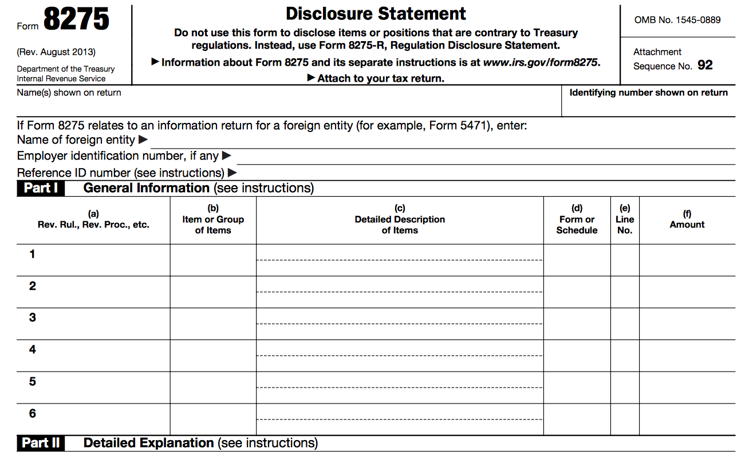
IRS Form 8275 Recommended if Challenge IRS Majority Owner Wage Position

Slide 91
C and S Corp Majority Owners w/ Listed Living Relatives If Claimed ERC Originally, Go Back and Amend?
Amended return or not?
My inclination is to say no amended return
Odds of penalty for pre-08/05/21 owner wage ERC claim arguably low
To be sure of no penalty, file amended return
If don’t amend, set money aside until statute of limitations expires
There is no legal obligation to file an amended return
Badaracco v. Comm. (464 U.S. 386 (1984)) “The Internal Revenue Code does not explicitly provide either for a taxpayer's filing, or for the Commissioner's acceptance, of an amended return; instead, an amended return is a creature of administrative origin and grace.”
Reg. §1.451-1(a) “If a taxpayer ascertains an item should have been included in gross income in a prior tax year, he should, if within period of limitation, file an amended return and pay any additional tax due”

Slide 92
Owners and ERC How to Advise Clients re: Amended Returns
IRS Circular 230 §10.21 Knowledge of Client's Omission
A practitioner, retained by a client re: a matter administered by IRS, who knows that the client has not complied with revenue laws of U.S. or has made an error in or omission from any return . . . which the client submitted or executed, must advise the client promptly of the fact of such noncompliance, error, or omission
The practitioner must advise the client of the consequences under IRC and regulations of such noncompliance, error, or omission
Question: Is a Form 941 or 941-X claiming ERC for a > 50% owner (with a forbidden relative) executed and submitted before 08/05/21 either noncompliance, an error or an omission? I don’t think so
However, out of an abundance of caution, to stay out of possible trouble, a preparer may choose to notify client in writing that subsequent IRS guidance ruled against position on return earlier taken

Slide 93
C and S Corp Majority Owners and ERC Notice 2021-49 and Penalty Abatement
No penalties for implementing Notice 2021-49 if reasonable cause
Notice 2021-49 §IV addresses several ERC issues for both 2020 and 2021
If employer files amended return to reflect Notice 2021-49 and consequently owes additional tax, any penalties for failure to timely pay or deposit tax will not apply if can show reasonable cause and not willful neglect

Slide 94
C and S Corp Majority Owners and ERC Next Moves
Next moves
Be a whole lot more cautious moving forward (after 08/05/21) (with late filed Form(s) 941 or Form(s) 941-X)
Whether to claim in future w/ or w/o Form 8275 disclosure – Client’s call
Whether to file an amended return
Client’s call
I’d let the sleeping dog lie (keeping in mind the original position you took was not a lie) (wait, see whether Congress or IRS reverse course)
IRS seems to be going out on two thin limbs
With double attribution against the owner (I’ve never seen that before)
By ruling that a living relative (that has nothing to do with the business) aces out an owner (I’ve never seen that before)

Slide 95
Let’s Put the Truth (BS) Meter on Outside ERC Solicitor Sales Pitches

Slide 96
Various Outside ERC Solicitor Sales Tactics
Topic | Advertising Claim | Pass / Fail / Maybe | Truth
Do owner’s wages qualify for ERC? | Wages of majority (>50%) owners do not qualify for ERC, nor do wages of immediate family. Wages of non-majority owners do qualify for ERC as do wages paid to immediate family members. [Author’s note: The ERC solicitor fails to explain aggregation, attribution & distinctions between Corps, LLCs and pshps. Scary.] | Fail (in this author’s humble opinion) | A genuine dispute of law exists as to whether the wages of a majority corporate owner (w/ a specified living relative) qualify for ERC. In this author’s opinion, such wages do qualify. It is disturbing to me that this ERC solicitor merely “drank the anti-taxpayer IRS koolaid” without giving the taxpayer a choice to challenge IRS’s position. Yet, elsewhere on their website, they took positions I do not believe may be supported.
Notes:
ERC Specialists
https://www.ercprogramaffiliate.com/qualify54365652?msclkid=7427b05acf9b1c12c1e6d28693a26216&utm_campaign=erc&utm_content=keywords&utm_medium=CPC&utm_source=Bing#section--44396-132-165

Slide 97
Notes
Notes:
07/28/22 Murray big course: A. 72% B. 13% C. 15%

Slide 98

Claiming ERC in 2023 The Road Trip Continues

Slide 99
Claiming ERC in 2023 Was Operation an Actual Business (or Charity)?
Question 2: Was the operation (that paid the wages) an actual business (or charity)?
A trade or business that employs qualifying employees is an eligible employer for ERC (CARES §2301(c)(2))
A mere investment activity (that does not rise to the level of a trade or business) (e.g., a non-business rental activity) is not an eligible employer for ERC
A §501(c) non-profit organization exempt from tax under §501(a) is an eligible employer for ERC
Federal, state or local govt agencies not ERC eligible
Household employers not ERC eligible

Slide 100
Claiming ERC in 2023 Was Operation an Actual Business (or Charity)?
Whether an activity rises to the level of a trade or business – Two factors (Groetzinger (US S Ct, 480 US 23 (1987)):
Primary purpose is economic profit (independent of tax savings)
Activity carried on w/ regularity and continuity
The facts of each case control
Finding new tenants, supplying furnishings and making units ready for new tenants “systematically regular and continuous” to meet trade or business standard (Curphey v. Comm., 73 TC 766 (1980))
7. For real estate, 4 factors whether trade or business:
Type of property (residential vs. commercial)
Number of rental properties
Involvement of owner or agent
Type of rental (triple net, long-term, short-term or heavy landlord role)

Slide 101

Claiming ERC in 2023 Be Careful Out There

Slide 102
Claiming ERC in 2023 Does Business (or Charity) Qualify for ERC?
Question 3: Does the business (or charity) qualify for ERC?
An eligible employer qualifies for ERC in one of three ways:
Full or partial suspension by government order
Drop in gross receipts
Recovery startup business

Slide 103
Claiming ERC in 2023 Does Business (or Charity) Qualify for ERC?
Drop in gross receipts (GR)
For 2020, an employer qualifies for ERC if its GR drop in any one quarter of 2020 by > 50% compared to the same calendar quarter of 2019
For 2021, an employer qualifies for ERC if its GR drop in any one quarter of 2021 by > 20% compared to the same calendar quarter of 2019
If employer meets drop in GR test, all qualifying wages (subject to dollar limits) paid in entire qualifying quarter count for ERC
Related businesses must be aggregated to test (as an aggregated group) whether drop in gross receipts test met

Slide 104
Claiming ERC in 2023 Does Business (or Charity) Qualify for ERC?
Full or partial suspension by government order
If operations of employer fully or partially suspended due to order(s) from a government authority re: Covid-19 limiting commerce, travel or group meetings, then ‘er qualifies for ERC
If employer meets full or partial government suspension test, qualifying wages (subject to dollar limits) paid only during days of government suspension (not entire qualifying quarter) count for ERC
Most of uncertainty surrounding whether a taxpayer is eligible for ERC surrounds how to interpret the vague statutory partial suspension test
We’ll jump much more deeply into this analysis later in this course

Slide 105
Claiming ERC in 2023 Does Business (or Charity) Qualify for ERC?
Recovery startup business (RSB)
If a business (or charity) begins operations after 02/15/20 and has < $1M average annual gross receipts, then it may qualify for ERC as a “recovery startup business” for either 3Q or 4Q 2021
Since Congress, in the “Infrastructure Act” otherwise ripped away ERC from eligible employers for 4Q 2021, a recovery startup business stands alone as the only manner to qualify for ERC for 4Q 2021
If an employer qualifies for ERC under either the “drop in gross receipts” test or “full or partial suspension by government order” test, then qualifying under the “recovery startup business” test is not possible
If a recovery startup business, an employer’s ERC for 3Q 2021 is limited overall to $50,000 and for 3Q 2021 limited overall to $50,000 (for a possible RSB total of $100,000)

Slide 106

Claiming ERC in 2023 Still on the Road

Slide 107
Claiming ERC in 2023 Which Wages Count for ERC, Which Not?
Question 4: Which wages (including health benefits) count for ERC, which not?
Only employee wages (and qualifying health insurance costs*) (also included in definition of wages) qualify for ERC
Only employee W-2 wages* actually paid from 03/13/20 through 12/31/21) may qualify for ERC

Slide 108
Let’s Put the Truth (BS) Meter on Outside ERC Solicitor Sales Pitches

Slide 109
Various Outside ERC Solicitor Sales Tactics
Topic | Advertising Claim | Pass / Fail / Maybe | Truth
How to compute wages? | May claim on wages up to $10,000/qtr (in 2021), plus health insurance paid | Fail | Wages (2021) capped at $10,000 (not grossed up by health insurance)
Notes:
https://www.joinallies.org/ertc?msclkid=7929d3b9621e1f9cc9eeb16641c215b6 This company’s main professed expertise is marketing.

Slide 110
Claiming ERC in 2023 Which Wages Count for ERC, Which Not?
3. Qualifying health insurance counts as wages for ERC
Qualifying health insurance included in definition of wages for ERC
The portion of health insurance paid by employer (and excluded from the employee’s W-2) qualifies for ERC
The portion of health insurance paid by employee (via pre-tax salary contributions) qualifies for ERC
The portion of health insurance paid by employee after-tax does not qualify for ERC (Notice 2021-20, QA 40)
Notice 2021-20, QAs 43 and 44 specify how an employer allocates its health insurance costs among employees for ERC purposes

Slide 111
Claiming ERC in 2023 Which Wages Count for ERC, Which Not?
ERC wages (§§3121(a) and 3231(e)) include:
Group health costs
Paid sick or disability leave (but, not FFCRA sick or family leave)
Pension or retirement plan contributions
Tips
Severance pay
Stock options
Any pay excluded from employee compensation
Agriculture labor
Etc.

Slide 112

Claiming ERC in 2023 Which Wages Count for ERC, Which Not?
Cash tips received from customers of $20 or more per month qualify as wages for ERC (not noncash tips or cash tips < $20/month)
Such tips not only qualify for ERC, but also qualify for the §45B FICA tip credit for the exact same “tip” wages (CARES §2301(c)(5), IRC §3121(a)(12)*) (Notice 2021-49, §IV.B.)
Yes, double dipping is permitted in this context w/ IRS approval

Slide 113
Availability of ERC Most Double Dipping Prohibited
Claim on same wages?* | ERC
If claim FFCRA 941 tax credit | Can’t use ERC on same wages (FFCRA comes 1st)
Fam. leave tax credit (§45S) | No ERC on same wages (§45S credit comes 1st)
PPP forgiveness | Not on same wages
Pre-3Q ‘21 – SVOG or RRG* | Yes (double dip ok)
Post-2Q ’21 – SVOG or RRG** | Not on same wages
Tip credit (§45B) | Yes (double dip ok)
R&D 941 tax credit*** | Not on same wages
Veterans 941 tax credit*** | Not on same wages
WOTC, FFCRA, Empowerment Zone Employment and Indian Employment Credits*** | Not on same wages
* For PPP, Con App 2021 Taxp. Uncertainty Disaster Relief Act of 2020 §207(f))
** PPP Second Draw, SVOG and RRG ARPA §9651 (New IRC §3134)
*** ARPA §9651, New IRC §3134(c)(2)(D)

Slide 114
Large Employers Only Get ERC For Pay to Employees Not Working
Large employers (Notice 2021-20, §II C. (Notice 2021-20 §II C. and QA 31, Notice 2021-23 §III E. and footnote 3) (CARES §2301(c)(3)(A)(i))
For 2020, for employers w/ > 100 actual (not merely equivalent) full-time ‘ees (in 2019) (per §4980H), only wages paid to employees not performing services (to extent such employees did not perform services) qualify for ERC
For 2021, the 100 number changes to 500. Thus, in 2021, for employers w/ > 500 actual (not merely equivalent) full-time ‘ees (in 2019) (per §4980H), only wages paid to employees not performing services (to extent such employees did not perform services) qualify for ERC
Also, for 2020, pay raises for employees (working for such a large ‘er) don’t qualify for ERC if such pay raise exceeds the rate of pay in place w/in 30 days before the (ERC qualifying) drop in revenue or government suspension occurred. This rule does not apply in 2021.
Notes:
IRS Notice 2021-23 Footnote 3: 3 In accordance with section 4980H(c)(4) of the Code and as provided by Notice 2021-20, the term “full-time employee” for purposes of the employee retention credit means an employee who, with respect to any calendar month in 2019, had an average of at least 30 hours of service per week or 130 hours of service in the month (130 hours of service in a month is treated as the monthly equivalent of at least 30 hours of service per week). Notice 2021-20 Q A 31: Question 31: How does an eligible employer identify the average number of fulltime employees employed during 2019? Answer 31: The term “full-time employee” means an employee who, with respect to any calendar month in 2019, had an average of at least 30 hours of service per week or 130 hours of service in the month (130 hours of service in a month is treated as the monthly equivalent of at least 30 hours of service per week), as determined in accordance with section 4980H of the Code. An employer that operated its business for the entire 2019 calendar year determines the number of its full-time employees by taking the sum of the number of full-time employees in each calendar month in 2019 and dividing that number by 12. An employer that started its business operations during 2019 determines the number of its full-time employees by taking the sum of the number of full-time employees in each full calendar month in 2019 in which the employer operated its 57 business and dividing that sum by the number of full calendar months in 2019 in which the employer operated its business. An employer that started its business operations during 2020 determines the number of its full-time employees by taking the sum of the number of full-time employees in each full calendar month in 2020 in which the employer operated its business and dividing by that number of months, consistent with the approach described above for employers that began business operations during 2019.

Slide 115
Large Employers Only Get ERC For Pay to Employees Not Working
Large employers (Notice 2021-20, §II C. (Notice 2021-20 §II C. and QA 31, Notice 2021-23 §III E. and footnote 3) (CARES §2301(c)(3)(A)(i))
There is an exception to the large employer limit that “only pay to employees not currently providing services counts for ERC”:
If an employer is a severely financially distressed employer, IRC §3134(c)(3)(C)(i) provides that, “qualified wages” means any [qualifying wages] paid by such employer with respect to an employee during any calendar quarter
Accordingly, for 3Q and 4Q 2021, a severely financially distressed employer that is a large eligible employer may treat all [qualifying] wages paid to its employees during the quarter in which the employer is considered severely financially distressed as qualified wages
Notes:
IRS Notice 2021-23 Footnote 3: 3 In accordance with section 4980H(c)(4) of the Code and as provided by Notice 2021-20, the term “full-time employee” for purposes of the employee retention credit means an employee who, with respect to any calendar month in 2019, had an average of at least 30 hours of service per week or 130 hours of service in the month (130 hours of service in a month is treated as the monthly equivalent of at least 30 hours of service per week). Notice 2021-20 Q A 31: Question 31: How does an eligible employer identify the average number of fulltime employees employed during 2019? Answer 31: The term “full-time employee” means an employee who, with respect to any calendar month in 2019, had an average of at least 30 hours of service per week or 130 hours of service in the month (130 hours of service in a month is treated as the monthly equivalent of at least 30 hours of service per week), as determined in accordance with section 4980H of the Code. An employer that operated its business for the entire 2019 calendar year determines the number of its full-time employees by taking the sum of the number of full-time employees in each calendar month in 2019 and dividing that number by 12. An employer that started its business operations during 2019 determines the number of its full-time employees by taking the sum of the number of full-time employees in each full calendar month in 2019 in which the employer operated its 57 business and dividing that sum by the number of full calendar months in 2019 in which the employer operated its business. An employer that started its business operations during 2020 determines the number of its full-time employees by taking the sum of the number of full-time employees in each full calendar month in 2020 in which the employer operated its business and dividing by that number of months, consistent with the approach described above for employers that began business operations during 2019.

Slide 116
Claiming ERC in 2023 Which Wages Count for ERC, Which Not?
Full-time vs. part-time employees
Do full-time employee’s wages count for ERC? Yes
Do part-time employee’s wages count for ERC? Yes

Slide 117

Claiming ERC in 2023 Grinding It Out – How Much Do I Qualify For?

Slide 118
Claiming ERC in 2023 How Much ERC Refund Do I Qualify For?
Question 5: How much ERC refund do I qualify for?
ERC computation
For 2020, a max of $10,000 wages per year per employee earn ERC at a 50% rate (max 2020 ERC = $5,000/’ee/year)
For 2021, a max of $10,000 wages per quarter per employee earn ERC at a 70% rate (max 2021 ERC = $7,000/’ee/quarter x 3 quarters = $21,000/’ee/year)
4th quarter 2021 (4Q 2021) ERC is possible at $7,000/’ee if business is a recovery startup business (but, entire business is limited to $50,000 per eligible quarter as a recovery startup business)

Slide 119
Let’s Put the Truth (BS) Meter on Outside ERC Solicitor Sales Pitches

Slide 120
Various Outside ERC Solicitor Sales Tactics
Topic | Advertising Claim | Pass / Fail / Maybe | Truth
For 2020 & 2021 combined, how much ERC per employee is available? | $26,000 (i.e., $5,000 for 2020, $21,000 for 2021) | Fail | $33,000 If the business is a “recovery startup business”, then $33,000 is possible* (i.e., $5,000 for 2020, $28,000 for 2021) (however, there is a $50,000 limit company-wide for each company for each 3Q and 4Q 2021)
Notes:
https://askfrost.com/employee-retention-credit-erc-resource-center?kw=employee%20rentention%20credit&cpn=376883233&hsa_acc=5874151191&hsa_cam=16009137051&hsa_grp=1266638208546838&hsa_ad=&hsa_src=o&hsa_tgt=kwd-79165359084769:loc-190&hsa_kw=employee%20rentention%20credit&hsa_mt=p&hsa_net=adwords&hsa_ver=3&msclkid=7c6a59a703d31a3be6303b782e5e4869&utm_source=bing&utm_medium=cpc&utm_campaign=ERC%20%7C%20US&utm_term=employee%20rentention%20credit&utm_content=ERC#FAQ

Slide 121

Math for Computing ERC

Slide 122
Math for Computing ERC Components of Computation
ERC credit computed separately per qtr for each ERC qualifying employee (‘ee)
Total ERC for employer per qtr is total of qualifying ERC for all ‘ees combined
Only wages actually paid qualify for ERC (time period earned or accrued irrelevant)
Wages defined broadly for ERC purposes
Wages include pre-tax health insurance cost allocable to employee
Wages also include other Form W-2 non-Box 1 items
If any one dollar of wage is used for PPP forgiveness, it's not available for ERC
Wage may be allocated between PPP and ERC in any manner taxpayer chooses
Spreadsheet allocating wages between PPP and ERC needed (for proof of no double dip)
Notice 2021-20, Ex. 49 (IRS guidance re: allocation of wages between PPP and ERC)
See Appendix 1 (attached to this outline) for 54 slide chart re: detailed definitions (for each PPP and ERC) of compensation costs (PPP) vs. wages (ERC) (PPP comp costs broader in scope than ERC wages)

Slide 123
Math for Computing ERC Components of Computation
Wage range for ERC depends on manner by which qualified for ERC
If qualify based on drop in gross receipts (GR), wages pd during entire qtr may qualify
If qualify based on suspension by government order, only wages paid only during period of suspension may qualify
If qualify as recovery startup business (RSB), wages pd during entire qtr appear to qualify (IRC or IRS do not specify “entire quarter”, but logically only this result makes sense)
Large employer (or not) (> 100 FT ‘ees (2020)) (> 500 FT ‘ees (2021)) (for measuring full-time (FT), see (for 2020) Notice 2021-20 §II C. and QA 31, and (for 2021) Notice 2021-23 §III E. and footnote 3)
If employer not large employer, all qualifying wages paid may qualify for ERC
If large employer, only wages paid to those not currently working may qualify for ERC
If employers are aggregated, ERC for each common employee must be shared by (allocated between) all aggregated employers (businesses)

Slide 124
Math for Computing ERC Components of Computation
For 2020, ERC available for up to $10,000 wages/employee/year
Max ERC per employee for all of 2020 = $5,000
For 1Q 2020, only wages paid 03/13/20 - 03/31/20 qualify
For 2021, ERC available for up to $10,000 wages/employee/quarter
Max ERC per ‘ee for 2021 = $21,000 (+ up to $7,000 more if recovery startup business (RSB))
For 3Q and 4Q 2021, ERC limited to $50,000 total/qtr for a RSB
For 4Q 2021, ERC only available if recovery startup business (RSB)

Slide 125
Computing ERC for 2020 Example
Example: Computing 2020 ERC Credit for Johnny
Wages* (including health insurance*) 1Q 2020
(but only wages paid 03/13/20 - 03/31/20) $ 0
Wages 2Q 2020 + 12,000
Total ERC potential wages (so far for 2020) 12,000
Less: 2Q 2020 wages allocable to PPP forgiveness - 4,000
2Q 2020 ERC eligible wages (after PPP) $ 8,000**
2Q 2020 ERC re: Johnny ($8,000 x 50% rate) $ 4,000
** Look to 3Q '20 for $2,000 more wages to complete $10,000 for Johnny for 2020
Compute for each employee. Total for all 'ees is total ERC for business.
In this example, no aggregation (thus, ERC for each 'ee not allocated among all grouped businesses)

Slide 126
Computing ERC for 2021 Example
Example: Computing 2021 ERC Credit for Susie
Wages* (including health insurance*) 1Q 2021 $ 15,000
Less: 1Q 2021 wages allocable to PPP - 3,000
1Q 2021 wages (after reduction for PPP) $ 12,000
Excess wages not utilizable for ERC - 2,000
1Q 2021 ERC wages (limit $10,000/qtr/’ee) $ 10,000
1Q 2021 ERC re: Susie ($10,000 x 70% rate) $ 7,000
Compute for each employee for qtr. Total of all 'ees is total ERC for the quarter for the business.
For 2021, each quarter stands alone. E.g., for 2Q 2021, repeat above process from scratch.
For 4Q 2021, ERC only available if recovery startup business (RSB)
For 3Q 2021 and 4Q 2021, ERC limited to $50,000 total/qtr for a RSB (for entire business)

Slide 127

Congress and 4Q 2021 ERC

Slide 128
Infrastructure Act Mostly Eliminates 4Q 2021 ERC
Senate Infrastructure Bill (H.R. 3684, Infrastructure Investment and Jobs Act, Division H, Title V1, §80604 (11/15/21)) eliminates most of 4Q 2021 Covid ERC
Cuts away 4Q 2021 (except for recovery startup businesses) and leaves 1Q 2020 through 3Q 2021 general ERC on table
Does not accelerate statute of limitations for applying for ERC for any qualifying quarter

Slide 129
ERC (After Infrastructure Act) Basic Example
ABC Co. has 10 employees. Each employee earns $40,000. Gross receipts dropped 55% for each quarter in 2020 (from 2019), and dropped 30% for each qtr in 2021 (from 2019).
2020: Assuming no competing PPP loan, ERC = $50,000. [Computation: For each employee, wages of $10,000/yr x 50% credit rate = $5,000. 10 employees x $5,000 = $50,000.]
2021: Assuming no competing PPP loan, ERC = $140,000. [Computation:
Pre-Rescue Act: For each employee, wages of $10,000/qtr x 2 qtrs x 70% credit rate = $14,000. 10 employees x $14,000 = $140,000.
Wages of $10,000/qtr x 3 (generally not 4) qtrs x 70% credit rate = $21,000. 10 employees x $21,000 = $210,000.]* (not RSB)
Even if received PPP loan, if plenty of wages to go around, may get full ERC and also full PPP forgiveness
* Infrastructure Bill (HR 3684, §80604, signed into law on 11/15/21), eliminates ERC for 4Q 2021, except for recovery startup businesses (RSBs) (business began after 02/15/20 and < $1M historical average annual gross receipts)

Slide 130
ERC How to Fix 4Q Repeal Problems?
In response to Congress’ repeal of ERC for 4Q 2021 for most businesses, what does a business do now that (in reliance on the promise of 4Q ERC) refrained from making 4Q 2021 employment tax deposits? (Notice 2021-65 (12/06/21))
Employers that are not recovery startup businesses (RSB) and received advance payments (via Form 7200) for 4Q 2021 wages avoid failure to pay penalties if they repay those amounts by due date of 4Q 2021 Form 941

Slide 131
ERC How to Fix 4Q Repeal Problems?
(Notice 2021-65 (12/06/21))
No failure to deposit (FTD) penalty for non-RSB employers that reduced deposits on or before 12/20/21, for 4Q 2021 wages in anticipation of ERC if
Employer deposits the amounts initially retained by due date of deposit for wages as if such wages paid by 12/31/21 (regardless of whether ‘er actually pays wages on such date), and
Employer reports tax liability from termination of ERC on 4Q 2021 Form 941 – Report tax liability associated w/ termination of ERC on:
Form 941, line 16, month 3, or
If a semiweekly schedule depositor, on Schedule B (Form 941) for the applicable day or days in December (month 3) for 4Q 2021

Slide 132

Claiming ERC in 2023 Cutting a Path

Slide 133
Claiming ERC in 2023 How and When to Apply (File) for ERC?
Question 6: How to apply (file) for ERC?
Apply via the employer’s original federal employment tax return (Form 941 for most, Form 943 for agriculture, CT-1 for railroad) (currently, this option is only available for late-filed returns)
Apply via employer’s amended federal employment tax return if original return prior filed (Form 941-X for most, Form 943-X for agriculture, CT-1-X for railroad)

Slide 134

ERC How Much Longer Can I Wait to File for Refund?

Slide 135
Let’s Put the Truth (BS) Meter on Outside ERC Solicitor Sales Pitches

Slide 136
Various Outside ERC Solicitor Sales Tactics
Topic | Advertising Claim | Pass / Fail / Maybe | Truth
Time limit on applying for ERC? | Time is of essence | Pass | There is a statute of limitations (S/L) to file an ERC claim. 3 years for 1Q 2020 through 4Q 2021*
 | The program has technically expired | Fail | While wages paid after 4Q 2021 do not qualify for ERC, the program remains open until S/L for refund ends
 | ERC could run out of allocated funds anytime | Fail | Assertion is wholly incorrect
* 3 years after April 15 following close of tax year in which ERC wages paid
Notes:
Innovation refunds: https://www.innovationrefunds.com/faq

Slide 137
Claiming ERC in 2023 How and When to Apply (File) for ERC?
Question 6: When to apply (file) for ERC?
Deadline for filing to obtain refund: Within 3 years following April 15 following the relevant tax year
For 2020, last day to file claim for ERC refund 04/15/24*
For 2021, last day to file claim for ERC refund 04/15/25*
Note: While the ARPA legislation gave IRS an extra 2 years (for 5 years total) (until 04/15/27) to examine 3Q and 4Q 2021 ERC claims, the taxpayer only has 3 years to file a claim for refund
* (IRC §6511(i)(1), IRC §6513(c), Instructions Form 941-X (04/2022))

Slide 138

Claiming ERC in 2023 It Is Still Possible to Apply

Slide 139
Let’s Put the Truth (BS) Meter on Outside ERC Solicitor Sales Pitches

Slide 140
Various Outside ERC Solicitor Sales Tactics
Topic | Advertising Claim | Pass / Fail / Maybe | Truth
Does tp have to pay ERC back? | It’s a refund of payroll tax – It’s your money | Fail | If tp claims ERC, but no qualifies for it, must pay back to IRS w/ penalty and interest.
 |  |  | IRS has launched ERC recapture regs and IRS audit initiative to snare nonqualifiers
Fee for services | % of refund contingent fee payable only when refund rec’d from IRS – You’re never out of pocket to pay fee | - | Wait a minute. I thought the payroll tax money the ERC solicitor recovered was my money.
Notes:
Innovation refunds: https://www.innovationrefunds.com/faq

Slide 141

IRS May Claw Back Tax Credits Granted in Error

Slide 142
IRS May Claw Back Tax Credits Granted in Error
After Originally Granting Tax Credit, IRS Allowed to Recover (Erroneously Granted Credit) (Affordable Bio Feedstock Inc. v. U.S., 11th Cir., No. 21-11850 (07/26/22))
After IRS originally allowed in a compliance review and paid $465,000 (alternative fuel) tax credit, IRS after full examination allowed to claw the credit back in full
Despite being repeatedly told by IRS that its refund claim was valid, taxpayer’s detrimental reliance claim (in equity) denied
Relying on Office of Personnel Management v. Richmond (496 U.S. 414 (1990)), the 11th Circuit held that IRS could indeed claw back the money despite IRS’s original approval of the credit claim

Slide 143

Claiming ERC in 2023 Best to Not Go Off the Edge

Slide 144
Claiming ERC in 2023 What is Cost and Risk of Applying for ERC?
Question 7: What is the cost (in fees) of applying for ERC?
Outside ERC retrieval companies reportedly charge between 15 and 35% of the ERC refund
Some charge 10-15% down and the balance later
Others charge 15% or more upon receipt of refund
Client’s CPA, bookkeeper or law firm charges vary

Slide 145
Claiming ERC in 2023 What is Cost and Risk of Applying for ERC?
What is the risk of applying for ERC?
Depends on how aggressive a position is taken on the ERC claim
It’s possible (now that IRS has a whole lot more funding) IRS will challenge ERC claims that take positions outside of existing IRS guidance
This would result in taxpayer owing tax, penalties and interest back to IRS
Fraud charges (75% civil fraud penalty and criminal sanctions) likely for criminally fabricated ERC claims

Slide 146
Claiming ERC in 2023 What is Cost and Risk of Applying for ERC?
What is the risk of applying for ERC?
How a court will rule, if ever, on ERC law is anyone’s guess
Congress did not direct Treas/IRS to issue guidance (e.g., legislative regs) on the ERC qualification rules
Since all of IRS’s guidance on ERC is low level guidance not promulgated in accordance with and under the rules of the APA, Courts may not smile on IRS’s guidance
How a court might view the matter depends on how reasonable IRS interpreted gaps in the statute (e.g., was IRS too narrow in granting relief to the taxpayer under the government suspension test?)
Ultimate resolution resides wholly within the discretion of the judge

Slide 147
IRS Gears Up For Hard Look at ERC Claims
IRS announced on 10/27/22 its SB/SE division has newly trained IRS examiners to focus on Employee Retention Credit (ERC) claims
Each IRS examiner has competed a 56 hour (7 day) ERC training course
IRS is considering a soft letter campaign to flesh out those who claimed ERC along with a voluntary disclosure practice for those who pushed the margins in claiming ERC
IRS CID (Criminal Investigation Division) continues to focus its agents on Covid-19 fraud, including ERC enablers and promoters
Notes:
“IRS Readying Hard Look at Employee Retention Credit Claims”, Tax Notes, Nathan Richman 10/28/22

Slide 148

First Round of Exams and IRS Info Document Requests (IDRs) re: ERC Start to Fly

Slide 149
First Round of Exams and IRS Info Document Requests (IDRs) re: ERC Start to Fly
IRS Information Document Requests (IDRs) re: ERC (07/28/22) https://www.withum.com/resources/irs-begins-auditing-the-employee-retention-credit/
On what grounds are you eligible for ERC? Explain in detail how qualification tests met
List government orders (and dates of such order(s)) that either fully or partially suspended operations of business (provide copy of order and highlight its specific provisions causing suspension)
Provide gross receipts computations, spreadsheets and backup financial records for 2019, 2020 and 2021 by year and by all relevant quarters
Submit your ERC calculation
Submit payroll journals (including pay dates for wages re: ERC claimed)

Slide 150
First Round of Exams and IRS Info Document Requests (IDRs) re: ERC Start to Fly
IRS Information Document Requests (IDRs) re: ERC (07/28/22) https://www.withum.com/resources/irs-begins-auditing-the-employee-retention-credit/
Submit records reflecting health plan expenses
Submit all 2020 and 2021 payroll tax returns and income tax returns
Submit lists of employees (for which ERC claimed)
Submit lists of owners
Submit related party info (including relatives of majority owners)
Submit PPP loan forgiveness info (forgive app, forgiveness letter)
Submit proof of allocation of wages between PPP and ERC
Notes:
See Sandi email 05/04/23 re: AICPA Town Hall re: IRS Notices re: ERC

Slide 151
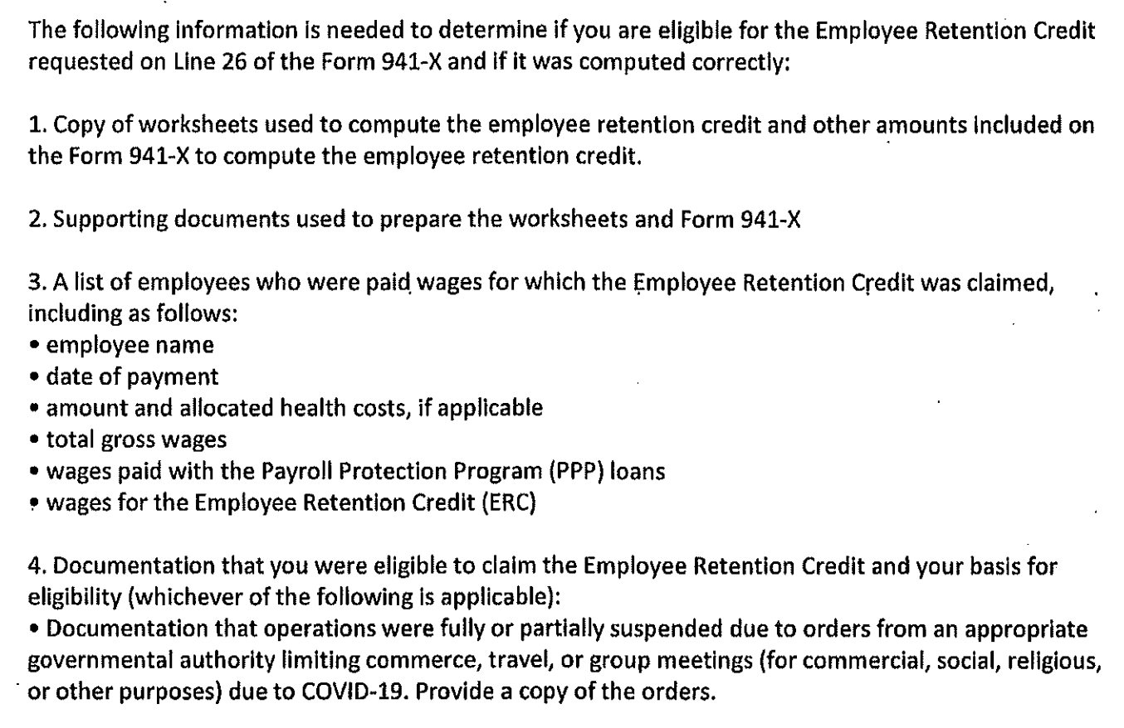
First Round of Exams and IRS Info Document Requests (IDRs) re: ERC Start to Fly
Notes:
See Sandi email 05/04/23 re: AICPA Town Hall re: IRS Notices re: ERC

Slide 152
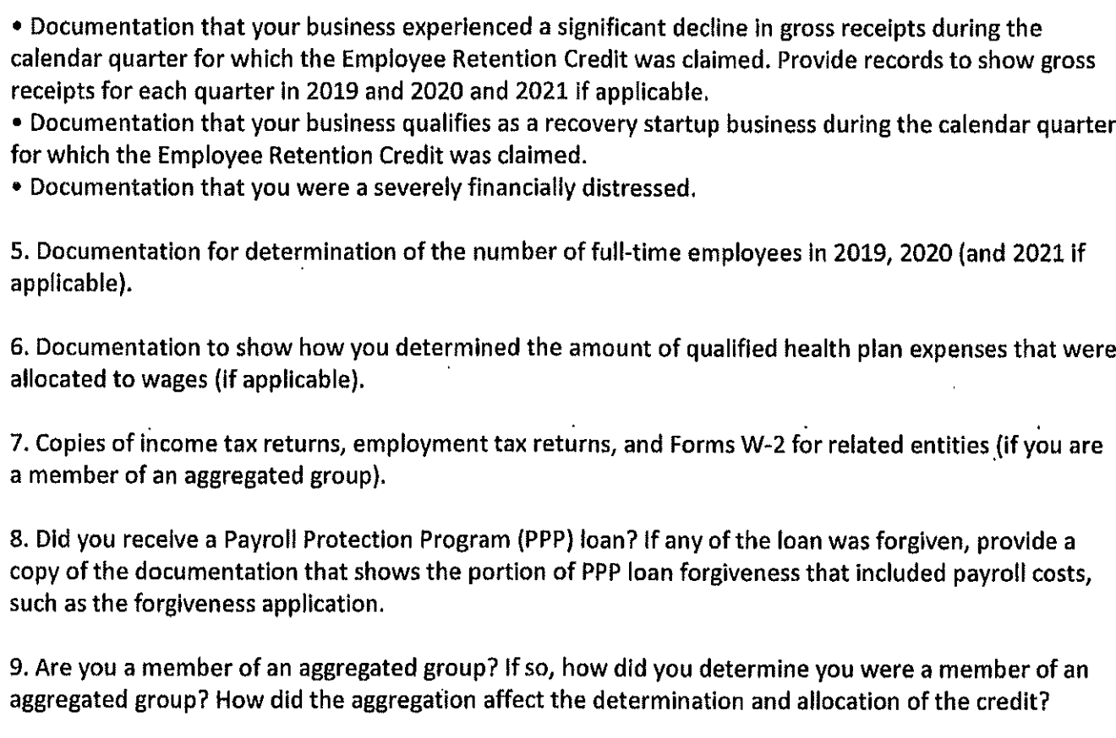
First Round of Exams and IRS Info Document Requests (IDRs) re: ERC Start to Fly
Notes:
See Sandi email 05/04/23 re: AICPA Town Hall re: IRS Notices re: ERC

Slide 153
IRS ERC Audit Guide
IRS releases copy of IRS employee training manual re: Employee Retention Credit (Lesson 3, Tax Credit for Employee Retention Credit (Student Guide, Revised 07/2022 (79909-002) (72 pages)) https://www.meadowscollier.com/58DDFE/assets/files/documents/ERC%20Training%20Materials-Dec.%205,%202022%20Blog%20Post.pdf
IRS training manual recites in principal part info IRS set forth in Notices 2021-20, -23, -49 and -65 and Rev. Proc. 2021-33
No new info or insight is provided that clarifies full or partial suspension by reason of government order or supply chain disruption
Helpful language in the training manual may be found on pages 3-60 and 3-61 re: use of third-party payers to pay employment tax to IRS and get the employee retention credit

Slide 154

ERC Tax Insurance Offered by Private Insurance Companies

Slide 155
ERC Tax Insurance Offered by Private Insurance Companies
What is covered by ERC tax insurance?
Covered = “Contest costs” (costs incurred after IRS issues 30-day letter) (30-day letter = IRS’s proposed changes after an exam)
Tax, penalty and interest
Costs of defense of taxpayer (tp) after 30-day letter received (IRS appeals process and forward) (tp may choose own defense representative (e.g., attorney)
Income tax on insurance award (since premiums were deducted, insurance proceeds received are income taxable)
2. What is not covered by ERC tax insurance?
Pre-30 day letter costs
Misrepresentation by taxpayer to insurance company
Retroactively applicable law (statute or regulation) affecting insured issue
Fraud (civil or criminal)
Criminal prosecution by govt

Slide 156
ERC Tax Insurance Offered by Private Insurance Companies
Frequently insured situations
Partial suspension uncertainties
Aggregation issues
Advanced funding issues (taxpayer “borrows” (against ERC claim) up front from lender)
Merger and acquisition (M&A) (Would you want to acquire the stock of a company with an ERC claim that might blow up? Might have to pay back to IRS ERC tax, plus penalty and interest)
Larger claims
May not be good candidate for ERC tax insurance
Smaller claims (> $500,000)
Fraud (civil and criminal)
Woozy supply chain disruption positions

Slide 157
ERC Tax Insurance Offered by Private Insurance Companies
ERC Tax Insurance pricing
Premium: 3% to 10% of ERC claim
Underwriting fee: $25,000 to $60,000 upfront (in addition to premium cost)
Deductible: 5% to 6%
Example: $1M ERC claim. Premium: $50,000 (at 5%). Underwriting fee: $25,000 to $60,000. Deductible: $60,000 on $1M ERC claim). Total cost: $170,000 (plus advisor fees) = 17%+ of ERC claim.
Insurance Coverage
Underwriting: 1-2 weeks, binding: 1-2 weeks
Policy coverage period: 7 years, but could negotiate w/ insurance company for longer (statute of limitations for fraud 10 years)
For ERC claims $500,000 and up

Slide 158
ERC Tax Insurance Offered by Private Insurance Companies
Why does insurance company insure these claims?
To make money
Insurance agent answer: “IRS can’t get to all of these claims”, “IRS will run out of time to audit these claims”
Why sh/ a taxpayer insure an ERC claim? Insurance agent answer:
Cost = Only 3% to 4% of total claim [In truth, up to 17%+]
Lots of grey area: No guidance, no prior law (as precedent)
Partial suspension arena unstable
Covers cost of representation (after audit stage)
Compare: What are costs if don’t buy insurance & ERC claim disallowed?
Costs of prep and defense of ERC claim not reimbursed
May not get ERC refund money [These are two risks I’m willing to take]

Slide 159
Notes
Notes:
07/28/22 Murray big course: A. 72% B. 13% C. 15%

Slide 160

Three Grounds for Eligibility for Covid ERC

Slide 161
Eligibility for Covid ERC
Three grounds for eligibility for Covid ERC
Full or partial suspension by order of government (any quarter 1Q 2020 – 3Q 2021)
Drop in gross receipts (GR) (any quarter 1Q 2020 – 3Q 2021)
Recovery startup business (only 3Q and/or 4Q 2021)

Slide 162

Business Closed in Full or Part By Government Covid Shut Down Order

Slide 163
Suspensions – List Government Responses to Covid
COVID-19: US State Policy Report – (link to Squire Patton Boggs website w/ other resources)
Captures shifting state, territorial and local government policies in response to COVID-19 and reopening of economy by tracking public info from official sources
See (05/04/21) (compliments of Squire Patton Boggs (US) LLP) https://www.natlawreview.com/article/covid-19-us-state-policy-report-april-23-27-2021 (Wayback Machine online can help you find old websites)
https://web.archive.org/web/20210507131718/https://www.natlawreview.com/article/covid-19-us-state-policy-report-april-23-27-2021?amp
The law firm Husch Blackwell has an excellent website listing government Covid orders by state: https://www.huschblackwell.com/state-by-state-covid-19-guidance

Slide 164
Let’s Put the Truth (BS) Meter on Outside ERC Solicitor Sales Pitches

Slide 165
Various Outside ERC Solicitor Sales Tactics
Topic | Advertising Claim | Pass / Fail / Maybe | Truth
Does my business qualify? | Qualifying disruptions include: 1. Supply chain disruptions; 2. Price increases; 3. Staffing shortages; 4. Difficulty hiring; 5. Reduced hours; 6. Reduction in goods or services offered; 7. Unable to travel or attend conventions | Fail | Qualifying is not that simple. Disruptions to any of these listed items do not automatically qualify. More tests must be met to qualify a business for ERC.
Notes:
Innovation refunds: https://www.innovationrefunds.com/faq

Slide 166
Various Outside ERC Solicitor Sales Tactics
Topic | Advertising Claim | Pass / Fail / Maybe | Truth
Does my business qualify? | Qualifying events: Restaurant must close or limit on-site dining; Business that needs to meet in-person w/ customer must cancel meeting due to Covid restrictions | Fail | Qualifying is not that simple. These listed items do not automatically qualify. More tests must be met to qualify a business for ERC.
Notes:
Innovation refunds: https://www.innovationrefunds.com/faq
ERC Specialists
https://www.ercprogramaffiliate.com/qualify54365652?msclkid=7427b05acf9b1c12c1e6d28693a26216&utm_campaign=erc&utm_content=keywords&utm_medium=CPC&utm_source=Bing#section--44396-132-165

Slide 167
Various Outside ERC Solicitor Sales Tactics
Topic | Advertising Claim | Pass / Fail / Maybe | Truth
Does my business qualify? | Company ordered to fully or partially close during pandemic restrictions | Fail | “Company ordered to fully or partially close” is oversimplified. May qualify if partial govt suspension resulted in > nominal portion suspended or modification had > nominal impact.
Notes:
https://www.payprocorp.com/resources/blog/what-is-the-employee-retention-credit/

Slide 168
Suspensions (Orders) by Governmental Authority
CARES Act §2301(c)(2) language re: suspension by government: https://www.congress.gov/116/plaws/publ136/PLAW-116publ136.pdf
“(2) ELIGIBLE EMPLOYER (A) IN GENERAL - The term ‘‘eligible employer’’ means any employer for which the operation of the trade or business
is fully or partially suspended during the calendar quarter due to orders from an appropriate governmental authority limiting commerce, travel, or group meetings (for commercial, social, religious, or other purposes) due to the coronavirus disease 2019 (COVID–19), or
has significant decline in gross receipts
The statute says nothing more than the above and seeks no Treasury or IRS interpretation for definition of suspension

Slide 169
Suspensions (Orders) by Government Statutory Elements
CARES Act §2301(c)(2) language re: suspension by government – Four statutory elements:
Operation (of business or charity)
Limited
By order (from an appropriate governmental authority)
Due to COVID-19
* If any of these elements missing, statutory test not met
Notes:
Also keep in mind purpose of statute: To help qualifying employers be able to keep employees on payroll

Slide 170
What is NOT a Government Order?
 | ERC Round 1 03/13/20 – 12/31/20 | ERC Rounds 2 and 3 01/01/21 – 12/31/21
NOT government order | Voluntary (not required by govt order) suspension of business or reduction in hours due to Covid (Notice 2021-20 QA 14) [But, may qualify if significant decline in gross receipts] | Same as 2020
NOT government order | Declaration of state of emergency by govt not govt order 1. If does not limit commerce, travel or group meetings in any manner, or 2. Limits commerce, travel or group meetings, but does not affect employer’s operation of business (Notice 2021-20 QA 10) | Same as 2020
In one case, a trucking company was advised by an ERC solicitor that because drivers had to wait an additional 15 minutes (due to Covid protocol) at weigh stations and generally experienced supply chain disruptions, company qualified for ERC – Not enough to qualify!!
Notes:
https://blogs.claconnect.com/transportation/the-good-and-bad-with-the-employee-retention-credit/

Slide 171

Partial Suspension
Notes:
Plum cake

Slide 172
ERC Partial Suspension
To qualify for a partial suspension (and, thus, qualify for ERC for the whole business), must prove (under facts and circumstances) either:
A > nominal portion of the business suspended by a government order (Notice 2021-20, QA 11); or
A government order must have placed a modification against the business which had more than a nominal effect on the business (Notice 2021-20, QA 17 and 18)

Slide 173
Notes
Notes:
07/28/22 Murray big course: A. 72% B. 13% C. 15%

Slide 174
Notes
Notes:
07/28/22 Murray big course: A. 72% B. 13% C. 15%

Slide 175
Partial Suspension Portion Suspended vs. Modification
Moral of the story: It ALWAYS depends on facts and circumstances
If portion of business closed, then (> nominal portion suspended) if either:
gross receipts (GR), or
employee hours
constituted (at least) 10% (of GR or hours of the entire business) in the corresponding quarter of 2019 (Notice 2021-20, QA 11)
If no portion of business closed, but modification of operation, then (> nominal effect if) reduction in ability to provide goods or services of at least 10% must have resulted (Notice 2021-20, QA 17, 18)

Slide 176
Linda’s Restaurant Partial Suspension or Not?
Portion of Physical Space Suspended | Modification of Operations | Partial Suspension?
Indoor, outdoor dining areas completely shut down |  | Yes (if > nominal portion under Notice 2021-20, QA 11)
Outdoor open, indoor closed |  | Yes (if > nominal portion under Notice 2021-20, QA 11)
 | Reduce indoor dining from 100 to 60 patrons | Yes (if > nominal effect under Notice 2021-20, QA 17, 18)
 | Reduce indoor dining by spacing tables 6’ apart | Yes (if > nominal effect under Notice 2021-20, QA 17, 18)
1. Moral of the story: It ALWAYS depends on facts and circumstances
If portion of business closed, then either: a. gross receipts (GR) or b. employee hours
constituted (at least) 10% of GR or hours in same qtr of 2019 (Notice 2021-20 QA 11)
If no portion of business closed, but modification of operations, then reduction in
ability to provide goods or services of at least 10% required (Notice 2021-20, QA 17, 18)

Slide 177
Burger King Partial Suspension or Not?
Portion of Physical Space Suspended | Modification of Operations | Partial Suspension?
Indoor dining shut down - Can prove indoor dining revenue dropped |  | Yes (if > nominal portion under Notice 2021-20, QA 11)
Indoor dining shut down - 3x volume, 3x profit via drive through |  | Yes (if > nominal portion under Notice 2021-20, QA 11)
 | Argument – Kitchen stayed open, so no shutdown | Probably not (if > nominal effect under Notice 2021-20, QA 17, 18)
1. Moral of the story: It ALWAYS depends on facts and circumstances
If portion of business closed, then either: a. gross receipts (GR) or b. employee hours constituted (at least) 10% of GR or hours in same qtr of 2019 (Notice 2021-20 QA 11)
If no portion of business closed, but modification of operations, then reduction in
ability to provide goods or services of at least 10% required (Notice 2021-20, QA 17, 18)

Slide 178

Sweat Shops Push Aggressive ERC a/k/a Burger King Gone Wild

Slide 179
Partial Suspension Portion Suspended vs. Modification
Moral of the story: It ALWAYS depends on facts and circumstances
If portion of business closed, then (> nominal portion suspended) if either:
gross receipts (GR), or
employee hours
constituted (at least) 10% of GR or hours in same qtr of 2019 (Notice 2021-20, QA 11)
If no portion of business closed, but modification of operation, then (> nominal effect if) reduction in ability to provide goods or services of at least 10% must have resulted (Notice 2021-20, QA 17, 18)

Slide 180

Partial Suspension Notice 2021-20 (QA 11) – 10% Bright Line Test

Slide 181
Partial Suspension Notice 2021-20 (QA 11) – 10% Bright Line Test
Notice 2021-20 QA 11 – For ERC, business operations more than nominal portion if either (always facts and circumstances)
GR from that portion of business is not < 10% of GR of total business (both determined using the gross receipts of the same calendar quarter in 2019), or
Hours of service performed by employees in that portion of business is not < 10% of hours of service performed by all employees in total business (both determined using the gross receipts of the same calendar quarter in 2019)

Slide 182
Partial Suspension Notice 2021-20 (QA 11) – 10% Bright Line Test
Notice 2021-20 QA 11 – For ERC, business operations more than nominal portion if either
GR from that portion of business is not < 10% of GR of total business (both determined using the gross receipts of the same calendar quarter in 2019)
Example: 1Q 2019 GR for non-essential portion of business = $80,000. 1Q 2019 GR for total business = $1M. In 1Q 2019, non-essential business at 8% GR (NOT at least 10%). Thus, non-essential portion NOT more than a nominal portion of business in 1Q 2020. Thus, not partial shutdown. Thus, entire business not ERC eligible.

Slide 183
Partial Suspension Notice 2021-20 (QA 11) – 10% Bright Line Test
Notice 2021-20 QA 11 – For ERC, business operations more than nominal portion if either
Hours of service performed by employees in that portion of business is not < 10% of hours of service performed by all employees in total business (both determined using the hours of the same calendar quarter in 2019)
Example: 1Q 2019 employee hours for non-essential portion of business = 100 hours. 1Q 2019 hours for total business = 1,000 hours. In 1Q 2019, non-essential business at least 10% of hours. Thus, non-essential portion is more than a nominal portion of business in 1Q 2020. Thus, partial shutdown. Thus, entire business ERC eligible.

Slide 184
ERC Partial Suspension
To qualify for a partial suspension (and, thus, qualify for ERC for the whole business), must prove (always facts and circumstances):
A portion of the entire business must be shut down by a government order (Notice 2021-20, QA 11), or
A government order must have placed a modification against the business which had more than a nominal effect on the business (Notice 2021-20, QA 17, 18)

Slide 185

Modification More Than Nominal Effect on Business

Slide 186
Modification More Than Nominal Effect on Business
Notice 2021-20, Q 17: If govt order requires employer to close workplace for certain purposes, but may remain operational for other purposes, is it a partial suspension?
A 17: If all (or all but a nominal portion) of business operations may continue, but operations subject to modification due to govt order, such modification is a partial suspension if modification has more than a nominal effect on business operations under the facts and circumstances

Slide 187
Modification More Than Nominal Effect on Business
Notice 2021-20, Q 17, Example 1: Burger King restaurant
Must close onsite dining due to a govt order
Allowed to continue food or beverage sales via carry-out, drive-through or delivery
On-site dining is more than a nominal portion of business operations – Please note: This assumption was made by IRS in this particular example, but in other cases it depends on facts and circumstances
Partially suspended because, under facts and circumstances, more than a nominal portion of operations, indoor and outdoor dining, suspended
However, what if Burger King drive-though window churns out 3 x volume and makes 3 x profit?

Slide 188
Modification More Than Nominal Effect on Business
Notice 2021-20, Question 18: What factors should be taken into account in determining whether a modification required by a govt order has more than a nominal effect on business operations for purposes of Q/A–17?
A 18: Whether a modification required by govt order has more than a nominal effect on business operations is based on the facts and circumstances
= Govt order that results in reduction in ability to provide goods or services of at least 10% will be deemed to have more than a nominal effect on operations

Slide 189
Notes
Notes:
07/28/22 Murray big course: A. 72% B. 13% C. 15%

Slide 190
Notes
Notes:
07/28/22 Murray big course: A. 72% B. 13% C. 15%

Slide 191
Partial Suspension Does Govt Order have to Put “The Hurt” on the Business?
IRS’ view appears to be the government order needs to limit the operation of the business itself in some way, not the population at large (which, in turn, affects the business)
Q: Does the govt order have to put the hurt on the business or merely limit it?
Q: If the requirement is the hurt is put on the business, must the hurt be financial or could the hurt be in some other way?
Keep in mind the statutory language on point is so vague that no one really knows the answers to these questions. So, the question becomes, is there another broader way to interpret the statute (that is reasonable) (and taxpayer friendly) that IRS did not provide to us?

Slide 192
Partial Suspension Does Govt Order Have To Put “The Hurt” On the Business?
Could the limit on the business be “opportunity cost” of not growing during 2020 and 2021?
Example: National office of insurance company advised all insurance agents they should claim ERC because agents could not get out and meet new prospects during Covid
Revenues of agents did not drop because agents lived off of commissions from renewals
Agent in Ohio reported that in OH, meetings with people not shut down
Since no govt shutdown, then no ERC partial shutdown
Even if shut down, couldn’t they have met on Zoom?
This situation doesn’t seem a strong enough fact pattern to merit ERC

Slide 193
Government Orders Example: Not Partial Suspension
 | ERC Round 1 03/13/20 – 12/31/20 | ERC Rounds 2 and 3 01/01/21 – 12/31/21
Not partial suspension | Essential business (not required to close physical locations or otherwise suspend operations) not considered to have a full or partial suspension for the reason its customers are subject to a government order requiring them to stay home (Notice 2021-20 QA 13) | Same as 2020
 | Example: Auto repair service business (essential). Govt order limits travel and requires community to stay home, except for certain essential travel (grocery store). Business declined significantly. No full or partial suspension. However, ERC eligible if significant decline in gross receipts (Notice 2021-20 QA 13) | Same as 2020
The distinction: Residents ordered in general to stay home, except for essential travel – Result: No partial suspension of the affected business

Slide 194
Government Orders Example: Partial Suspension
 | ERC Round 1 03/13/20 – 12/31/20 | ERC Rounds 2 and 3 01/01/21 – 12/31/21
Partial Suspension | Orders, proclamations, or decrees from fed, state or local govt enable ERC only if they limit “commerce, travel, or group meetings (for commercial, social, religious, or other purposes) due to Covid-19 and relate to the suspension of an employer’s operation of its trade or business (Notice 2021-20 QA 10) | Same as 2020
 | Example: An order from a local official imposing a curfew on residents that impacts the operating hours of a trade or business for a specified period (Notice 2021-20 QA 10) | Same as 2020
The distinction: Residents ordered under a curfew to stay home certain hours – This
impacted specific operating hours of the business – Result: Partial suspension

Slide 195
Government Orders Example: Partial Suspension
 | ERC Round 1 03/13/20 – 12/31/20 | ERC Rounds 2 and 3 01/01/21 – 12/31/21
Partial Suspension | Orders, proclamations, or decrees from fed, state or local govt enable ERC only if they limit “commerce, travel, or group meetings (for commercial, social, religious, or other purposes) due to Covid-19” and relate to the suspension of an employer’s operation of its trade or business (Notice 2021-20 QA 10) | Same as 2020
 | Restaurant is ordered by local health deptmt to close due to a health code violation. Since order unrelated to COVID-19, it’s not a govt order for ERC (Notice 2021-20 QA 10) | Same as 2020
The distinction: If govt order not due to Covid-19, then not a govt order for purposes
of ERC – Result: No partial suspension

Slide 196
Government Orders Teleworking
 | ERC Round 1 03/13/20 – 12/31/20 | ERC Rounds 2 and 3 01/01/21 – 12/31/21
Partial suspension | If workplace closed by a govt order, but able to continue operations comparable to operations prior to the closure by requiring employees to telework, operations not fully or partially suspended (Notice 2021-20, QA 16) | Same as 2020

Slide 197
Telework – Notice 2021-20 (QA 16) Able to Continue Comparable Operations?
Employer’s telework capabilities (adequate support (IT and otherwise)) so operations can continue from another location
Portability of employees’ work
Need for presence in employee’s physical work space (critical and necessary, beneficial but not necessary or merely convenient)
Transitioning to telework operations – Some adjustment period expected - Generally, operations not partially suspended then – However, if significant delay (e.g., beyond 2 weeks) in converting to comparable telework (e.g., implementing telework policies or providing employees w/ equipment to telework), then may be deemed a partial suspension during transition
Additional factors considered if relevant

Slide 198
Government Orders Example: Teleworking Aces Out Suspension
Example 1: Software development company (not essential) maintains an office in a city where the mayor has ordered that only essential businesses may operate (IRS Notice 2021-20, QA 15, Ex. 1)
Prior to the governmental order, all employees at the company teleworked once or twice per week, and business meetings were held at various locations
Following the governmental order, the company ordered mandatory telework for all employees and limited client meetings to telephone or video conferences
Business operations NOT fully or partially suspended by govt order because operations may continue in a comparable manner
Won’t work for some physical therapy (Ex. 2) or research lab (Ex. 3)

Slide 199
Government Orders Partial Suspension if More Than Nominal Effect
 | ERC Round 1 03/13/20 – 12/31/20 | ERC Rounds 2 and 3 01/01/21 – 12/31/21
Partial suspension | If workplace closed by govt order for some purposes, but open for other purposes (or employer able to continue some operations remotely), then partially suspended (Notice 2021-20, QA 11, 17, Ex. 1-6) | Same as 2020
 | If all operations may continue, even if subject to modification (e.g., to satisfy distancing requirements), such modification not a partial suspension due to govt order, unless modification has more than a nominal effect on business operations under facts and circumstances (Notice 2021-20, QA 17, Ex. 1-6) | Same as 2020

Slide 200
Government Orders Partial Suspension Retail Store Shutdown
Example 3: Retail business G, must close its retail storefront locations due to a govt order (Notice 2021-20, QA 17, Ex. 3)
G also maintains a website through which it continues to fill online orders
G’s ordering and fulfillment system unaffected by govt order
G's business operations partially suspended (due to govt order requiring it to close its retail store locations)

Slide 201
Government Orders Not Partial Suspension Big Store Mostly Not Affected by Social Distancing
Example 6: Large retailer J required to close storefront location due to a govt order, but permitted to provide customers with curbside service to pick up items ordered online or by phone (Notice 2021-20, QA 17, Ex. 6)
Partially suspended due to govt order to close storefront location
2 months later, under subsequent govt order, J permitted to reopen its storefront location, but must enforce social distancing guidelines requiring J to admit only a specified number of customers into the store per 1,000 square feet
Results in customers waiting in line for a short period of time to enter the store during certain busy times of the week
Govt order to enforce social distancing guidelines does not have > nominal effect on operations under facts and circumstances, though required to modify its business operations – Not partially suspended

Slide 202
Government Orders Not Partial Suspension Adjustment by Grocery Store
Example 5: Grocery store, operates essential business under a govt order. However, govt order requires grocery stores to discontinue self-serve offerings, such as salad bars, though they may offer prepared or prepackaged food (Notice 2021-20, QA 17, Ex. 5)
Store modifies operations to close its salad bar and other self-serve offerings and instead offers prepackaged salads and other items
Does not have more than a nominal effect on business operations under facts and circumstances, though required to modify operations
Business operations not partially suspended because govt order requiring closure of self-serve offerings does not have more than a nominal effect

Slide 203
Government Orders Partial Suspension Reduction of Operating Hours
 | ERC Round 1 03/13/20 – 12/31/20 | ERC Rounds 2 and 3 01/01/21 – 12/31/21
Partial suspension | Employer that reduces its operating hours due to a govt order is considered to have partially suspended its operations (Notice 2021-20, QA 19) | Same as 2020
 | May alternatively be ERC eligible employer if significant decline in gross receipts | Same as 2020

Slide 204
Government Orders Partial Suspension Reduction of Hours for Covid Cleaning
Employer K operates a food processing facility that normally operates 24 hours a day (Notice 2021-20, QA 19, Ex.)
Govt order issued by local health department requires all food processing businesses to deep clean their workplaces once every 24 hours in order to reduce risk of COVID-19 exposure
To comply, K reduces daily operating hours by 5 hours per day so that a Covid deep cleaning may be conducted once every 24 hours
K partially suspended its operations due to governmental order requiring it to reduce its hours of operation

Slide 205
Government Orders Partial Suspension Shutdown of Some, But Not All, Locations
 | ERC Round 1 03/13/20 – 12/31/20 | ERC Rounds 2 and 3 01/01/21 – 12/31/21
Partial suspension | Business in multiple locations subject to local govt orders limiting operations in some, but not all, jurisdictions have partial suspension of operations (Notice 2021-20, QA 20) | Same as 2020
 | Business on a national or regional basis may be subject to govt orders requiring closure of their locations in certain jurisdictions, but not others – Partial suspension – ERC eligible for all operations in all locations (Notice 2021-20, QA 20, Ex.) | Same as 2020
The rule that if any one location is suspended, they’re all suspended helps taxpayer qualify for partial suspension

Slide 206
Government Orders Partial Suspension Shutdown of Some, But Not All, Locations
Example: National retail store chain F operates in every state in U.S. (e.g., Best Buy) (Notice 2021-20, QA 20, Ex.)
In some states, F under govt order to close stores, but permitted to provide curbside service to pick up items ordered online or by phone
In other jurisdictions, F not subject to govt order to close stores (or is considered an essential business permitting its stores to remain open)
F establishes company-wide policy, in compliance w/ local governmental orders and consistent with CDC and DHS guidance, requiring closure of all stores and operating w/ curbside pick-up only, even in those jurisdictions where business not subject to govt order
As result of govt orders requiring closure of F's stores in certain jurisdictions, Employer F has a partial suspension nationwide

Slide 207
Partial Suspension Portion Suspended vs. Modification
Moral of the story: It ALWAYS depends on facts and circumstances
If portion of business closed, then (> nominal portion suspended) if either:
gross receipts (GR), or
employee hours
constituted (at least) 10% of GR or hours in same qtr of 2019 (Notice 2021-20, QA 11)
If no portion of business closed, but modification of operation, then (> nominal effect if) reduction in ability to provide goods or services of at least 10% must have resulted (Notice 2021-20, QA 17, 18)

Slide 208
Government Orders Partial Suspension One Group Member Shutdown Qualifies Group
 | ERC Round 1 03/13/20 – 12/31/20 | ERC Rounds 2 and 3 01/01/21 – 12/31/21
Partial suspension | All members of an aggregated group are treated as a single employer for purposes of the Employee Retention Credit (Notice 2021-21, QA 20) | Same as 2020
 | Thus, if a trade or business operated by multiple members of an aggregated group and if operations of one member of group suspended by govt order, then all members of group partially suspended (even if another member of group is in a jurisdiction not subject to govt order (Notice 2021-20, QA 20)

Slide 209

Partial Suspension Disruption in Supply Chain

Slide 210
Notes
Notes:
07/28/22 Murray big course: A. 72% B. 13% C. 15%

Slide 211
Government Orders Effect of Failure by Supplier Under Covid Lockdown
 | ERC Round 1 03/13/20 – 12/31/20 | ERC Rounds 2 and 3 01/01/21 – 12/31/21
Full or partial suspension | Essential business may have full or partial suspension if business's suppliers unable to make deliveries of critical goods or materials due to Covid-19 govt order that causes supplier to suspend operations (Notice 2021-20 QA 12) E.g., Auto parts manufacturer can’t get raw materials supply Alternatively, may be eligible if significant decline in gross receipts | Same as 2020

Slide 212

Full or Partial Suspension If Supplies Cut Off by Supplier to Manufacturer

Slide 213
Partial Suspension Supply Chain Disruption
Example: Auto parts manufacturing business qualifies for partial suspension if cannot get supplies to operate (because supplier shut down over Covid-19) (Notice 2021-20 QA 12)
Its supplier of raw materials is required to shut down by Covid govt order
Unable to procure these raw materials elsewhere
Result: Suspension by government order

Slide 214
Partial Suspension Supply Chain Disruption
(Notice 2021-20 QA 12):
QA 12: If facts and circumstances indicate that
Business’s operations are fully or partially suspended
As result of inability to obtain critical goods or materials from suppliers
Because they [supplier] was required to suspend operations, then
Eligible employer for calendar quarters during which its operations are fully or partially suspended

Slide 215
Partial Suspension Shutdown of Supplier
(Notice 2021-20 QA 12)
How far does logic of supplier example reach?
If operations are severely hampered, but not suspended, do we qualify?
E.g., Car dealer runs extremely low on new car inventory (how low does auto inventory have to go to be considered a suspension?)
How low do operations have to go to be considered suspension?
IRS guidance does not stretch this far
If those we supply to are shut down, so we have no market (thus are we shut down?)
IRS guidance does not stretch this far
E.g., Local judicial court shuts down, so operations of law firm hampered

Slide 216
Partial Suspension Shutdown of Supplier
(Notice 2021-20 QA 12)
How far does logic of supplier example reach?
Q: Might the items failed to be supplied be:
Needed intangible assets?
Services?
Availability of a forum so that taxpayer may conduct its business?
E.g., Availability of premises for construction contractor to work
E.g., Operation of a court for lawyers

Slide 217

Is Courthouse Shutting Down Suspension for Law Firm?

Slide 218
Government Orders Effect of Failure by Supplier Under Covid Lockdown
Notice 2021-20 QA 12 – Suspension due to govt order if:
Under the facts and circumstances, the business’s suppliers are unable to make deliveries of critical goods or materials due to a governmental order that causes the supplier to suspend its operations
If facts and circumstances indicate business’s operations fully or partially suspended as a result
Cannot procure materials from alternate supplier
Not able to perform operations for a period of time

Slide 219
Supply Chain Disruption Analysis
To qualify for supply chain disruption, must meet and prove:
Supplier
Supplier unable to make deliveries of critical goods or materials
Due to a Covid-19 (U.S., state or local) government order
That caused supplier to suspend its operations, and
Business affected by supply chain disruption
Business cannot secure critical goods or materials elsewhere
Wages eligible limited to wages paid during which govt order in effect

Slide 220
Partial Suspension Disruption in Supply Chain
Could the above positions be reasonably taken? Consider:
The statute on point is extremely vague
IRS guidance on point (IRS Notices and FAQs) are
Extremely low level,
Not specifically requested by Congress, and
Not properly promulgated under Administrative Procedures Act (APA)
Consider attaching Form 8275 (to employment tax return upon which ERC supply chain disruption partial suspension is claimed) explaining position and supporting argument and authority

Slide 221
Partial Suspension Disruption in Supply Chain
Possible points of supply chain disruption:
Sourcing point (where goods or materials extracted or produced)
Storage point (where goods or materials stored pending next move)
Transfer point (where goods or materials loaded for transit)
Shipping (via land)
Shipping (via air)
Shipping (via water)
Destination point (location of end use or further manufacture)

Slide 222
Partial Suspension Disruption in Supply Chain
Example: During Covid, a gasoline service station (retail outlet) could not secure premium gasoline for resale. Is this a supply chain interruption meriting ERC partial suspension?
Other grades of gasoline were obtained and sold
No proof that a govt Covid shutdown order caused the premium gasoline shortage
I do not believe this case is strong enough to merit ERC partial suspension
Operations of gas station not suspended
No proof that a govt Covid shutdown order caused the premium gasoline shortage
Taxpayer can argue opportunity cost of lost premium gas revenues, but I don’t think that’s enough – Many outside ERC retrieval services disagree w/ me
I don’t think this fact pattern is strong enough to hold up in a court of law

Slide 223
Partial Suspension Disruption in Supply Chain
Example: Building insulation installer in Boston has installation operations severely hampered and slowed
Social distancing requirements cut in half our ability to install
Further hampered by supply chain difficulties in obtaining insulation to install
Tp can argue that, even though it’s on the client’s, not installation company’s premises that limits are imposed, it’s a portion of space in which to operate shut down by govt order – Thus, ERC partial suspension – I’d run with this argument
As to the effect of not getting supplies, in my opinion to qualify as ERC supply chain shutdown, you’d have to have proof that the supply chain difficulties tied to a domestic (U.S.), state or local Covid shutdown order – I don’t think the Longshoreman’s labor strike in CA cuts it

Slide 224
Supply Chain Disruption Analysis
To qualify for supply chain disruption, must meet and prove:
Supplier
Supplier unable to make deliveries of critical goods or materials
Due to a Covid-19 government order
That caused supplier to suspend its operations, and
Business affected by supply chain disruption
Business cannot secure critical goods or materials elsewhere
Wages eligible limited to wages paid during which govt order in effect

Slide 225
Supply Chain Disruption Proof Required
To qualify for supply chain disruption, must meet and prove:
Supplier
Supplier (name and location of supplier) unable to make deliveries of critical goods or materials
Due to a Covid-19 govt order (specific order itself the duration of such order and the specific U.S., state or local govt imposing the order) (foreign jurisdictions don’t cut it (Notice 2021-20 QA 10))
That caused supplier to suspend its operations (detailed description of supply chain disruption), and
Business affected by supply chain disruption (detailed description of supply chain disruption itself and its impact on the business)
Business cannot secure critical goods or materials elsewhere (detailed description of efforts to secure items)
Wages eligible limited to wages paid during which govt order in effect (duration of supply chain disruption) (duration of Covid-19 govt order that suspended operations of supplier)

Slide 226
Courage is Somewhere Between Cowardice and Recklessness (Ryan Holiday)
Notes:
Courage is Somewhere Between Cowardice and Recklessness (Ryan Holiday)
Daily Stoic email 09/21/22

Slide 227
Government Orders Partial Suspension Wages Only ERC Eligible for Period of Shutdown
 | ERC Round 1 03/13/20 – 12/31/20 | ERC Rounds 2 and 3 01/01/21 – 12/31/21
Partial suspension | If subject to govt order to fully or partially suspend operations and order later lifted, were operations that suspended? Yes, but only for periods business operations fully or partially suspended (Notice 2021-20, QA 22) | Same as 2020
 | If order effective for portion of calendar quarter, then eligible employer for entire calendar quarter but can only claim ERC for wages paid during period order in force (Notice 2021-20, QA 22) | Same as 2020

Slide 228

Drop in Gross Receipts Wage Range (Wide)
 | ERC Round 1 03/13/20 – 12/31/20 | ERC Rounds 2 and 3 01/01/21 – 12/31/21
“Gross receipts”* ERC wage range | Entire quarter for which qualify | Same as for 2020
* Wage range for recovery startup business also appears to be entire quarter
(no official answer, but logic seems to dictate “entire quarter”)

Slide 229
ERC Wages Paid vs. Incurred
 | ERC Round 1 03/13/20 – 12/31/20 | ERC Rounds 2 and 3 01/01/21 – 12/31/21
Wages qualifying for ERC: Cash vs. Accrual | If qualifying for drop in GR, all wages PAID within qualifying period (cal. quarter or suspension period) qualify for ERC Wages must be actually PAID, not merely accrued (CARES Act §2301(c)) (No IRS guidance yet) E.g., Wages earned prior to ERC qualifying qtr paid inside (at beginning of qualifying qtr) appear to qualify for ERC E.g., TX shuts down non-essential businesses on 03/19/20. Payroll checks cut on 03/20/20 for 03/01-14/20. | Same as for 2020

Slide 230

Suspension by Government Order Wage Range (Narrow)
 | ERC Round 1 03/13/20 – 12/31/20 | ERC Rounds 2 and 3 01/01/21 – 12/31/21
“Full or partial suspension” ERC wage range | ERC for only wages paid during time of suspension (not entire calendar quarter) (Notice 2021-20, QA 22) | Same as 2020

Slide 231
Three Grounds for Eligibility for Covid ERC

Slide 232
Eligibility for Covid ERC
Three grounds for eligibility for Covid ERC
Full or partial suspension by order of government (any quarter 1Q 2020 – 3Q 2021)
Drop in gross receipts (GR) (any quarter 1Q 2020 – 3Q 2021)
Recovery startup business (only 3Q and/or 4Q 2021)

Slide 233
Let’s Put the Truth (BS) Meter on Outside ERC Solicitor Sales Pitches

Slide 234
Various Outside ERC Solicitor Sales Tactics
Topic | Advertising Claim | Pass / Fail / Maybe | Truth
Does my business qualify? | Gross receipts dropped under 50% (2020) and under 80% (2021) qualifies you for ERC | Fail | The ad claim actually got the test backwards. Gross receipts must drop by > 50% (2020) and > 20% (2021).
 | A 50% drop in gross receipts (2020) and 20% drop in gross receipts (2021) for any quarter qualifies for ERC | Fail | A mere 50% drop in gross receipts (2020) and 20% drop in gross receipts (2021) for any quarter is not enough. Gross receipts must drop by > 50% (2020) and >20% (2021).
Notes:
https://www.payprocorp.com/resources/blog/what-is-the-employee-retention-credit/

Slide 235

Significant Decline in Gross Receipts

Slide 236
Gross Receipts (for Business) Definition
Notice 2021-20, QA 24 (and IRS FAQ #40) – What are "gross receipts" for an employer (other than a tax-exempt org)?
“Gross receipts” for ERC has same meaning as under §448(c)
Under §448(c) reg. (§1.448-1T(f)(2)(iv)), “gross receipts”
Includes total sales (net of returns and allowances),
All amounts received for services,
Income from investments and incidental or outside sources, including interest (including original issue discount and tax-exempt interest under §103), dividends, rents, royalties, and annuities, regardless of whether such amounts derived in ordinary course of taxpayer's trade or business
To determine ERC gross receipts, utilize usual method (e.g., cash or accrual) of accounting for income tax purposes

Slide 237
Gross Receipts (for Business) Definition
Notice 2021-20 QA 24 (IRS FAQ #40) – What are "gross receipts" for an employer (other than a tax-exempt org)?
Gross receipts not reduced by cost of goods sold or cost of property sold if such property is §1221(1) (inventory), (3) patent, copyright, etc. held by tp whose personal efforts created such property, (4) accts or notes receivable received in ord. course of business, or (5) govt documents
Gross receipts reduced by taxpayer's adjusted basis in such property for sales of property described in §1221 (2) (property used in business)
Gross receipts do not include the repayment of a loan, or sales tax if the tax is legally imposed on the purchaser of the good or service and the taxpayer merely collects and remits the sales tax to the taxing authority
FAQ #41 – Does an employer need to prove that a significant decline in gross receipts is related to COVID-19? No

Slide 238
Gross Receipts (for Tax-Exempts) Definition
Notice 2021-20 QA 25 – Gross receipts (§6033) =
Gross amount received by org from all sources w/o reduction for costs or expenses, including cost of goods or assets sold, cost of operations or expenses of earning, raising or collecting
Includes includes gross amount received as (from)
Contributions, gifts and grants
Dues or assessments from members or affiliated organizations
Gross sales or receipts from business activities (including business activities unrelated to org’s exempt purpose)
Gross from sale of assets w/o reduction for cost or other basis and expenses of sale, and
Investment income, such as interest, dividends, rents and royalties

Slide 239
Red Alert Do ERC Gross Receipts Include PPP, SVOG, RRG?
Q: Do Gross Receipts Include PPP, SVOG, RRG receipts (or forgiveness)? A: No (Rev. Proc. 2021-33 (08/10/21))
In general, income tax gross receipts (GR) very broadly conceived. Thus, PPP loan (when forgiven) and Shuttered Venue Operator Grant (SVOG) and Restaurant Revitalization Grant (RRG) (when received) included in GR for ERC purposes.
However, if follow Rev. Proc. 2021-33 safe harbor, then PPP forgiveness and SVOG and/or RRG received not included in GR for ERC purposes
To elect the safe harbor, tp must consistently exclude PPP, SVOG and RRG from GR:
For ERC purposes consistently for all quarters, and
For all members of an aggregated group

Slide 240
Significant Decline in Gross Receipts Combine GR for Aggregated Group
Notice 2021-20 QA 26 – For an aggregated group, is the significant decline in gross receipts (GR) test determined based on the entire group?
Yes. All entities are considered a single employer for purposes of determining whether the employer had a significant decline in gross receipts
To be an ERC eligible on the basis of a significant decline of gross receipts, the employer must take into account the gross receipts of all members of the aggregated group
If the aggregated group does not experience a significant decline in gross receipts, then no member of the group may claim the ERC (on the grounds of significant drop in gross receipts)

Slide 241
Effect of Aggregation on Gross Receipts
 | GR 2Q 2020 | GR 2Q 2019 | % Drop per Co. | Meet 50% Test for Co. | % Drop Combined | Meet 50% Combined
A Co. | $400k | $1M | 60% | Yes | 42.5% | No
B Co. | $750k | $1M | 25% | No |  | No
Total | $1.150M | $2M | 42.5% | - | 42.5% | No
Since A Co. and B. Co. got combined under the attribution rules, both flunk the drop
in gross receipts test together. Without aggregation, A Co. alone would have qualified
for ERC.

Slide 242

Measuring 2020 Drop in Gross Receipts

Slide 243
Eligibility for ERC Drop in 2020 Gross Receipts*
 | ERC Round 1 03/13/20 – 12/31/20 | Example
> 50% Test | ERC eligible for any 2020 qtr if GR drop (for such qtr) by > 50% from same quarter in 2019 | Qualify if 2Q 2020 52% drop in GR cf to 2Q 2019 GR
“ | “ | Do not qualify if 2Q 2020 47% drop in GR cf to 2Q 2019 GR
Safe Harbor for Prior Qtr Activity | No | No official safe harbor exists
* Notice 2021-20, III. E.
Notes:
When go from drop in GR test to Full or partial suspension test, start clean. It’s like an etch a sketch.

Slide 244
Eligibility for ERC Drop in 2020 Gross Receipts
 | ERC Round 1 03/13/20 – 12/31/20 | Example
Duration of qualification | Through quarter of drop by < 20% of GR | 2Q 2020 drop in GR of 52% cf to GR of 2Q 2019 (qualify!). 3Q 2020 GR drop only 17% (flunk). ERC eligible Q2 and Q3 2020, but not Q4 2020 (unless independently qualify for Q4 if GR drop by > 50%).
“ |  | Same as above, but if 4Q 2020 drop by only 35%, then no qualify for 4Q 2020
 |  | Same as above, but if 4Q 2020 drop by 64%, then also qualify for 4Q 2020
* Notice 2021-20, III. E.

Slide 245
Eligibility for ERC Drop in 2020 Gross Receipts
 | ERC Round 1 03/13/20 – 12/31/20 | Example
Duration of qualification | Thru quarter of drop by < 20% of gross receipts (GR) | E.g., 2Q 2020 drop in GR of 52% cf to GR of 2Q 2019. 3Q 2020 GR drop only 17%. ERC eligible Q2 and Q3 2020, but not Q4 2020 (unless independently qualify for Q4)
“ | For 2020, if get initial quarter under > 50% test, you get at least two (if qualify for one quarter, you also qualify for the next) (but, not necessarily the one after that) | “
* Notice 2021-20, III. E.

Slide 246
Eligibility for ERC Drop in 2020 Gross Receipts
 | ERC Round 1 03/13/20 – 12/31/20 | Example
Employer not in existence at any time during 2019 | If not in existence at all in 2019, NO qualify for ERC based on drop in gross receipts | ABC Co. did not exist at all in 2019. ABC cannot qualify for ERC for any quarter of 2020 based on drop in GR.
“ | Eligibility for ERC alternatively available if qualifying based on full or partial suspension | ABC Co. may, however, qualify for ERC by alternate means
* Notice 2021-20, III. E.

Slide 247
Eligibility for ERC Drop in 2020 Gross Receipts
 | ERC Round 1 03/13/20 – 12/31/20 | Example
Started busi-ness in 2019 | If started in 1Q 2019, cf 1Q 2020 GR to 1Q 2019 GR | Business started on 02/10/19, cf each qtr of 2020 to same qtr of 2019
 | If started in 2Q 2019, cf 1Q 2020 GR to 2Q of 2019 GR | Business started on 05/10/19, cf each 1Q and 2Q of 2020 to 2Q of 2019, then cf 3Q, 4Q 2020 to same qtr 2019
 | If started in 3Q 2019, cf 1Q and 2Q 2020 GR to 3Q of 2019 GR | Business started on 09/10/19, cf each 1Q, 2Q and 3Q of 2020 to 3Q of 2019, then 4Q 2020 to same qtr 2019
 | If started in 4Q 2019, cf 1Q, 2Q and 3Q 2020 GR to 4Q of 2019 GR | Business started on 11/10/19, cf each 1Q, 2Q, 3Q and 4Q of 2020 to 4Q of 2019
 | If start in middle of a quarter | Extrapolate part mo. to full mo. pace
* Notice 2021-20, III. E.

Slide 248
Eligibility for ERC Drop in 2020 Gross Receipts*
Effect of purchase of a business in 2020 on GR
Any GR after business acquired included in buyer’s GR (of course)
Safe harbor (SH): For purposes of ERC GR computation, acquirer of business (in 2020) may include GR (prior to acquisition) of acquired business (for purposes of 2020 to 2019 GR comparison)
SH applies whether acquire assets, stock or any other type of acquisition
SH optional, not mandatory
Example: D buys business E on 01/01/20. For 1Q 2020, GR of acquired business is $50k. For 1Q 2019, GR of business E was $200k. Under SH, the 1Q (of 2019) $200k is included in testing for ERC GR eligibility.
* Notice 2021-20, III. E.

Slide 249

Measuring 2021 Drop in Gross Receipts

Slide 250
Eligibility for ERC Drop in 2021 Gross Receipts
 | ERC Rounds 2 and 3 01/01/21 – 12/31/21 | Example
Initial gross receipts drop | ERC eligible for a 2021 qtr if GR drop (for such qtr) by > 20% from same quarter in 2019* | Qualify if 1Q 2021 drop in GR of 22% cf to 1Q 2019 GR
 |  | Do not qualify if 1Q 2021 only 15% drop in GR cf to 1Q 2019 GR
 | For 2021, GR test made separately for each quarter | If ultimately flunked GR test for any 2021 qtr, forget about it and move on to the next qtr
* Notice 2021-23, §III.C.
Notes:
When go from 2020 to 2021 for GR test, start clean. Etch a sketch.
When go from drop in GR test to Full or partial suspension test, start clean. It’s like an etch a sketch.

Slide 251
Eligibility for ERC Drop in 2021 Gross Receipts
 | ERC Rounds 2 and 3 01/01/21 – 12/31/21 | Example
Availability of credit for employers not in existence for all of 2019 | For drop in GR, for any 2021 calendar quarter, if employer not in existence at beginning of same cal. qtr in cal. year 2019, substitute 2020 for 2019 | ABC Co. did not exist in 2019. Started business in 2020. To test for 2021 drop in GR, cf any 2021 qtr to same qtr in 2020
 | Test is applied qtr by qtr | ABC started 07/01/19. For 1Q and 2Q 2021, cf to 1Q and 2Q 2020. For 3Q and 4Q 2021, cf to 3Q and 4Q 2019.
 | Using 2020 (in lieu of 2019) is only available If ‘er did not exist in 2019 | DEF Co. did exist in 2019. Thus, 2021 GR must be cf to 2019 (not 2020) GR.
* Notice 2021-23, §III.C.

Slide 252
Eligibility for ERC Drop in 2021 Gross Receipts
 | ERC Rounds 2 and 3 01/01/21 – 12/31/21 | Example
Safe harbor (backward looking) | If don’t meet drop in GR test, 2nd chance: Election to use alternate (prior) quarter’s GR: [Safe harbor (SH)] Look at previous qtr and compare it to same qtr in 2019 (use 2020 instead if not in business in 2019) (to see if GR drop by > 20%) | For 1Q 2021, ABC Co. GR drop by only 15% (i.e., > 20%). Look back to 4Q 2020 & cf. to 4Q 2019 (to see if > 20% GR drop). If 4Q 2020 had 22% drop, then SH met.* For 2Q 2021, if drop in GR < 20%, may use GR 1Q 2021 cf. to 1Q 2019 (or if did not exist in 2019, then cf. to 1Q 2020)**
* If did not exist in 2019, cannot use alternative (prior) quarter test that compares
4Q 2020 to 4Q 2019
** All of above per Notice 2021-23, §III.C.

Slide 253
Eligibility for ERC Drop in 2021 Gross Receipts
 | ERC Rounds 2 and 3 01/01/21 – 12/31/21 | Example
Duration of qualification | For quarter of qualification For 2021, if get initial quarter under GR test only, then automatically qualify for the next (under 2nd chance SH) | DEF Co. 1Q 2021 drop in GR of 22% cf to GR of 1Q 2019 In this example, also qualify for 2Q 2021 (applying SH test)
“ | However, if qualify for a 2021 qtr under SH, don’t automatically get next qtr | In above example, SH does not automatically qualify DEF Co. for 3Q 2021

Slide 254
Three Grounds for Eligibility for Covid ERC

Slide 255
Eligibility for Covid ERC
Three grounds for eligibility for Covid ERC
Drop in gross receipts (GR) (any quarter 1Q 2020 – 3Q 2021)
Full or partial suspension by order of government (any quarter 1Q 2020 – 3Q 2021)
Recovery startup business (only 3Q and/or 4Q 2021)

Slide 256
Rescue Act ERC Expansion Recovery Startup Business
Recovery startup businesses (RSB) (began operating after 02/15/20 and average annual gross receipts (GR) for last 3 years not > $1M) is qualified employer (Notice 2021-49, §III.D.)
Gets ERC up to $50,000/quarter, even though no drop in GR or govt suspension (only applies to 3Q, but not 4Q 2021)
Since won’t h/ 3 yrs history, use time period in existence
Exact language from statute (New IRC §3134(c)(5) (applicable only to 3Q and 4Q 2021)) (RSB is the only ERC available for 4Q 2021):
(5) RECOVERY STARTUP BUSINESS.—The term ‘recovery startup business’ means any employer—
“(A) which began carrying on any trade or business after February 15, 2020 …

Slide 257
Rescue Act ERC Expansion Recovery Startup Business
Recovery startup business is an employer that began carrying on a trade or business after 02/15/20 (Notice 2021-49, §III D.)
For ERC, “trade or business” has the same meaning as in §162 other than the trade or business of performing services as an employee (Notice 2021-20, §III.A.)
Under §162, a taxpayer has not begun carrying on a trade or business “until such time as the business has begun to function as a going concern and performed those activities for which it was organized.” (Richmond Television Corp. v. U.S., 345 F.2d 901, 907 (4th Cir. 1965), Rev. Rul. 81- 150, 1981-1 C.B. 119)

Slide 258
Recovery Startup Business Examples
Owner of business rental residential apartment building in Denver buys new business apartment building in Boulder after 02/15/20
Bookstore in Seattle installs new café in center of bookstore after 02/15/20 during Covid shutdown

Slide 259
Recovery Startup Business Examples
Individual buys 100% of stock of S Corp restaurant business in Miami after 02/15/20 and business continues to operate
Individual buys 100% of assets of restaurant business in Wilmington after 02/15/20 and operates business

Slide 260
Recovery Startup Business Examples
LLC established in New York City in November 2019. Business not funded, operations not geared up and first hamburger not sold until March 2020.

Slide 261
Rescue Act ERC Expansion Recovery Startup Business
Exempt Orgs. ERC, a §501(c) org exempt from tax under §501(a) is deemed engaged in a “trade or business” w/ respect to all operations of org (Notice 2021-20 §III. A.) (Notice 2021-49, §III D.)
Thus, tax exempts can be a recovery startup business based on all of its operations and average annual gross receipts under §6033 per Notice 2021-20 §III. E.
A recovery startup business that is a small employer may treat all wages paid to an employee during the quarter as qualified wages
The determination of whether an employer is a recovery startup business is made separately for each calendar quarter
Ex: If recovery startup business in 4Q 2021, but not for 3Q 2021 (because ERC eligible due to a full or partial suspension or a decline in gross receipts during 3Q 2021), $50,000 limit applies to 4Q 2021, but not 3Q 2021

Slide 262

ERC Aggregation Rules Getting Snagged

Slide 263
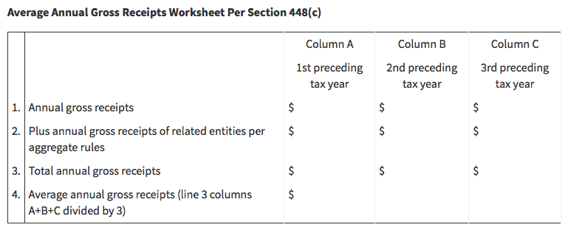
ERC Aggregation Rules

Slide 264
ERC vs. PPP Effect of Aggregation Small vs. Large Employer
Item | PPP Covered Payroll Costs | ERC Qualifying Wages
Aggregation for determining whether small or large employer | N/A | Yes – If companies combined under aggregation rules, then whether > 100 (for 2020) (or 500) (for 2021) ‘ees based on ‘ee count of entire combined group
 |  | Ex: In 2020, each ‘er A and B have 75 ‘ees. If A and B aggregated, result: 150 combined ‘ees. Thus, large ‘er.
 |  | Aggregation hurts if renders taxpayer large employer

Slide 265
Aggregation Rules Effect on ERC
(Notice 2021-20, §G QA 32, §II E, §III B., §III G. QA 32, Notice 2021-49, §III D.) Aggregation affects the following:
Whether employer has business fully or partially suspended
Whether significant decline in gross receipts
Whether employer is a recovery startup business (RSB) (including for gross receipts test and $50,000 limitation on credit for RSB)
Whether > 100 (or 500) full-time employees
Determining max amount of credit per employee

Slide 266
Allocating ERC Among Members of Aggregated Group
Wages paid by A Co. to its employee, Susie, generated $7,000 of ERC for 1Q 2021. A Co. is member of aggregated group ABC. Susie earns > $10,000 for 1Q ‘21 (net of PPP forgive wages) from each group member A, B and C.
The amount of ERC for a member of an aggregated group is based on the member's proportionate share of ERC qualifying wages giving rise to the credit for each calendar quarter for which the credit is claimed (Notice 2021-20, §III B., Q A 8)
In aggregated group ABC, ERC qualifying wages for each of Companies A, B and C are:
A Company $400,000 (4/7 of total)
B Company 200,000 (2/7 of total)
C Company + 100,000 (1/7 of total)
Total $700,000
A’s share of ERC qual. wages (4/7) yields A $4,000 (i.e., 4/7 x $7,000) of ERC for Susie for 1Q 2021. B’s share $2,000. C’s share $1,000. Total $7,000.

Slide 267
Aggregation Rules Effect on ERC Recovery Startup Business
Aggregation rules and recovery startup business (Notice 2021-49, §III D.)
Aggregation rules apply when determining whether business fully or partially suspended or decline in gross receipts (for 3Q 2021)
Aggregation rules apply when determining if an employer is a recovery startup business (e.g., $1M gross receipts test) (e.g., whether starting date of business after 02/15/20)
Aggregation rules apply w/ respect to $50,000 limitation on credit

Slide 268
Recovery Startup Business (RSB) Example: Aggregation Rules
Example: Does newly added restaurant (2nd of 2 restaurants) qualify for 4Q 2021 as an RSB?
Restaurant A (S Corp) gross receipts (GR) $10M/year for last 5 years
Owned 50% each by Jack and Jill
Restaurant B (newly formed in June 2021) GR $300K (June through Sept. 2021), GR $800K (Oct. through Dec. 2021)
Owned 35% by Jack, 35% by Jill and 30% by Joe
Does restaurant B qualify as an RSB for 4Q 2021 ERC? Yes

Slide 269
Recovery Startup Business (RSB) Example: Aggregation Rules
Is restaurant B an RSB? Yes
It’s a separate business started after 02/15/20
New set of owners
Has its own set of books
Passes test “does not exceed $1M average annual gross receipts”
5. “Does not exceed $1M average annual gross receipts” test
Restaurant B’s average annual gross receipts for 2021 = $900,000
Computation (per §448(c)(3)): 2021 receipts prior to 4Q 2021 = $300,000 x 12 ÷ 4 = $900,000
Since $900,000 is < $1M, test is met
Gross receipts test applied to 4 mo. period of prior existence (Restaurant B’s entire period of existence prior to 4Q 2021)

Slide 270
Recovery Startup Business (RSB) Example: Aggregation Rules
Restaurants A and B do not get aggregated because they fail “single employer test”
Single employer test = Corps that are members of a controlled group are treated as single employer
Controlled group = Brother-sister, parent-sub or combined group
Brother-sister controlled group = 2 or more Corps where:
5 or fewer persons who are individuals . . . own at least 80% of total combined voting power (or value) of all classes of stock of each Corp; and
The same 5 or fewer persons, taking into account ownership only to extent identical with respect to each Corp, own > 50% of total combined voting power (or value) of all classes of stock of each Corp

Slide 271
Recovery Startup Business (RSB) Example: Aggregation Rules
Restaurants A and B fail “single employer test” because together they do not comprise a controlled group*
Not a brother-sister controlled group because:
Jack and Jill own only 70% of restaurant B combined
This flunks the 80% test
Not a parent-sub group because no one company owns another
Since restaurants A and B not combined, the “below $1M GR test met – Because restaurant B’s average annual GR only $900,000
Thus, restaurant B is a recovery startup business (RSB) (and therefore qualifies for 4Q 2021 ERC)
* If Jack and Jill would have owned each restaurant A and B 50/50, the 2 Corps would be a controlled group – Thus, restaurant B would not qualify as an RSB (because average annual GR combined would exceed $1M)

Slide 272
ERC Aggregation Rules
Four ways to get snagged by §448(c) attribution rules
§52(a) – Controlled group of C Corps under §1563, but w/ > 50% relatedness
§52(b) – Parent-sub or brother-sister common control
Can be any entity (not just C Corps)
§414(m) – Affiliated service group (employee benefit plans)
§414(o) – Anti-abuse rules (employee benefit plans)

Slide 273
ERC Aggregation Rules
§52(b) – Parent-sub controlled group
One or more chains of organizations conducting businesses connected by > 50% ownership with a common parent
Can be any entity(ies) (not just C Corps)

Slide 274
ERC Aggregation Rules
§52(b) – Brother-sister controlled (or common control) group
Brother-sister group = 2 or more Corps* (or entities) where:
5 or fewer persons who are individuals own at least 80% of total com-bined voting power (or value) of all classes of stock of each Corp*; and
The same 5 or fewer persons, taking into account ownership, only to extent identical with respect to each Corp*, own > 50% of total combined voting power (or value) of all classes of stock of each Corp*
For purposes of above > 50% test
5 or fewer persons have > 50% control taking into account only identical ownership of such person
Supreme Court case: Vogel Fertilizer (1982) – If any one of the 5 or fewer persons owns 0% of any company, that person excluded (kicked out) of analysis
* Can be any entity(ies) (not just C Corps)

Slide 275

ERC Income Tax Alley

Slide 276

Adjustments to Income Tax Return Reduction of Wage Deduction

Slide 277
Effect of ERC on Income Tax Return
 | Tax Break | Effect on Income Tax
Employee Retention Credit (ERC) | ERC [(Round 1 (2020)) = 50% x up to $10k comp cost] [(Round 2 (2021)) = 70% x up to $20k comp cost] offset against employer OASDI [(Round 3 (2021)) = 70% x up to $20k comp cost] offset against employer Medicare (HI) | Income tax deduction for wages reduced by amount of credit taken (CARES §2301(e), FAQ 85). Reduce wages in year ERC generated e.g., If wages paid in 2020, credit received in 2021, reduce wages on 2020 return (CARES §2301(e), IRC §280C, Reg. §1.280C-1)
 |  | E.g., $10,000 ERC wages in 2020. $5,000 ERC rec’d in 2021. 2020 deductible wages only $5,000.
M-1 Adjustment? |  | Yes (for expense recorded on books, but not on tax return)
Notes:
Q: If there is no state ERC, should wages be reduced on state income tax return?

Slide 278
Effect of ERC on Income Tax Return Communications With Client
There is no legal obligation to file an amended return (Badaracco v. Comm. (464 U.S. 386 (1984))
Reg. §1.451-1(a) “If a taxpayer ascertains an item should have been included in gross income in a prior tax year, he should, if within period of limitation, file an amended return and pay any additional tax due”
Circular 230 §10.21 A practitioner who knows that the client has not complied with revenue laws or has made an error in or omission from any return, must advise the client promptly of the fact of such noncompliance, error, or omission and must advise client of conse-quences under IRC and regs of such noncompliance, error, or omission

Slide 279

Reasonable Cause

Slide 280
Effect of ERC on Income Tax Return Reasonable Cause for Late Pay of Income Tax
IR 2022-89 provides (per reasonable cause relief granted by Notice 2021-49):
A taxpayer who files for ERC (and has not yet received expected ERC refund)
May have reasonable cause for abatement of a penalty (for not paying the income tax resulting from wage reduction) immediately
May be eligible for relief from penalties for failing to pay income tax if can show reasonable cause and not willful neglect for failure to pay
May also qualify for administrative relief from penalties for failing to pay on time under IRS's First Time Penalty Abatement program if:
Did not previously have to file a return or had no penalties for the three prior tax years;
Filed all currently required returns or filed an extension of time to file; and
Paid, or arranged to pay, any tax due

Slide 281
Effect of ERC on Income Tax Return Working with Client
Wage expense must be reduced for the year ERC generated, not year ERC claimed or received
If income tax return for year ERC generated (e.g., 2020) was filed and wage expense not reduced by amount of corresponding ERC, what should preparer do?
To amend return reducing wage expense deduction by amount of ERC claimed is the right thing to do
Advise client in writing that amended return should be filed and consequences of doing so or not doing so
You cannot make a client file an amended return
If item affects a carryover, preparer must adjust carryover
Circulating rumor: Some IRS centers won’t pay ERC claim until corresponding amended income tax return filed by taxpayer

Slide 282
Effect of ERC on Income Tax Return War Story / Possible Protective Claim
Story from Texas: Company claimed $3M Covid ERC from IRS. Two years later, still no ERC refund check. Amended income tax return. $1M resulting income tax. IRS now aggressively pursuing collection for “delinquent” income tax. Threats of liens and levies.
Hire the best tax attorney money can buy to get IRS to back off
File a protective income tax claim
Protective income tax claim
To reverse the $1M income tax liability, just in case IRS never pays ERC claim
Malpractice insurance company much more worried about tax practitioner not filing protective claim vs. client not choosing to file amended return

Slide 283

Dilemma The Owner Wage Question and Income Tax Interaction

Slide 284
Catch-22 The Owner Wage Question and Income Tax Interaction
Example: ABC Co. files, prior to 08/05/21, an ERC claim for wages of a (>50%) owner (w/ a listed relative)
IRS later rules against ERC eligibility for such wages in Notice 2021-49
IRS also rules the income tax deduction for wages must be reduced by the amount of ERC claimed
Catch-22: Must the income tax deduction be reduced by the ERC (which IRS says is not available)?
Income tax returns past due date (calendar year 2020 returns are extended through 09/15/21 or 10/15/21)
If file 941-X to eliminate ERC claim, then should not reduce deduction
If wait to file 941-X (to see if IRS position reversed), you won’t know whether to reduce deduction on income tax return
This bizarre dilemma will likely force amended income tax returns and may force amended 941s, with each amendment triggering the other

Slide 285
Notes
Notes:
07/28/22 Murray big course: A. 72% B. 13% C. 15%

Slide 286
Income Tax Alley

Slide 287
ERC and Income Tax Interaction Decrease in §199A W-2 Wages (Ouch!!)
Does receipt of ERC refund decrease wages for purposes of computing §199A qualified business income (QBI) deduction?
For §199A qualified business income deduction (QBID) purposes, a non-C Corp taxpayer may enjoy a 20% QBID deduction if their income is below a certain threshold amount
Even if income exceeds a certain threshold amount, if a non-SSTB business has either W-2 wages paid or UBIA (property basis), then some (or all) of the §199A QBID deduction may be available
Question: Does ERC received decrease W-2 wages for computing the QBI deduction? Answer: Likely yes. (CARES §2301(e), IRC §199A(b)(4))
Result: For a taxpayer with income above the §199A income thresholds, the reduction in W-2 wages (by reason of ERC) yields yet another increase in income tax – Reduces the net benefit of receiving ERC

Slide 288
ERC and Income Tax Interaction Effect on Pass-Through Owner’s Basis
ERC reduces the income tax deduction for the wages that generated it by the amount of ERC received
The decrease in deduction increases basis by amount of ERC
Some tax prep software packages don’t increase basis due to offsetting booking the offset to wage expense as a nondeductible expense
This is wrong treatment – Tp should get a basis increase
The wage is not “nondeductible” – Instead, deduction is reduced
c. The proper accounting entry:
When apply for ERC, debit Receivable, credit Wage expense
When receive ERC money, debit Cash, credit Receivable

Slide 289

PPP Loans and ERC

Slide 290
ERC vs. PPP Process Objective
Develop plan to best utilize minimum amount of wages for best PPP forgiveness (100% benefit), and save the most wages for ERC (a watered down 50% or 70% benefit)

Slide 291
PPP vs. ERC Bang for Your Buck
 | PPP 1st Draw | PPP 2nd Draw | ERC 2020 | ERC 2021
Amount | Forgiveness = dollar per dollar | Forgiveness = dollar per dollar | Credit = 50% (ERC reduces income tax de-duct for wages) | Credit = 70% (ERC reduces income tax de-duct for wages)
Desirability | Better than ERC | Better than ERC | PPP is better | PPP is better
Take both? | Yes, but not on same wages | Yes, but not on same wages | Yes, but not on same wages | Yes, but not on same wages
Coordination required in same time period? | Yes – Map out strategy for 100% PPP forgive, leaving most wages possible for ERC | Yes – Map out strategy for 100% PPP forgive, leaving most wages possible for ERC | Yes – Map out strategy for 100% PPP forgive, leaving most wages possible for ERC | Yes – Map out strategy for 100% PPP forgive, leaving most wages possible for ERC

Slide 292

PPP vs. ERC Strategy to Maximize Each

Slide 293
PPP vs. ERC Strategy to Maximize Each
Stake out PPP
Identify covered period (CP) (or potential CP) for PPP forgive app
Allocate wages (and health insurance) to PPP CP
Allocate other covered comp costs and non-payroll costs to CP
Stake out ERC
Identify quarters (and/or suspension periods) qualifying for ERC
Allocate wages (and health ins) to each ERC qualifying quarter (period)
Identify PPP & ERC duplicating (& non-duplicating) time period(s)
Isolate and apply qualifying wages (and health ins) to non-duplicating time frames – Soak up first
Isolate and apply qualifying wages (and health ins) to duplicating time periods – Use up for PPP first, leave max possible on table for ERC

Slide 294
PPP vs. ERC Strategy to Maximize Each
Maximize PPP forgiveness (100% benefit), leaving maximum ERC (near 50% or 70% benefit) on table
Use up to 40% covered non-payroll costs (e.g., rent) for PPP
Use up all non-wage (and non-health ins) covered payroll costs for PPP
Use up cov. wage (& health ins) for PPP allocable to non-ERC time frames
Begrudgingly use up cov. wage (& health ins) for competing (duplicating) time frames to max (top off) PPP forgive
For CP straddling 12/31/20, use up 2020 cov. wage (& health ins) for PPP 1st
Shake, stir, taste, repeat to investigate whether cutting off CP earlier yields 100% forgive and maximizes ERC even more

Slide 295

How Do the Puzzle Pieces Fit?

Slide 296
IRS Notice 2021-20 QA 49 PPP and ERC Interaction
Employer may elect not to take into account wages for ERC by not claiming ERC on fed employment tax return
However, recipient of PPP loan deemed to h/ made election (not to claim ERC) for wages included on PPP forgive app up to minimum amount of payroll costs needed for forgive
If wages listed on PPP forgive app, but SBA denies forgive (on part or all), then freed up wages eligible for ERC

Slide 297
IRS Notice 2021-20 QA 49 PPP and ERC Interaction
Example 1: PPP loan $100,000. $100,000 (both ERC and PPP eligible) wages paid in 2Q and 3Q 2020.
$100,000 wages and other expenses reported on PPP forgive app
SBA forgive granted for $100,000
Election to not include $100,000 for ERC deemed made
$100,000 wages not eligible for ERC

Slide 298
IRS Notice 2021-20 QA 49 PPP and ERC Interaction
Example 2: PPP loan $200,000. Paid $250,000 in (both ERC and PPP eligible) wages in 2Q and 3Q 2020.
$250,000 wages listed on PPP forgive app
SBA forgive granted for $200,000
Election to not include $200,000 for ERC deemed made
Election NOT deemed made for remaining $50,000 leftover wages - Thus, $50,000 wages available for ERC

Slide 299
IRS Notice 2021-20 QA 49 PPP and ERC Interaction
Example 3: PPP loan $200,000. Paid $200,000 in (both ERC and PPP eligible) wages in 2Q and 3Q 2020.
Also paid other PPP allowable (and forgivable) expenses of $70,000
Submitted PPP forgive app w/ wages $200,000, but not other of $70,000
On PPP forgive app, could have reported $70,000 covered non-payroll and $130,000 covered wages, but did not
SBA forgive granted for $200,000
Election to not include $200,000 for ERC deemed made
No portion of $200,000 wages eligible for ERC

Slide 300
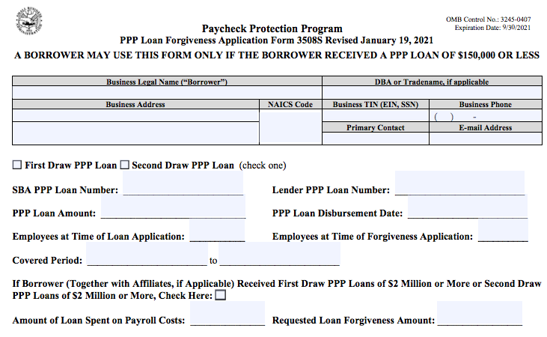
PPP Forgiveness SBA Form 3508S Does Not Allow Listing of Nonpayroll Costs

Slide 301
IRS Notice 2021-20 QA 49 PPP and ERC Interaction
Example 4: PPP loan $200,000. Paid $200,000 in (both ERC and PPP eligible) wages in 2Q and 3Q 2020.
Both $200,000 wages and $70,000 covered non-payroll listed on PPP forgive app
SBA forgive granted for $200,000
Election to not include $130,000 for ERC deemed made
$130,000 wages NOT eligible for ERC
$70,000 wages ELIGIBLE for ERC

Slide 302
IRS Notice 2021-20 QA 49 PPP and ERC Interaction
Example 5: PPP loan $200,000. Paid $200,000 in (both ERC and PPP eligible) wages in 2Q and 3Q 2020.
Both $200,000 wages and $90,000 covered non-payroll listed on PPP forgive app
SBA forgive granted for $200,000
Election to not include $120,000 for ERC deemed made - $120,000 is 60% (minimum amount required for 100% PPP forgive) of $200,000
$120,000 wages NOT eligible for ERC
$80,000 wages ELIGIBLE for ERC (diff. between $200,000 and $120,000)

Slide 303
IRS Notice 2021-20 QA 49 PPP and ERC Interaction
Example 6: PPP loan $200,000. Paid $150,000 in (both ERC and PPP eligible) wages in 2Q and 3Q 2020.
Also, $100,000 (non-ERC eligible) payroll costs (from large employer pay to employees who were working) and $70,000 covered non-payroll costs
Submitted PPP forgive app submitted with $130,000 payroll costs and $70,000 covered non-payroll costs
Payroll costs on PPP forgive app consist of $100,000 non-ERC eligible wages and $30,000 ERC eligible wages
SBA forgive granted for $200,000
Election to not include $30,000 for ERC deemed made
$30,000 wages NOT eligible for ERC
$120,000 wages ELIGIBLE for ERC (diff. between $150,000 and $30,000)

Slide 304
IRS Notice 2021-20 QA 49 PPP and ERC Interaction
Example 7: PPP loan $200,000. Paid $150,000 in (both ERC and PPP eligible) wages in 2Q and 3Q 2020.
Also, $100,000 (non-ERC eligible) payroll costs (from large employer pay to employees who were working) and $70,000 covered non-payroll costs
Submitted PPP forgive app listing $130,000 payroll costs and $70,000 covered non-payroll costs
Payroll costs on PPP forgive app consist of $100,000 non-ERC eligible wages and $30,000 ERC eligible wages
SBA forgive granted for $0
Election to not include $150,000 for ERC deemed made
$150,000 wages ELIGIBLE for ERC (diff. between $150,000 and $0)
(ILM 202237010 (09/16/22)): PPP loan not forgiven is taxable income

Slide 305

PPP Forgive or ERC Credit Cardinal Rules
Notes:
Cardinal rule: Rain, snow or shine
Latin cardinalis (adj.) "principal, chief, essential" (see cardinal (adj.)). https://www.etymonline.com/word/cardinal

Slide 306
PPP Forgive or ERC Credit Cardinal Rules
Goal is to first satisfy (w/ wages) PPP forgiveness (100% benefit) and secondly qualify for ERC (50% or 70% benefit)
Accomplished by building your own “build to spec” spreadsheet allocating compensation costs (wages) between PPP and ERC
You can utilize any dollar of wage for either covered PPP forgiveness or ERC, but not for both (no double dip on same dollar of wage)
Any qualifying dollar of wage not used for one purpose (PPP or ERC), can be used (in any order) (for any employee) for the other purpose
A broader batch of comp costs qualify for PPP forgiveness than for ERC (see Appendix 1 to this outline for 54 slide chart outlining differences)
Non-wage (and non-health insurance) PPP comp costs may be used first (prior to wage and health insurance) for PPP forgive purposes – This leave more wages potentially eligible for ERC on the table

Slide 307
PPP Forgive or ERC Credit Cardinal Rules
If you don’t list PPP covered non-payroll costs on PPP forgive app (accepted by SBA), then IRS says PPP wages (covered comp costs) get wasted (used for PPP forgive instead of covered non-payroll costs (e.g., rent)) (i.e., cannot be used for ERC)
List ALL non-payroll costs on PPP forgive app!!
If too late to list on PPP forgive app (app already filed), consider challenging IRS position in Notice 2021-20 QA 49 Ex. 3 (and allocating (up to 40% of PPP loan balance) to paid non-payroll costs (thus, leaving more wages on the table for ERC purposes)
If filed SBA forgive app Form 3508S, also consider such challenge
If challenge IRS position in Notice 2021-20 QA 49 Ex. 3, consider attaching Form 8275 to Form 941 (client’s judgement call)

Slide 308
PPP Forgive or ERC Credit Cardinal Rules
Isolate on the timeline the portions of:
PPP covered period(s) (entire quarter); and
Government suspension period(s) (period of suspension) that do not overlap with each other
Allocate wages to the non-overlapping (PPP vs. ERC) periods first
For the PPP and ERC periods that overlap (i.e., compete for the same wages):
Use up to 40% of PPP covered non-payroll costs (e.g., rent) first, then
Wages (compensation costs)
Consider that a broader batch of compensation costs qualify for PPP forgiveness than for ERC qualification
Use comp. costs (wages) first to satisfy PPP forgiveness (100% benefit)
Use wages secondly to qualify for ERC

Slide 309
Allocating Wages Between PPP and ERC Examples
No double dipping: If any one dollar of wage is used for PPP forgiveness, it's not available for ERC (and visa versa)
Wage (for all employees or for any one employee) may be allocated between PPP and ERC in any manner taxpayer chooses
Examples
For the same pay period, Johnny’s wages may go to PPP, Susie’s to ERC
For same pay period, half* of Johnny’s wages to PPP, Susie’s half* to ERC
For pay period 1, Johnny’s wages to PPP. For period 2, Johnny’s wages to ERC. For period 3, half (or any proportion) of Johnny’s wages for PPP, half (or remaining portion) for ERC.
* Or any proportion

Slide 310
Allocating Wages Between PPP and ERC Examples
For periods on timeline during which PPP covered period and ERC qualifying period do not overlap, allocate wages to PPP exclusive period and ERC exclusive period
For time periods of PPP and ERC overlap, allocate (minimum needed) to PPP first, to ERC second

Slide 311

What if Someone Lied on PPP Forgiveness App? Did Not Qualify for Forgive, But Got It Anyway?

Slide 312
PPP Loans, On Second Thought, Not Forgiven Taxable Income
PPP loan not forgiven is taxable income (ILM 202237010 (09/16/22))
If attestations on PPP forgiveness application not truthful (e.g., PPP loan forgive app represent all forgiveness requirements met, yet (in truth) not all requirements met (e.g., proceeds not exclusively spent on PPP qualifying covered expenses)), then PPP loan is taxable income in year PPP proceeds received and spent (Springfield Hosp., Inc., 28 F.4th 403, 424 (2nd Cir. 2022))
Taxable income whether SBA audits and discovers the problem (Comm. v. Glenshaw Glass Co., 348 U.S. 426, 431 (1955)*)
Taxable income whether SBA pursues recovery of PPP funds or not
Amended return must be filed by PPP recipient (who did not qualify for forgiveness) reporting income in year PPP loan received
Silver lining: If PPP loan is income taxable, then more wages may be available for a retroactive ERC claim

Slide 313

Payroll Tax Returns Grand Central Station

Slide 314
How to Claim ERC Form 941-X
(Notice 2021-20, Q A 50) Example: Employer paid $10,000 in 3Q 2020 in ERC qualifying wages (no qualifying health plan expenses paid) – Thus, $5,000 in employee retention credit (ERC)
After deferral of $2,000 of employer's share of social security tax, is otherwise required to deposit $8,000 (i.e., $10,000 less $2,000) in federal employment taxes for all of its employees for wage payments made during the same quarter as the $10,000 in qualified ERC wages
No paid sick or family leave under FFCRA
May keep up to $5,000 of the $8,000 of tax was going to deposit – No penalty for holding back the $5,000
Later account for the $5,000 it retained when it files 941
Deposits only $3,000 during quarter

Slide 315

Payroll Tax Credits What if You Missed the Party?

Slide 316
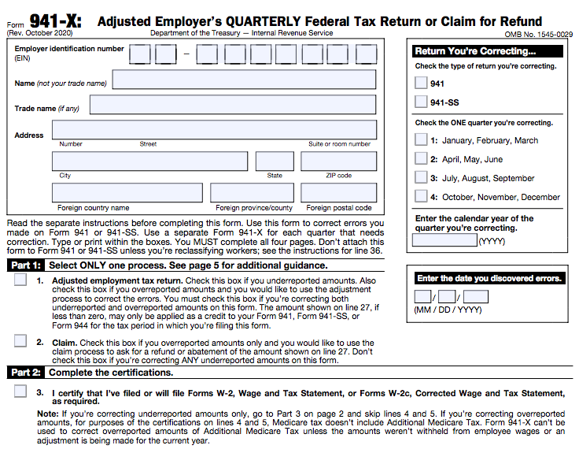
ERC Retroactively Form 941-X (Rev. Oct. 2020)
To claim ERC on Form 941, check the “Claim” box above. Since wages are
not being adjusted (on page 1 of Form 941), do not check box for
“Adjusted employment tax return” above.
Notes:
941-X not revised after Con App 2021

Slide 317
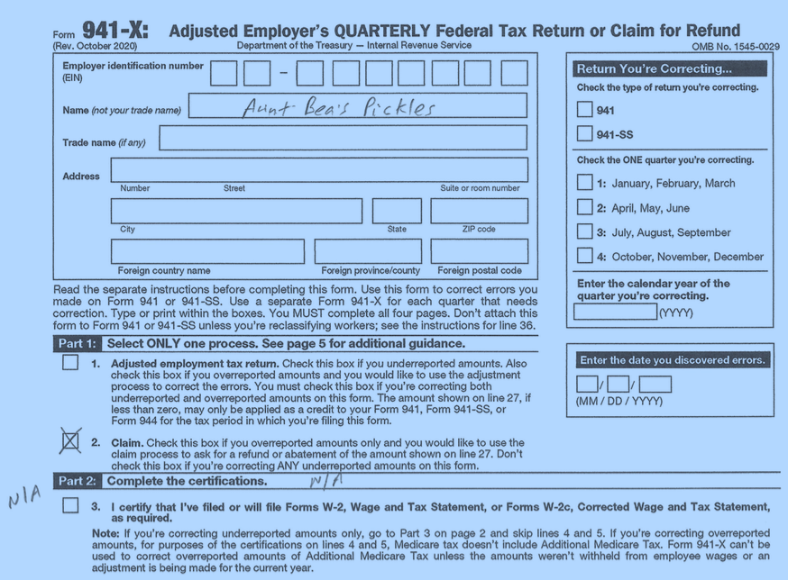
Form 941-X Example
Note: Though it seems contrary to the 941-X Instructions, we’re receiving increasing
reports that IRS is rejecting more and more claims if Part 2, Box 5d is not checked!!

Slide 318
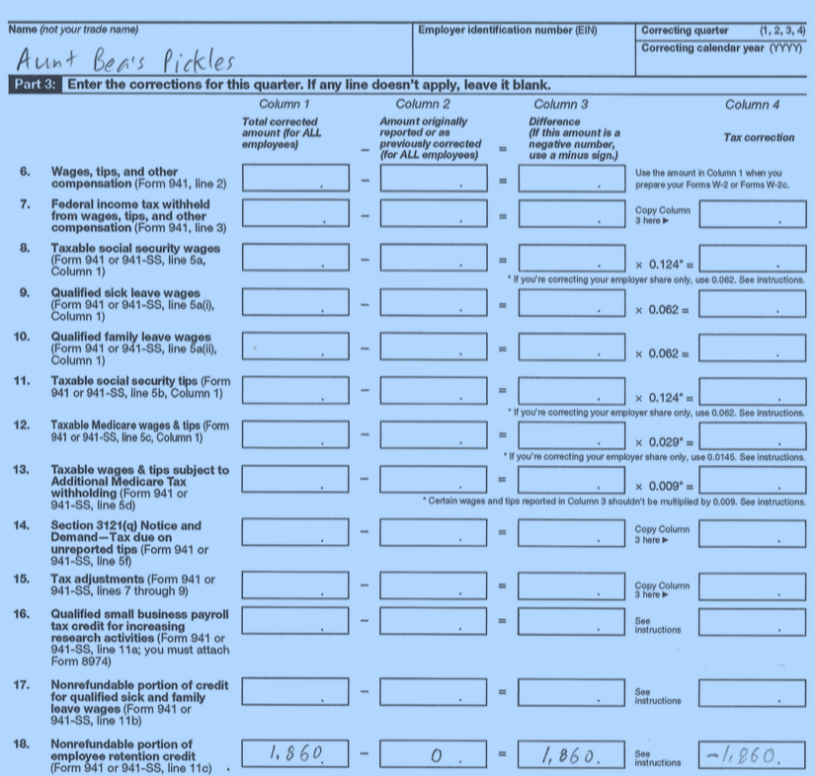
Form 941-X Example

Slide 319
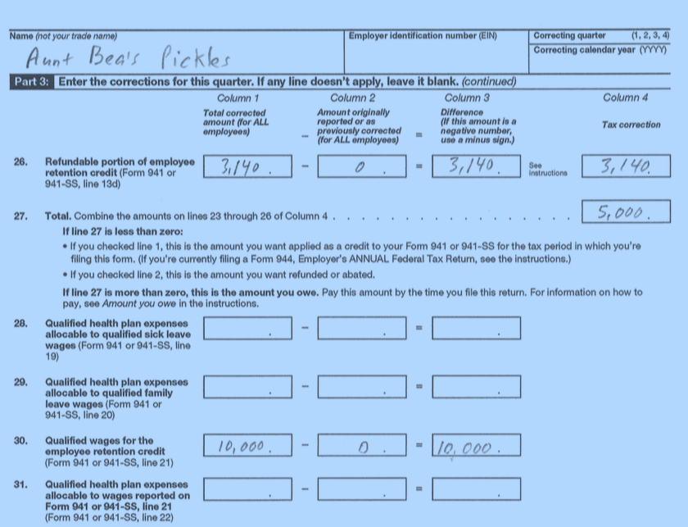
Form 941-X Example (This page filled out wrong on purpose)

Slide 320
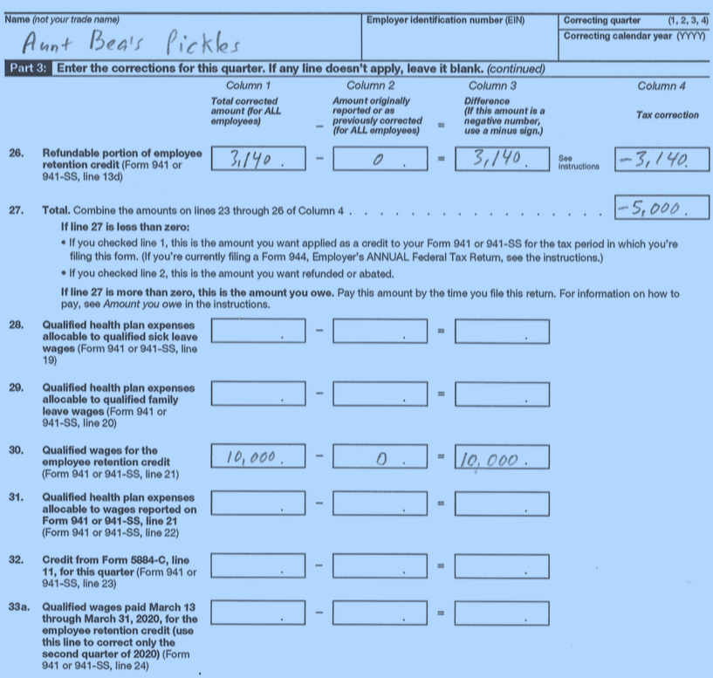
Form 941-X Example

Slide 321
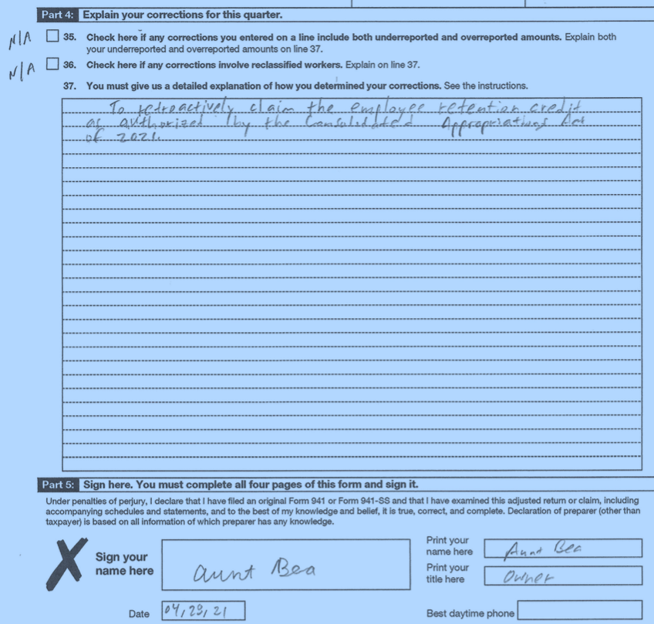
Form 941-X Example

Slide 322

Claiming ERC After 2021 The Home Stretch
For 2020, to file for ERC after 04/15/24 is too late
For 2021, to file for ERC after 04/15/25 is too late
Notes:
(IRC §6511(i)(1), IRC §6513(c), Instructions Form 941-X (04/2022))

Slide 323
That’s All Folks

Slide 324
UPCOMING EVENT: FORM 1065 SCHEDULES K-1,K-2 AND K-3 IRS THROWS ROCKS AT A HORNETS’ NEST
FRIDAY, AUGUST 11, 2023 01:00 PM - 4:00 PM ET
Registration Link:
https://cpewarehouse.com/course/course-detail/form-1065-schedules-k-1-k-2-and-k-3-irs-throws-rocks-at-a-hornets-nest
OR
Email us: cpe@cpewarehouse.com

Slide 325

325

Slide 326
Questions?
Click the box with the arrow above the questions box to expand
Type question in box and submit answer by pressing send
326

Slide 327

THANK YOU
CPE@CPEWAREHOUSE.COM

Slide 328
Index of Appendices
Appendix 1 Wage Chart: PPP vs. ERC
Appendix 2 ERC Majority C and S Corp Owner Wages
Appendix 3 Covid ERC/PPP/EIDL Fraud
Appendix 4 Payroll Tax Returns (Original and Amended)
Appendix 5 Harry Truman Decision Model
Appendix 6 Covid ERC vs. Natural Disaster Related ERC

Slide 329
Appendix 1 Wage Chart: PPP vs. ERC

Slide 330

Threading the Needle Between ERC and PPP Forgiveness

Slide 331
PPP Forgive or ERC Credit Cardinal Rules
Notes:
Cardinal rule: Rain, snow or shine
Latin cardinalis (adj.) "principal, chief, essential" (see cardinal (adj.)). https://www.etymonline.com/word/cardinal

Slide 332
PPP Forgive or ERC Credit Cardinal Rules
You can utilize a dollar of wage for either covered PPP forgiveness or ERC, but not for both
Any qualifying dollar of wage not used for one purpose (PPP or ERC), can be used (in any order) for the other purpose
A broader batch of comp costs qualify for PPP forgiveness than for ERC
Non-wage (and non-health insurance) PPP comp costs may be used first (prior to wage and health insurance) for PPP forgiveness purposes
If you don’t list PPP covered non-payroll costs on PPP forgive app (accepted by SBA), then IRS says PPP wages (covered comp costs) get wasted (used for PPP forgive instead of covered non-payroll costs)

Slide 333
PPP Cov. Payroll vs. ERC Qual. Wages Administrative Law
Paycheck Protection Program as Amended by Economic Aid Act, SBA IFR, Fed. Reg. Vol. 86, No. 9 (01/14/21), §III, B., 4. g. and h.
https://home.treasury.gov/system/files/136/Interim-Final-Rule-Paycheck-Protection-Program-as-Amended-by-Economic-Aid-Act.pdf
Paycheck Protection Program—Revisions to Loan Amount Calculation and Eligibility, SBA IFR, Fed. Reg. Vol. 86, No. 43 (03/08/21)
https://home.treasury.gov/system/files/136/PPP-IFR-Loan-Amount-Calculation-and-Eligibility.pdf
Guidance on ERC under §2301 of CARES Act for 2020 (Notice 2021-20)
https://www.irs.gov/pub/irs-drop/n-21-20.pdf
Guidance on ERC under Con App 2021 (Relief Act) for First and Second Calendar Quarters of 2021 (Notice 2021-23)
https://www.irs.gov/pub/irs-drop/n-21-23.pdf
SBA PPP Payroll Costs FAQs
https://home.treasury.gov/system/files/136/PPP--Loan-Forgiveness-FAQs.pdf

Slide 334

PPP vs. ERC Which Employees Qualify?

Slide 335
PPP vs. ERC Eligible vs. Excluded Employees
Item | PPP Covered Payroll Costs* | ERC Qualifying Wages**
Eligible employees | Employee w/ principal place of residence is in U.S. | ERC qualified wages = IRC §3121(a) FICA wages (CARES §2301(c)(5)(A))
Excluded employees | Employee w/ principal place of residence outside of U.S. | Employees not earning §3121(a) FICA wages
Employers in U.S. Territories | Yes (employers in U.S. Territories not excluded from PPP loan eligibility) | Yes - ERC qualified wages = IRC §3121(a) FICA wages (CARES §2301(c)(5)(A))
* Paycheck Protection Program as Amended by Economic Aid Act, SBA IFR, Fed. Reg. Vol. 86, No. 9
(01/14/21), §III, B., 4. g. and h.
** CARES Act §2301 and progeny

Slide 336
PPP vs. ERC Eligible vs. Excluded Employees
Item | PPP Covered Payroll Costs* | ERC Qualifying Wages**
Full-time employees | Yes | Yes
Part-time employees | Yes | Yes
Student employees | Yes, unless work study (or similar) in higher education | Yes
Household employees | No | No (Notice 2021-20, §A. QA 6)
* Paycheck Protection Program as Amended by Economic Aid Act, SBA IFR, Fed. Reg. Vol. 86, No. 9
(01/14/21), §III, B. 1. g. and 4. a., g., h. and k.
** CARES Act §2301 and progeny

Slide 337
PPP vs. ERC Eligible vs. Excluded Owner Employees
Wages Paid To | PPP Covered Payroll Costs | ERC Qualifying Wages
C Corp owner (regardless of ownership %) | Yes | Yes*
S Corp owner (regardless of ownership %) | Yes | Yes*
Spouse of C or S Corp owner | Yes | Yes*
Relative of > 50% C or S Corp owner | Yes | No
Relative of 50% or less C or S Corp owner | Yes | Yes
* In the author’s opinion, C or S Corp owner (and spouse’s) wage qualifies for ERC (regardless of ownership % or whether actual or deemed owner). (CARES §2301, IRC §51(i), §267). There’s disagree-ment among intelligent members of tax profession as to whether wages of a > 50% owner qualify
for ERC (if his (her) ownership is triggered by “backwards” attribution (from a relative)).

Slide 338
PPP vs. ERC Eligible vs. Excluded Owners
Item | PPP Covered Payroll Costs* | ERC Qualifying Wages
Net earnings from self-employment of general partner (in pshp) | Yes | No (there’s no legitimate employer/employee relationship (no W-2))
Net earnings from self-employment of sole proprietor (SP) | Yes | No (there’s no legitimate employer/employee relationship (no W-2))
W-2 earnings paid by partnership or SP to its non-owner ‘ee | Yes | Yes (if ‘ee related to 50% or less owner) No (if ‘ee related to > 50% owner)
* Paycheck Protection Program as Amended by Economic Aid Act, SBA IFR, Fed. Reg. Vol. 86, No. 9
(01/14/21), §III, B., 4. b. (sole prop), d. (farmer, rancher) and 3. (partnership)

Slide 339

PPP vs. ERC Spending Within a Time Period

Slide 340
PPP vs. ERC Spending Within a Time Period
Item | PPP Covered Payroll Costs* | ERC Qualifying Wages**
Time Period | PPP covered period (CP) | 03/13/20 – 12/31/21
Role of Calendar Quarter | PPP CP may span across > one quarter | Each of 8 quarters may qualify for ERC: 1Q, 2Q, 3Q or 4Q (2020) 1Q, 2Q, 3Q or 4Q (2021)
Timing of Expenditure | Covered payroll costs must be paid or incurred only inside covered period to be eligible for PPP forgiveness | Wages must be paid inside of a quarter to be eligible for ERC for such quarter
Paper check vs. Electronic Pay | Paid on day paycheck distributed or originate ACH transaction IFR §III 3.a. (05/22/20) | No specific guidance available
* Paycheck Protection Program as Amended by Economic Aid Act, SBA IFR, Fed. Reg. Vol. 86, No. 9
(01/14/21), §III, B., 4. g. and h.
** CARES Act §2301, Con App ’21 (Relief Act) §206 and ARPA §9651 and progeny

Slide 341
PPP Covered Periods First Draw vs. Second Draw
 | PPP* |  | ERC
Time Period | First Draw | Second Draw | N/A
Covered Period (CP) Choices | If SBA forgive on or < 12/27/20: 8 weeks or 24 weeks (if funded on or < 06/04/20) -or- 24 wks (if funded 06/05/20 or >) | If SBA forgive > 12/27/20: 24 weeks -or- After “spend out” if so elect (elect by filing “cut off” app)
 | If SBA forgive > 12/27/20: 8 (if qualify) or 24 weeks -or- After “spend out” if so elect (elect by filing “cut off” app) | --
* PPP Flexibility Act and SBA Forms 3508, 3508EZ and 3508S

Slide 342
PPP vs. ERC Spending Within a Time Period
Item | PPP Covered Payroll Costs* ** | ERC Qualifying Wages
Time Period | PPP covered period (CP) | 03/13/20 – 12/31/21
 | Payroll costs paid or incurred inside CP | Only wages paid inside qtr inside qualifying period w/in such qtr: If drop in gross receipts, entire quarter If govt suspension, only period of suspension Recovery startup business > 02/15/20 (ARPA) (only 3Q, 4Q 2021), entire qtr
 | Payroll cost incurred inside (at end of) CP paid by next payroll date after CP if paid by next regular payroll date
 | Example: CP ends 10/04/20. Bi-weekly payroll. Pay cycle ends 10/04/20. Pay date 10/09/20.*
* Payroll Cost SBA FAQ 1, 2, 3 (08/04/20)
** However, if pay period is semi-monthly (twice a month) or slower, calculate payroll costs for
partial pay periods (Payroll Cost SBA FAQ 3 (08/04/20))
- Result 1: Pay must apparently prorated between pay before CP vs. inside CP
- Result 2: Pay must apparently prorated between pay inside CP vs. after CP

Slide 343
PPP vs. ERC Spending Within a Time Period
Item | PPP Covered Payroll Costs* ** | ERC Qualifying Wages
Time Period | PPP covered period (CP) | 03/13/20 – 12/31/21
 | Payroll costs paid or incurred inside CP | Only wages paid inside qtr inside qualifying period w/in such qtr: If drop in gross receipts, entire quarter If govt suspension, only period of suspension Recovery startup business > 02/15/20 (ARPA) (only 3Q, 4Q 2021), entire qtr
 | Payroll costs incurred before CP but paid during CP eligible for forgiveness
 | Example: CP begins 04/20/20. Bi-weekly payroll. Pay cycle ends 04/18/20. Pay date 04/24/20. Result: Wholly earned before CP, but paid inside CP counts.
* Payroll Cost SBA FAQ 1, 2, 3 (08/04/20)
** However, if pay period is semi-monthly (twice a month) or slower, calculate payroll costs for
partial pay periods (Payroll Cost SBA FAQ 3 (08/04/20))
- Result 1: Pay must apparently prorated between pay before CP vs. inside CP
- Result 2: Pay must apparently prorated between pay inside CP vs. after CP

Slide 344

PPP Covered Payroll Costs Broader than ERC Qualifying Wages

Slide 345
PPP vs. ERC Covered Payroll Costs vs. ERC Qualifying Wages
Item | PPP Cov. Payroll Costs* | ERC Qualifying Wages
Payroll Costs (PPP) / Wages (ERC) | Payroll costs = Medicare wages and tips (W-2 Box 5) plus pre-tax ‘ee contributions for health insurance or other excluded fringe benefits (e.g. dependent care assistance) | Social security (OASDI) wages §3121(a) (W-2 Box 3) (not limited to OASDI wage base), and comp costs §3231(e) (per CARES §2301(c)(3) and Notice 2021-20 QA 30)
* Paycheck Protection Program as Amended by Economic Aid Act, SBA IFR, Fed. Reg. Vol. 86, No. 9
(01/14/21), §III, B., 4. a., b. and e.

Slide 346
PPP vs. ERC Covered Payroll Costs vs. ERC Qualifying Wages
Item | PPP Cov. Payroll Costs* | ERC Qualifying Wages
Maximum Wages | For non-owner ‘ee, payroll costs** limited to $100,000/’ee’/yr, but annualized for PPP CP (for 24 wk CP, max of $46,154) | For 2020, $10,000/’ee/yr For 2021, $10,000/’ee/qtr
* Paycheck Protection Program as Amended by Economic Aid Act, SBA IFR, Fed. Reg. Vol. 86, No. 9 (01/14/21), §III, B., 4. a., b. (sole prop), e. (partnership) and g. (payroll costs)
** Payroll costs = Medicare wages and tips (W-2 Box 5) plus pre-tax ‘ee contributions for health insurance or other excluded (e.g., dependent care) fringe benefits

Slide 347
PPP vs. ERC Covered Payroll Costs vs. ERC Qualifying Wages
Item | PPP Covered Payroll Costs* | ERC Qual Wages
PPP Payroll Costs for PPP Forgiveness Purposes (wages and beyond) | For non-owner ‘ee, payroll costs** limited to $100,000/’ee’/yr, but annualized for PPP CP, plus ’Er contribs to ‘er sponsored group health, life, disability and dental, ‘Er retirement plan contributions, and 3. State/local payroll taxes | Unless related to > 50% owner: For 2020, $10,000/’ee/yr For 2021, $10,000/’ee/qtr
* Paycheck Protection Program as Amended by Economic Aid Act, SBA IFR, Fed. Reg. Vol. 86, No. 9 (01/14/21), §III, B., 4. a., b. (sole prop), e. (partnership) and g. (payroll costs)
** Payroll costs = Medicare wages and tips (W-2 Box 5) plus pre-tax ‘ee contributions for health insurance or other excluded (e.g., dependent care) fringe benefits

Slide 348

PPP vs. ERC Owner Employee or Self Employed

Slide 349
PPP vs. ERC C or S Corp Owner
Item | PPP Cov. Payroll Costs | ERC Qualifying Wages
How to compute owner comp eligible for forgiveness? | Depends on business type and whether borrower using 8 or 24 (or shorter than 24) week CP | If C or S Corp owner: For 2020, $10,000/’ee/yr For 2021, $10,000/’ee/qtr
Maximum Wages | For owner ’ee, limited to 20.833% of up to $100k (i.e., $100k / 12 x 2.5 = $20,833) | For 2020, $10,000/’ee/yr For 2021, $10,000/’ee/qtr
 | $15,385 for 8 week CP
 | $20,833 for 10.8 wk or > CP
 | If total comp across businesses that receive a PPP loan exceeds the cap, owner can choose how to allocate the capped amount across different businesses*
* SBA FAQ 8

Slide 350
PPP vs. ERC Owner vs. Non-Owner
Item | PPP Cov. Payroll Cost - Max Wages |  | ERC Qualifying Wages*
CP Length | Owner | Non-Owner | CP N/A (quarter instead)
8 week | $15,385 | $15,385 | CP N/A (quarter instead)
10.8 week | $20,833 | $20,833 | CP N/A (quarter instead)
16 week | $20,833 | $30,769 | CP N/A (quarter instead)
24 week | $20,833 | $46,154 | CP N/A (quarter instead)
* For 2020, $10,000/’ee/yr
For 2021, $10,000/’ee/qtr

Slide 351
C or S Corp Ownership

Slide 352
PPP vs. ERC C or S Corp Owners
Item | PPP Cov. Payroll Costs* ** | ERC Qualifying Wages
Maximum Wages | For C or S Corp owner ’ee, limited to 20.833% of up to $100k (i.e., $100k / 12 x 2.5 = $20,833) of cash comp | For 2020, $10,000/’ee/yr For 2021, $10,000/’ee/qtr
 | C or S Corp owner ‘ee = 5% or > ownership of Corp stock | All C or S Corp owner ‘ees qualify (regardless of ownership %)
* PPP—Revisions to Loan Amount Calculation and Eligibility, SBA IFR, Fed. Reg. Vol. 86, No. 43 (03/08/21)
** Paycheck Protection Program as Amended by Economic Aid Act, SBA IFR, Fed. Reg. Vol. 86, No. 9 (01/14/21), §III, B., 4. a., b. (sole prop), e. (partnership) and g. (payroll costs)

Slide 353
PPP vs. ERC C Corp Owners
Item | PPP Covered Payroll Costs* | ERC Qual Wages
PPP Payroll Costs for PPP Forgiveness Purposes (wages and beyond) | For owner/’ee, limited to 20.833% of up to $100k (i.e., $100k / 12 x 2.5 = $20,833) of (prior year) payroll costs**, plus 1. ’Er contribs to ‘ee group health, life, disability and dental***, ‘Er retirement plan contributions***, State/local payroll taxes*** | All C Corp owner ‘ees qualify (regardless of %): For 2020, $10,000/’ee/yr For 2021, $10,000/’ee/qtr
* Paycheck Protection Program as Amended by Economic Aid Act, SBA IFR, Fed. Reg. Vol. 86, No. 9 (01/14/21), §III, B., 4. a., b. (sole prop), e. (partnership) and g. (payroll costs)
** Payroll costs = Medicare wages and tips (W-2 Box 5) plus pre-tax ‘ee contributions for health
insurance or other excluded (e.g., dependent care) fringe benefits
*** These additional benefits 1. are allowed in addition to the up to $20,833 cash comp and 2. the
retirement plan contribution is limited in amount to 2.5/12 of prior year employer retirement plan
contribution (SBA PPP Payroll Costs FAQ 8)

Slide 354
PPP vs. ERC S Corp Owner
Item | PPP Covered Payroll Costs* | ERC Qual. Wages Pro-Taxpayer
S Corp Owner Comp | S Corp (5% or >) owner (5% or >) employees comp capped by prorated amount of their 2019 or 2020 (whichever used to calculate loan amount) owner employee cash comp plus employer retirement contribs** | All S Corp owner ‘ees qualify (regardless of ownership %): For 2020, $10,000/’ee/yr For 2021, $10,000/’ee/qtr
 | However, employer health, life, disability, vision and dental insurance contributions made on their behalf cannot be separately added***
* PPP—Rev. to Loan Amount Calculation, SBA IFR, Fed. Reg. Vol. 86, No. 43 (03/08/21)
** These additional benefits 1. are allowed in addition to the up to $20,833 cash comp and 2. the
retirement plan contribution is limited in amount to 2.5/12 of prior year employer retirement plan
contribution (SBA PPP Payroll Costs FAQ 8)
*** Thus, 2% shareholder addback of health ins to W-2 can be ignored in this analysis

Slide 355

PPP vs. ERC General Partner in Partnership

Slide 356
PPP vs. ERC General Partner in Partnership
Item | PPP Covered Payroll Costs* | ERC Qual. Wages
General partner “net, net” earnings from self-employment | General partners “payroll cost” capped by prorated amount of 2019 or 2020 net earnings from SE (reduced by claimed §179 expense deduct, unreimbursed partnership expenses, and oil and gas depletion) multiplied by 0.9235 (only if payments made to partner w/in CP**) | Not eligible (there’s no legitimate ’er/’ee relationship (no W-2))
 | For gen. partners, retirement plan contribs and health, life, disability, vision or dental ins. are included in their net SE income (thus, not separately added to payroll)
 | LLC members are subject to the rules based on their LLC’s tax filing status in the reference year used to determine their loan amount
* PPP—Rev. to Loan Amount Calculation, SBA IFR, Fed. Reg. Vol. 86, No. 43 (03/08/21)
** SBA PPP Payroll Costs FAQ 8

Slide 357


PPP vs. ERC Sole Proprietor

Slide 358
PPP vs. ERC Sole Proprietor w/ Schedule C or F (Net Profit)
Item | PPP Covered Payroll Costs* | ERC Qual. Wages
Schedule C or F earnings | C or F filer “covered payroll costs” capped by prorated amount of their owner comp replacement (based on 2019 or 2020 net profit) or “proprietor expenses” (based on 2019 or 2020 gross income) | Not eligible (there’s no legitimate ’er/’ee relationship (no W-2))
 | Separate payments for health insurance, retirement or state or local tax not eligible for additional forgiveness**
* PPP—Rev. to Loan Amount Calculation, SBA IFR, Fed. Reg. Vol. 86, No. 43 (03/08/21)
** SBA PPP Payroll Costs FAQ 8

Slide 359
PPP vs. ERC Sole Proprietor w/ Schedule C or F (Gross Income)
Item | PPP Covered Payroll Costs* | ERC Qual. Wages
Schedule C or F earnings | For SE Sch C or F borrowers with no employees who used gross income to calculate PPP loan, proprietor expenses equal gross income | Not eligible (there’s no legitimate ’er/’ee relationship (no W-2))
 | For SE Sch C or F borrowers with employees who used gross income to calculate PPP loan, “proprietor expenses” = diff. between gross income and employee payroll costs
* PPP—Rev. to Loan Amount Calculation, SBA IFR, Fed. Reg. Vol. 86, No. 43 (03/08/21)

Slide 360

PPP vs. ERC Wages

Slide 361
PPP vs. ERC Small vs. Large Employer
Item | PPP Covered Payroll Costs | ERC Qualifying Wages
Wages paid to employee currently providing services | Yes | No, for large employer Yes, for small employer
Wages pd to ‘ee NOT currently providing services | Yes | Yes, for large ‘er (not pay raises, sever. pay, vac. pay, sick pay, pers. leave) Yes, for small ‘er
Large employer | N/A | In 2020, > 100 FT ‘ees In 2021, > 500 FT ‘ees
Small employer | N/A | In 2020, 100 or < FT ‘ees In 2021, 500 or < FT ‘ees
Full-time (FT) ‘ee* | N/A | 30 hrs or > / week (or 130 hrs or > / month) employed during 2019 (or 2020)* No FT equivalents
* Notice 2021-20, §G QA 30 (see QAs 31, 32, 3428 for rules, computational mechanics)

Slide 362
PPP vs. ERC Effect of Aggregation – Small vs. Large Employer
Item | PPP Covered Payroll Costs | ERC Qualifying Wages
Aggregation for determining whether small or large employer | N/A | Yes – If companies combined under aggregation rules, then whether > 500 ‘ees based on ‘ee count of entire combined group*
 |  | Ex: In 2020, each ‘er A and B have 75 ‘ees. If A and B aggregated, result: 150 combined ‘ees. Thus, large ‘er.
 |  | Aggregation hurts if renders taxpayer large employer
* Notice 2021-20, §G QA 32, §II E, §III B., §III G. QA 32. Aggregation affects the following:
Whether employer has business fully or partially suspended
Whether significant decline in gross receipts
Whether > 100 (or 500) full-time employees
Determining max amount of credit per employee

Slide 363
PPP vs. ERC Sick Pay and Family Leave
Item | PPP Covered Payroll Costs* | ERC Qualifying Wages
Sick pay (in general) | Yes | No (Notice 2021-20, §H QA 38)
FFCRA emergency sick pay | No | No (Notice 2021-20, §H QA 48)
Family, parental or medical leave (in general) | Yes | No (Notice 2021-20, §H QA 38)
FFCRA emergency Family and medical leave | No | No (Notice 2021-20, §H QA 48)
* Paycheck Protection Program as Amended by Economic Aid Act, SBA IFR, Fed. Reg. Vol. 86, No. 9 (01/14/21), §III, B., 4. g. (payroll costs) and h. (exclusions)

Slide 364
PPP vs. ERC Vacation, Separation, Bonus, Fringe
Item | PPP Cov. Payroll Costs* | ERC Qualifying Wages
Vacation pay | Yes | No (Notice 2021-20, §H QA 38)
Separation (severance) or dismissal pay | Yes | No (Notice 2021-20, §H QA 38)
Bonuses / other forms of incentive pay** | Yes | 2020: Bonuses only for ‘ees of small employers 2021: Bonuses if reasonable***
Qualified transportation benefits | No | No****
* Paycheck Protection Program as Amended by Economic Aid Act, SBA IFR, Fed. Reg. Vol. 86, No. 9 (01/14/21), §III, B., 4. g. (payroll costs) and h. (exclusions)
** SBA PPP Payroll Costs FAQ 5
*** CARES §2301(c)(3)(B) and Con App ‘21 (Disaster Tax Relief Act 2020 Title III §207(e)(2)(A))
**** Notice 2021-20, III G. QA 30 Example

Slide 365
PPP vs. ERC Retirement Plan Contributions
Item | PPP Covered Payroll Costs | ERC Qualifying Wages
Employer contributions to retirement plan fbo non-owner ‘ee | Yes – If paid or incurred by borrower during CP (no proration for number of weeks in CP)* | No (not wages per IRC §3121(a))**
Retirement contributions deducted from non-owner ‘ee pay (e.g., 401(k)) | No* | Yes (wages per IRC §3121(a))**
Retirement contributions otherwise paid by ‘ee | No* | No (not wages per IRC §3121(a))**
For treatment of retirement plan contributions of owner/’ees, see C Corp, S Corp. partnership and sole prop slides in this outline
* SBA PPP Payroll Costs FAQ 7
** Notice 2021-20, III, G. QA 30 Example

Slide 366
PPP vs. ERC Are Tips Wages?

Slide 367
PPP vs. ERC Tips Received by Employee
Item | PPP Covered Payroll Costs* | ERC Qualifying Wages
Cash Tips | Yes | Yes (CARES §2301(c)(5), IRC §3121(a)(12)*)
 | (Based on employer records of past tips or, in the absence of such records, a reasonable, good-faith employer estimate of such tips) | * ERC eligible tips = Cash tips received by employee of $20 or > / mo, but NOT cash tips < $20/mo or tips received in any medium other than cash
Other tips | No (although IFR reads: “cash or the equivalent” – It’s not clear what “equivalent” means) | No
* Paycheck Protection Program as Amended by Economic Aid Act, SBA IFR, Fed. Reg. Vol. 86, No. 9 (01/14/21), §III, B., 4. g. (payroll costs) and h. (exclusions)

Slide 368
PPP vs. ERC Employee Contributions
Item | PPP Covered Payroll Costs | ERC Qualifying Wages
Pre-income tax salary contribs under §401(k) | Yes (by default because W-2 Box 5 used) (do not add back to salary) | Yes**
Non-elective (or matching) ‘er retirement plan contributions | Yes* | No**
‘Ee pre-tax dependent care assistance | No (already included in gross salary) | No**
‘Ee pre-tax qualified transportation benefits | No (already included in gross salary) | No**
* Paycheck Protection Program as Amended by Economic Aid Act, SBA IFR, Fed. Reg. Vol. 86, No. 9 (01/14/21), §III, B., 4. a., b. (sole prop), e. (partnership) and g. (payroll costs)
** §3121(a), Notice 2021-20, §G QA 30 Example

Slide 369
PPP vs. ERC Retirement, 401(k) and Fringes
Item | PPP Covered Payroll Costs | ERC Qualifying Wages
Non-elective (or matching) ‘er retirement plan contributions | Yes* | No**
Pre-income tax ‘ee salary reduction contributions under §401(k) | Yes (by default because W-2 Box 5 used) (do not add back to salary) | Yes**
‘Ee pre-tax dependent care assistance | No (already included in gross salary) | No**
‘Ee pre-tax qualified transportation benefits | No (already included in gross salary) | No**
* Paycheck Protection Program as Amended by Economic Aid Act, SBA IFR, Fed. Reg. Vol. 86, No. 9 (01/14/21), §III, B., 4. a., b. (sole prop), e. (partnership) and g. (payroll costs)
** §3121(a), Notice 2021-20, §G QA 30 Example

Slide 370

PPP vs. ERC Health Care Expenses

Slide 371
PPP vs. ERC Health Expenses – Small vs. Large Employer
Item | PPP Covered Payroll Costs | ERC Qualifying Wages
Qualifying health plan expenses allocable to qual. period (or quarter) count regardless of whether ‘ees working or wages paid | Yes | For small ‘er, yes (Notice 2021-20, §H QA 41 Ex. 2)
Qualifying health plan expenses allocable to qual. period (or quarter) count only to ‘ees not providing services only to extent not providing services | Yes | For large ‘er, yes, but only for ‘ees not providing services to extent not providing services (Notice 2021-20, §H QA 42)

Slide 372
PPP vs. ERC Group Health Insurance
Item | PPP Covered Payroll Costs | ERC Qualifying Wages
Group Health Insurance (§5001(b)(1) pd by ‘er, excluded for ‘ee (§106) | Yes (SBA PPP Payroll Costs FAQ 6) | Yes (CARES §2301(c)(5)(B)) allocated pro rata (or per other method) to ‘ees (Notice 2021-20, §G, QA 30, and §H QA 44, 45 (computation methods))
‘Er contributions to self insured health plan | Yes (apparently) | Yes (Notice 2021-20, §H QA 45)
* SBA PPP Payroll Costs FAQ 6

Slide 373
PPP vs. ERC Timing of Health Expenses
Item | PPP Covered Payroll Costs | ERC Qualifying Wages
Timing of qualifying health plan expenses | Amounts PAID or INCURRED by borrower during CP (premiums paid inside CP or by next premium due date after CP (no pre-pay)* | Amounts PAID or INCURRED in qtr in govt suspension period or entire qtr if drop in GR (Notice 2021-20, §H QA 41) (CARES §2301(c)(3)(C))
 |  | Cf: For ERC cash wages, only amounts PAID inside either entire quarter (if drop in gross receipts) or govt suspension period qualify as ERC wages (CARES §2301(c)(3))
* SBA PPP Payroll Costs FAQ 6

Slide 374
PPP vs. ERC Wages Paid vs. Incurred
 | PPP Cov. Payroll Costs | ERC Qual. Wages
Wages qualifying for ERC: Cash vs. Accrual | Wages PAID or INCURRED during CP (wages paid inside CP or by next regular pay date after CP (no pre-pay) (SBA PPP Payroll Costs FAQ 6) Wages may be either paid or incurred | If qualifying for drop in GR, all wages PAID within qualifying period (cal. quarter or suspension period) qualify for ERC Wages must be actually PAID, not merely accrued (CARES Act §2301(c)(3)) (No IRS guidance yet) E.g., Wages earned prior to ERC qualifying qtr paid inside (at beginning of qualifying qtr) appear to qualify for ERC E.g., TX shuts down non-essential businesses on 03/19/20. Payroll checks cut on 03/20/20 for 03/01-14/20.

Slide 375
PPP vs. ERC Employer Provided Group Insurance
Item | PPP Covered Payroll Costs | ERC Qualifying Wages
‘Er Provided Group Dental Insurance | Yes* | Probably**
‘Er Provided Group Vision Insurance | Yes* | Probably**
‘Er Provided Group Life Insurance | Yes* | No (life insurance is obviously not health ins)
‘Er Provided Group Disability Insurance | Yes* | No (disability ins is income replacement ins, not health)
* Available retroactively if no PPP forgiveness received yet as of 12/27/20. Also available
prospectively for PPP forgive after 12/27/21 (Con App Division N,— Additional Corona-
virus Response and Relief, Title III, §308)
** It’s likely, per common sense, that medical includes dental and vision insurance,
though this author’s research of IRC and other guidance yielded no official guidance

Slide 376
PPP vs. ERC Gross Pay vs. Employee Funded
Item | PPP Covered Payroll Costs | ERC Qualifying Wages
Gross pay before deductions for taxes and ‘ee benefit payments* | Yes* | Apparently not (see below)
‘Ee funded pre-tax health plan under FSA §125 | No** | Yes***
‘Ee funded after-tax contribs for health exp. | No** | No***
* SBA PPP Payroll Costs FAQ 4 Thus, cafeteria plan (pre-tax portion elected by employee) counts
as forgivable cash compensation Instead of as group health care benefits
** SBA PPP Payroll Costs FAQ 6
*** Notice 2021-20, §H QA 40

Slide 377
PPP vs. ERC Various Health Benefit Plans
Item | PPP Covered Payroll Costs* | ERC Qualifying Wages
‘Er contributions to HSA (or Archer MSA) | Probably not (likely not a group plan) | No (Notice 2021-20, §H QA 46)
‘Er contributions to high deductible health plan (insurance) (HDHP) | Yes – If group plan | Yes (Notice 2021-20, §H QA 46)
‘Er contributions to health reimbursement arrangement (HRA) | Probably not (likely not a group plan) | Yes (Notice 2021-20, §H QA 47)
‘Er contributions to health FSA (flex spending account) | Probably not (likely not a group plan) | Yes (Notice 2021-20, §H QA 47)
‘Er contributions to QSEHRA (qualified small ‘er health reimb. arrangmt) | Probably not (likely not a group plan) | Yes (Notice 2021-20, §H QA 47)
* SBA PPP Payroll Costs FAQ 6

Slide 378
PPP vs. ERC
Item | PPP Covered Payroll Costs* | ERC Qualifying Wages
‘Ee fed payroll taxes** withheld including FIT (fed income tax withholding) and FICA (‘ee share of OASDI and HI (Medicare)) | Yes | No
Fed payroll taxes imposed on employer FICA (‘er share of both OASDI and HI (Medicare)) | No | No
State and local taxes assessed on ‘ee comp (e.g., SUTA Tax) | Yes | No
* Paycheck Protection Program as Amended by Economic Aid Act, SBA IFR, Fed. Reg. Vol. 86, No. 9 (01/14/21), §III, B., 4. g. (payroll costs) and h. (exclusions)
** SBA PPP Payroll Costs FAQ 4

Slide 379

PPP vs. ERC Non-Payroll Costs

Slide 380
PPP vs. ERC Non-Payroll Costs
Item | PPP Covered Non-Payroll Costs* | ERC Eligible
Non-Payroll | Yes (up to 40% of PPP loan amount paid or incurred within CP)** | No
 | If > 40% PPP covered non-payroll costs used for PPP forgive, then PPP forgive will drop < 100% | -
* PPP covered non-payroll expenses include
Certain rent (but, rent paid to related party limited to lessor’s underlying mortgage interest paid to outside party),
Certain mortgage interest (paid to outside party),
Certain utility payments, and
(If no PPP forgiveness granted by SBA on or < 12/27/20) Covered operations expenditures, property damage costs, supplier costs and worker protection expenditure property (Con App 2021, Division N,— Addtl Coronavirus Response Relief, Title III §304)
** For SBA Non-Payroll Costs FAQs re: timing and substance, see
https://home.treasury.gov/system/files/136/PPP--Loan-Forgiveness-FAQs.pdf

Slide 381
PPP Forgive or ERC Credit Cardinal Rules
Notes:
Cardinal rule: Rain, snow or shine
Latin cardinalis (adj.) "principal, chief, essential" (see cardinal (adj.)). https://www.etymonline.com/word/cardinal

Slide 382
PPP Forgive or ERC Credit Cardinal Rules
You can utilize a dollar of wage for either covered PPP forgiveness or ERC, but not for both
Any qualifying dollar of wage not used for one purpose (PPP or ERC), can be used (in any order) for the other purpose
A broader batch of comp costs qualify for PPP forgiveness than for ERC
Non-wage (and non-health insurance) PPP comp costs may be used first (prior to wage and health insurance) for PPP forgiveness purposes
If you don’t list PPP covered non-payroll costs on PPP forgive app (accepted by SBA), then PPP wages (covered comp costs) get wasted (used for PPP forgive instead of covered non-payroll costs)

Slide 383

That’s All Folks

Slide 384
Appendix 2 ERC Owner Wages

Slide 385

ERC Owner Wages

Slide 386
C or S Corp Ownership

Slide 387
ERC on Wages to Owner of Corp and Spouse Pro-Taxpayer Position
Owners of C or S Corps (regardless of ownership %) wages do qualify for ERC
Spouses of owners of C or S Corps (regardless of the owner’s ownership percentage) wages do qualify for ERC
Non-spouse relatives of > 50% owners, do NOT qualify for ERC
Non-spouse relatives of 50% (or less) owners wages do qualify for ERC
(CARES Act §2301), (Con App (Division EE—Taxpayer Certainty and Disaster Tax Relief Act of 2020, §§ 206-207, 303))
The above is consistent w/ original legislative history to §51
Other readings not consistent w/ original legislative history

Slide 388
Reasonable Minds May Differ And They Do
"Reasonable minds may differ on when uncertainties creep in.”
U.S. Supreme Court Justice Benjamin Cardozo (Jurisprudence: Address before New York State Bar Assoc. Meeting, Hotel Astor, January 22, 1932)

Slide 389

Claiming ERC for Owner Employees IRS Has Made Things Foggy

Slide 390
Both Sides of ERC (>50%) Owner (w/ Living Relative) Wage Dispute
ERC Wage Qualification | IRS Notice 2021-49 (IRS changes position) | Pro-Taxpayer Reading of §51
C or S Corp shareholder (shh) (regardless of ownership %) | Wages of 50% or < shh eligible. Wages of > 50% shh NOT eligible if listed relative (brother, step-brother, sister, step-sister, ancestor or lineal descendent) alive, regardless of whether such relative works in the business. | Yes
Shh’s spouse | Same as above if owner has living relative | Yes
Non-spouse relative of > 50% shareholder** | No | No
Non-spouse relative of 50% (or <) shh** | Yes | Yes
* Originally, in FAQ #59, IRS ignores issue and did not take Notice 2021-49 position
** Notice 2021-49 does not effect eligibility of actual non-owner relatives of owners

Slide 391
Both Sides of ERC (>50%) Owner (w/ Living Relative) Wage Dispute
ERC Wage Qualification | IRS Notice 2021-49 | Pro-Taxpayer Reading of §51
Sole prop (SP) or gen. ptnr (GP) profit comp? (No W-2) | No | No (except for pay to W-2 ’ees) No (except for pay to W-2 ’ees)
SP’s or GP’s spouse | No | Yes
Non-spouse relative of SP or > 50% GP | No | No
Non-spouse relative of 50% (or <) GP | Possibly yes | Yes

Slide 392
IRS Notice 2021-49 Reaction by Congressman Bergman

Slide 393
IRS Notice 2021-49 Reaction by Congressman Bergman
Congressman Jack Bergman, R (MI) in (08/09/21) letter to IRS:
I write w/ my concerns … about Notice 2021-49
I object to language that prevents wages paid to a majority owner of a Corp from qualifying for ERC solely if owner has a direct family member
Notice 2021-49 excludes wages to majority owners or spouses only if “the majority owner has a brother or sister (whether by whole or half-blood), ancestor, or lineal descendant”
As a result, the only business owners that can take advantage of this credit are those who are orphaned and have no children or siblings
Meanwhile, those with families are cut off from this support, despite having an equal or greater need for financial relief

Slide 394
IRS Notice 2021-49 Reaction by Congressman Bergman
Congressman Jack Bergman, R (MI) in (08/09/21) letter to IRS:
The distinction made in your guidance is entirely illogical, goes against the intent of Congress and arbitrarily punishes Americans with families
I therefore request further explanation as to the statutory rationale for this decision
I urge you to take action to correct this absurd bureaucratic move
Thank you for your prompt attention to this critical request

Slide 395
But, Others Disagree . . .
Kristen Esposito, Director of Tax Policy and Advocacy for AICPA, told Tax Notes:
“’We are really pleased with the IRS guidance (Notice 2021-49)
She said some practitioners were surprised to see the related-party distinction — a long-standing constructive ownership concept — included in the context of majority owner qualified wages for the ERC
However, Esposito said the guidance is clear-cut. “If you have any of those existing relatives and you’re the majority owner of a corporation or the spouse, and you are working there, then your wages don’t qualify for the credit”, she explained. (Tax Notes 08/16/21 “Related-Party Restriction Prompts Concern About Retention Credits”, Taylor, Kelly R.)
Ed Zollars, CPA, of Kaplan Education also touts IRS position: https://www.currentfederaltaxdevelopments.com/blog/2021/8/6/guide-to-key-notice-2021-49-stock-ownership-attribution-situations

Slide 396
ERC on Wages to Owner of Corp and Spouse Pro-Taxpayer Position
Owners of C or S Corps (regardless of ownership %) wages do qualify for ERC
Spouses of owners of C or S Corps (regardless of the owner’s ownership percentage) wages do qualify for ERC
Non-spouse relatives of > 50% owners, do NOT qualify for ERC
Non-spouse relatives of 50% (or less) owners wages do qualify for ERC
(CARES Act §2301), (Con App (Division EE—Taxpayer Certainty and Disaster Tax Relief Act of 2020, §§ 206-207, 303))
The above is consistent w/ original legislative history to §51
Other readings not consistent w/ original legislative history

Slide 397
ERC Availability on Wages to Relatives of Corporate Shareholder
Non-spouse relatives (of > 50% owner) wages aced out of ERC
Non-spouse relatives (of 50% (or <) owner) wages not aced out of ERC
§51(i) – Certain individuals ineligible
Related individuals No wages shall be taken into account under subsection (a) with respect to an individual who—
(A) bears any of the relationships … or, if the taxpayer is a corporation, to an individual who owns, directly or indirectly, more than 50 percent in value of the outstanding stock of the corporation, …

Slide 398
The Back of this SUV Has on It Backsplash

Slide 399
ERC Availability on Wages to Corporate Shareholder
IRS opines (and some tax practitioners agree) that a corporate shareholder (shh) loses eligibility for ERC wages by reason of backwards (or backsplash) attribution (from non-spouse relatives who are either employees or not employees)
The statute, regulation (and accompanying legislative history)
Only ace out (from ERC) some relatives (of shh), not shareholder
Do not provide for backwards attribution
"Reasonable minds may differ on when uncertainties creep in.”
U.S. Supreme Court Justice Benjamin Cardozo (Jurisprudence: Address before New York State Bar Assoc. Meeting, Hotel Astor, January 22, 1932)

Slide 400

ERC and Owner Wages At First, There Were No Traffic Signs

Slide 401
ERC Wage Availability Related Party Rules
1. IRS FAQ #59: Are wages paid by an employer to employees who are related individuals considered qualified wages?
No. Wages paid to related individuals, as defined by §51(i)(1), not taken into account for ERC.
A related individual is any employee who has of any of the following relationships to an individual [shareholder who owns > 50% of the Corp]:
A child or a descendant of a child;
A brother, sister, stepbrother or stepsister;
The father or mother or ancestor of either;
A stepfather or stepmother;
A niece or nephew;
An aunt or uncle; or
A son-in-law, daughter-in-law, father-in-law, mother-in-law, brother-in-law or sister-in-law
IRS FAQ #59 only says that relatives are aced out and does not even come close to saying that shareholders themselves are aced out

Slide 402

ERC Related Individuals

Slide 403
ERC Related Individuals
Type of Wage | Eligible for ERC?
Pay to related individuals (per §51(i)(1)) of > 50% owner: A related individual is any employee who has of any of the following relationships to his (her) employer who is an individual: Child or a descendant of a child; Brother, sister, stepbrother or stepsister; Father, mother, or ancestor of either; Stepfather or stepmother; Niece or nephew; Aunt or uncle; Son-in-law, daughter-in-law, father-in-law, mother-in-law, brother-in-law or sister-in-law | No (FAQ #59)

Slide 404
ERC Related Individuals
Type of Wage | Eligible for ERC?
Pay to related individuals (per §51(i)(1)): 8. If employer is a Corp, then a related individual is any person that bears a relationship described above with an individual owning, directly or indirectly, more than 50% in value of the outstanding stock of the Corp 9. If employer is an entity other than a Corp, then a related individual is any person that bears a relationship described above with an individual owning, directly or indirectly, more than 50% of the capital and profits interests in the entity 10. If employer is an estate or trust, then a related individual includes a grantor, beneficiary or fiduciary of the estate or trust, or any person that bears a relationship described above with an individual who is a grantor, beneficiary or fiduciary of the estate or trust | No (FAQ #59)

Slide 405

Owner Wages Argument to Support Owner ERC Wages

Slide 406
Owner Wages Argument to Support Owner ERC Wages
§51(i): Are wages paid to > 50% shareholders eligible for the employee retention credit”
Statute, regulations and legislative history:
Wages paid to relatives of > 50% shareholders are ineligible for work opportunity credit (§51(i)(1))
Wages paid to actual shareholders (shh) of stock are eligible, even if shh owns > 50% of stock
CARES §2301(k): Rules similar to these are applied for purposes of employee retention credit

Slide 407
Owner Wages Argument to Support Owner ERC Wages
When determining the percentage of stock owned, the attribution rules of §267(c) apply
Under §267(c), a non-majority (50% or >) shareholder may be considered to own a majority (> 50%) interest
This renders wages paid to relatives of such a shh ineligible for ERC
However, wages paid to actual shareholder ERC eligible

Slide 408
Owner Wages Argument to Support Owner ERC Wages
§51(i) – Statute, regulation (Reg. §1.51-1(e)(iii)) and original legislative history only ace out relatives, not actual shareholders
Statute – The overall structure of the statute is inconsistent with the “any living relative” rule. Actual stock ownership is required (as opposed to family attribution).
Reg. (§1.51-1(e)(iii))
Legislative history – Credit denied for hiring “relatives” of the employer. No mention of denial for shareholder’s own wages. (CB 1981-2 pg. 502)

Slide 409
Owner Wages Argument to Support Owner ERC Wages
7. Reg. §1.51-1(e)(iii)
Reg. requires actual stock ownership
Reg. applies disallowance rule to an “individual who is related. . . to a shareholder who owns (per §267(c)) > 50% . . . of the outstanding stock of the taxpayer if the taxpayer is a corporation”
Reg does not provide for “deemed” shareholder status
Reg. doesn’t apply to non-shhs who own stock through family attribution
If Treasury had intended treatment as a shareholder by virtue of a relative’s stock ownership), it would have written the reg. differently

Slide 410

Owner Wages Argument to Support Owner ERC Wages
IRS has ruled (some commenters agree) application of an “any living relative” rule
This aces out (eliminates) for ERC wages paid to a majority (> 50% shareholder) if the shareholder has living relatives
Under this position, a similar shh without living relatives is ERC eligible
Some practitioners believe the IRS “living relative rule” reads like something out of “The Onion”

Slide 411
Owner Wages Argument to Support Owner ERC Wages
Unreasonable results -- The “any living relative” argument produces absurd or unreasonable results
That shareholders with living relatives should be treated differently than shareholders without living relatives is on its face unreasonable
Even if the language of the statute clearly supported the “any living relative” argument (it does not), the “any living relative” argument should be rejected as absurd or unreasonable
Courts will look past the plain language of a statute if it produces an unreasonable result at variance w/ policy of legislation (U.S. vs. American Trucking Association, 310 US 534 (1940))

Slide 412
Owner Wages Argument to Support Owner ERC Wages
Taxpayer argument Achilles heel: “Similar” rules
The exact rules of §51(i) are not applied to the employer retention credit
Rather, “similar” rules are to be applied (CARES Act §2301(k))
When acceptance of the literal meaning of words in a statute leads to results which are absurd or futile or plainly at variance with the policy of the legislation, the legislative purpose will be followed (U.S. vs. American Trucking Association) (310 US 534 (1940))
Although it’s not clear exactly what the differences between the two provisions should be, it’s certainly rational to apply a more lenient test to the employee retention credit given the circumstances surrounding its enactment (a devastating pandemic)

Slide 413
Owner Wages IRS Position Against Most Owner ERC Wages

Slide 414

IRS Position – Notice 2021-49 Which Owners Qualify / Which Not?

Slide 415
IRS Position – Notice 2021-49 Which Owners Qualify / Which Not?
Related Individuals – Effect of §51(i) and §267(a) attribution (Notice 2021-49, §IV.D.)
Issues:
Whether wages paid to an employee who owns > 50% (majority owner) of value of a Corp are ERC qualifying wages
Whether wages paid to a spouse of a majority owner are treated as ERC qualifying wages

Slide 416
IRS Position – Notice 2021-49 Which Owners Qualify / Which Not?
Related Individuals – Effect of §51(i) and §267(a) attribution (Notice 2021-49, §IV.D., Ex. 1, 2)
Wrong kind of relative aces > 50% owner out. A majority owner of a Corp is a related individual, whose wages are not ERC qualified wages, if owner has brother or sister (whether by whole or half-blood), ancestor or lineal descendant

Slide 417
IRS Position – Notice 2021-49 Which Owners Qualify / Which Not?
Example 1: Parent and child ace each other out of ERC
Corp A is owned 80% by Mother and 20% by her Daughter
Corp A ERC eligible for 1Q 2021. Both Mother and Daughter employees
Under §267(c) attribution rules, both Mother and Daughter are treated as 100% owners
Mother has the relationship to Daughter described in §152(d)(2)(C) (and Daughter has the relationship to Mother described in §152(d)(2)(A))
Accordingly, Mother’s and Daughter’s wages both aced out of ERC because each are related individuals.

Slide 418
IRS Position – Notice 2021-49 Which Owners Qualify / Which Not?
Example 2: Child of parent not working at business aces parent out of ERC
Corp B is owned 100% by Dad
Dad has a son Ralphie that is alive
Corp B ERC eligible for 1Q 2021
Dad is an employee of Corp B, but Son is not
Under §267(c) attribution rules, Son is attributed 100% ownership of Corp B, and both Dad and Son are treated as 100% owners
Dad has the relationship to Son described in §152(d)(2)(c)
Accordingly, Dad’s wages aced out of ERC because Dad is a related individual

Slide 419
Dad’s Brother Crazy Uncle Billy Ice Fishing in Outer Siberia

Slide 420
Crazy Uncle Billy He’s Alive

Slide 421
IRS Position – Notice 2021-49 Which Owners Qualify / Which Not?
Related Individuals – Effect of §51(i) and §267(a) attribution (Notice 2021-49, §IV.D., Ex. 3)
If no wrong kind of relative, > 50% owner not aced out. If majority owner of a corporation has no brother or sister (whether by whole or half-blood), ancestor, or lineal descendant as defined in §267(c)(4), then neither majority owner nor his (her) spouse is a related individual under §51(i)(1) and the wages paid to the majority owner and/or the spouse are qualified ERC wages, assuming other requirements met

Slide 422
No Living Siblings, Parents or Children a/k/a Crazy Uncle Billy Was Never Heard From Again

Slide 423

IRS Position – Notice 2021-49 Which Owners Qualify / Which Not?

Slide 424
IRS Position – Notice 2021-49 Which Owners Qualify / Which Not?
Example 3: If no “listed relatives”, owner and spouse’s wages eligible for ERC (Notice 2021-49, §IV.D., Ex. 3)
Corp C is owned 100% by Husband (H)
Husband (h) married to Wife (W)
No other family members defined in §267(c)(4)
H and W are both employees
§267(c): W attributed 100%, both H and W treated as 100% owners
H and W do not have a relationship described in §152(d)(2)(A)-(H)
All qualifying wages paid to H and W in 1Q 2021 are ERC qualifying
If have siblings, kids or parents, IRS position appears to be H and W ace each other out

Slide 425
IRS Position – Notice 2021-49 Which Owners Qualify / Which Not?
Related Individuals – Effect of §51(i) and §267(a) attribution (Notice 2021-49, §IV.D., Ex. 3)
Wrong kind of relative would ace > 50% owner’s spouse out. The spouse of a majority owner is a related individual (for ERC), whose wages are not qualified wages, if the majority owner has a family member who is a brother or sister (whether by whole or half-blood), ancestor or lineal descendant (and, thus, is deemed to own the majority owner’s shares under §267(c)) and the spouse bears a relationship in §152(d)(2)(A)-(H) to the family member
Ex: A direct majority owner’s brother is a constructive majority owner under §267(c)(2) and (4) the direct majority owner’s spouse is considered related to the constructive majority owner by virtue of the in-law relationship described in §152(d)(2)(G) – But, if no “listed” relatives, then wages of spouse not aced out

Slide 426

IRS Position – Notice 2021-49 Relatives Splashing on Each Other Can Add Up

Slide 427
IRS Position – Notice 2021-49 Relatives Splashing on Each Other Can Add Up
1. Related Individuals – Effect of §51(i) and §267(a) attribution
Siblings can add up to 100%. Notice 2021-49 Example 4:
Corp D is owned 34% by Individual L, 33% by Individual M, and 33% by Individual N. L, M, and N are siblings
Corp D is ERC eligible for 1Q 2021
L, M, and N are employees of Corp D
Under attribution rules of §267(c), L, M, and N are treated as 100% owners
L, M, and N have relationship to each other described in §152(d)(2)(B)
Accordingly, Corp D may not treat as qualified wages any wages paid to L, M, or N

Slide 428

If These Guys Are All Brothers (Some Owners, Some Working in Business, Some Not) IRS Says Everyone Aces Everyone Else Out

Slide 429

ERC Owner Wages What Is Effect of Notice 2021-49?

Slide 430

ERC Owner Wages Is Notice 2021-49 End of the Freeway?

Slide 431

ERC Owner Wages Is Pro-Taxpayer Position in Shambles?

Slide 432
Owners and Relatives State of the Union
IRS changed its mind (from FAQ #59 to Notice 2021-49) from “indifferent” on the issue to “against the taxpayer”
At first, IRS only indicated (in FAQ #59) that certain relatives of > 50% owner aced out
IRS (in FAQ #59) did not assert backsplash attribution against owner from certain relative(s)
IRS has now “bought in” to backsplash
IRS National Office was reportedly split when made choice
The issue in a court of law could go either way
The political and fiscal winds have changed – Now blow against, instead of for, employer (in Covid era) – ERC projected to cost more than expected and Congress looking to repurpose ERC $

Slide 433
Owners and Relatives State of the Union
Claiming ERC on owner (with alive “listed” relatives) wages after Notice 2021-49 (08/05/21) more treacherous than before
It’s all about whether penalties are on the table (§6662 accuracy for client and §6694 preparer for practitioner)
Reasonable cause argument stronger for pre-08/05/21
For 08/05/21 and later, consider attaching Form 8275 to Form 941 (or Form 941-X)
Complex issue – Courts often cut a break on penalties on complex issues
Conversation w/ Denver area IRS counsel – 8275 not a free pass – How much effort did practitioner put in to determine appropriate approach
IRS let lots of water (time) go under the bridge before switching positions

Slide 434
IRS Form 8275 Disclosure of Uncertain Positions

Slide 435

The Food Chain Reg. §1.6662-4

Slide 436

The Food Chain Reg. §1.6662-4

Slide 437
The Food Chain Reg. §1.6662-4
§1.6662-4(d)(3)(iii) Authorities to be considered
Internal Revenue Code (IRC) and other statutory provisions;
Proposed, temporary and final regulations construing such statutes;
Revenue rulings and revenue procedures;
Tax treaties and regulations thereunder;
Court cases;
Congressional intent (as reflected in committee reports);
General Explanations of tax legislation prepared by the Joint Committee on Taxation (Blue Book);
Private letter rulings and technical advice memoranda issued after 10/31/76;
Actions on decisions and general counsel memoranda issued after 03/12/81;
IRS information or press releases; and
Notices, announcements and other admin pronouncements published by IRS in Internal Revenue Bulletin (IRB)

Slide 438
The Food Chain Reg. §1.6662-4
§1.6662-4(d)(3)(i) Evaluation of authorities
There is substantial authority for the tax treatment of an item only if the weight of the authorities supporting the treatment is substantial in relation to the weight of authorities supporting contrary treatment
There may be substantial authority for more than one position with respect to the same item
§1.6662-4(d)(3)(ii) Taxpayer may have substantial authority for a position that is supported by only by a well-reasoned construction of an applicable statute

Slide 439

The Grey Light, Mid and Deep

Slide 440
Uncertain / Aggressive Tax Positions
Spectrum – From white to grey to black
White = Unabashedly conservative
Black = Illegal
Grey = The middle (where the tax profession operates, whether by choice or not, every day) (tax law vague in general)
Light grey = Modestly aggressive
Mid grey = Medium range aggressive
Deep grey = profoundly, intensely aggressive, but not illegal

Slide 441
Uncertain / Aggressive Tax Positions
Where on the spectrum is challenging Notice 2021-49 wages on (>50%) owner and spouse wages w/ listed relatives?
Before Notice 2021-49 (i.e., prior to 08/05/21)
My opinion: Light to mid grey
Support for position: Arguably substantial authority (no Form 8275 necessary), but at least reasonable basis (8275 bails you out of penalty)
After Notice 2021-49 (i.e., 08/05/21 and later)
My opinion: Middle mid grey
Position has at least reasonable basis, perhaps not substantial authority (thus, Form 8275 highly recommended)
Why is it a tougher go for pro-taxpayer position now? Because a Notice is official authority, though it’s low level

Slide 442
Owners and Relatives State of the Union
It’s all about whether penalties are on the table (§6662 accuracy for client and §6694 preparer for practitioner)
Substantial authority for position (or disclosure on Form 8275 if have reasonable basis) avoids penalties
You’re held to authority that exists on date you sign (file) tax return
Substantial authority (35-45% or so chance) exists for pre-08/05/21 (> 50%) owner wage eligible for ERC – In my opinion, yes (Form 8275 disclosure not required)
Reasonable basis (20% or so chance) exists for 08/05/21 and later (> 50%) owner wage eligible for ERC – In my opinion, probably (Form 8275 disclosure recommended)

Slide 443

We Don’t Want To Be an Impala in Trouble So, What Do We Do?

Slide 444
Owners and Relatives State of the Union
Claiming ERC for (>50%) owner (w/ listed relatives) wage on 941 after 08/05/21
Only 3Q and 4Q 2021 Form 941s remain to be timely originally filed
Go for it now. If file 3Q or 4Q 2021 941 claiming ERC on (50%) owner (w/ listed relatives alive) wage, consider attaching Form 8275
Wait it out. Consider filing Form 941 without claiming ERC on (50%) owner (w/ listed relatives alive) wage – Then, if Congress reverses IRS (or IRS reverses course), amend later to claim

Slide 445
Owners and Relatives State of the Union
Amended return or not?
My inclination is to say no
Odds of penalty for pre-08/05/21 owner wage ERC claim arguably low
To be sure of no penalty, file amended return
If don’t amend, set money aside until statute of limitations expires
There is no legal obligation to file an amended return
Reg. §1.451-1(a) “If a taxpayer ascertains an item should have been included in gross income in a prior tax year, he should, if within period of limitation, file an amended return and pay any additional tax due”
Badaracco v. Comm. (464 U.S. 386 (1984)) “Internal Revenue Code does not explicitly provide either for a taxpayer's filing, or for the Commissioner's acceptance, of an amended return; instead, an amended return is a creature of administrative origin and grace.”

Slide 446
Owners and ERC How to Advise Clients re: Amended Returns
IRS Circular 230 §10.21 Knowledge of Client's Omission
A practitioner, retained by a client re: a matter administered by IRS, who knows that the client has not complied with revenue laws of U.S. or has made an error in or omission from any return . . . which the client submitted or executed, must advise the client promptly of the fact of such noncompliance, error, or omission
The practitioner must advise the client of the consequences under IRC and regulations of such noncompliance, error, or omission
Question: Is a Form 941 or 941-X claiming ERC for a > 50% owner (with a forbidden relative) executed and submitted before 08/05/21 either noncompliance, an error or an omission? I don’t think so
However, out of an abundance of caution, to stay out of possible trouble, a preparer may choose to notify client in writing that subsequent IRS guidance ruled against position on return earlier taken

Slide 447
Owners and ERC Notice 2021-49 and Penalty Abatement
No penalties for implementing Notice 2021-49 if reasonable cause
Notice 2021-49 §IV addresses several ERC issues for both 2020 and 2021
If employer files amended return to reflect Notice 2021-49 and consequently owes additional tax, any penalties for failure to timely pay or deposit tax will not apply if can show reasonable cause and not willful neglect

Slide 448
Owners and Relatives Next Moves
Next moves
Be a whole lot more cautious moving forward (after 08/05/21) (with either 3Q or 4Q 2021 Form 941 or Form 941-X)
Whether to claim in future w/ or w/o Form 8275 disclosure – Client’s call
Whether to file an amended return
Client’s call
I’d let the sleeping dog lie (keeping in mind the original position you took was not a lie) (wait, see whether Congress or IRS reverse course)
IRS seems to be going out on two thin limbs
With double attribution against the owner (I’ve never seen that before)
By ruling that a living relative (that has nothing to do with the business) aces out an owner (I’ve never seen that before)

Slide 449
Appendix 3 Covid ERC/PPP/EIDL Fraud

Slide 450
Fraud
Fraud = Deceit, trickery, sharp practice or breach of confidence, perpetrated for profit or to gain some unfair or dishonest advantage (Dictionary.com)

Slide 451
In the Old Wild West Things Got Settled the Old Fashioned Way

Slide 452
In the Old Wild West Things Got Settled the Old Fashioned Way
Three Dalton brothers, Bob, Grat and Emmet, and 2 others wanted to do what had never been done before: rob two banks at the same time
After camping on Onion Creek, west of Coffeyville, KS, they rode into town on horse on October 5, 1892. Three bandits entered the Condon Bank, two entered First National Bank.
A 12 minute gun battle ensued killing 4 bandits and 4 townspeople. Emmet Dalton, though shot 23 times, survived.
The bandits got a combined $25,000, but the banks got it back. At the end of the day, Condon Bank $20 short and First National $1.98 over. www.coffeyville.com/514/The-Dalton-Raid-Story
Notes:
$25,000 on 10/05/1892 is worth about $800,000 today.

Slide 453
In the Old Wild West Things Got Settled the Old Fashioned Way
“They were duelin', Doolin-Dalton High or low, it was the same
Easy money, faithless cohorts Red-eye whiskey for the pain
If you're fast, and if you're lucky
You will never see that hangin' tree”
Song “Doolin-Dalton” by the Eagles (Desperado LP)

Slide 454
In the Old Wild West Things Got Settled the Old Fashioned Way

Slide 455

In the New Wild West Things Get Settled the New Fashioned Way
Nicholas L. McQuaid, Acting Assistant U.S. Attorney General of the Justice Department's Criminal Division:
"To anyone thinking of using the global pandemic as an opportunity to scam and steal from hard working Americans, my advice is simple – don't. No matter where you are or who you are, we will find you and prosecute you to the fullest extent of the law."

Slide 456
In the New Wild West Things Get Settled the New Fashioned Way
Applicants who fraudulently steal Covid relief funds (ERC, PPP loans and EIDL loans) from fed govt must pay it back, for starters, pay a whole lot extra and do serious hard time
Notes:
At least that’s what the Department of Justice says

Slide 457
In the New Wild West Things Get Settled the New Fashioned Way
DOJ’s criminal and civil enforcement efforts to combat COVID-19 related fraud, to date:
Criminal charges against over 1,000 defendants with alleged losses exceeding $1.1 billion;
Seizure of over $1B in Economic Injury Disaster Loan (EIDL) proceeds; and
Over 240 civil investigations into more than 1,800 individuals and entities for alleged misconduct in connection with pandemic relief loans totaling more than $6B

Slide 458
CARES Act Covid Relief
Paycheck Protection Program (PPP) Loans
For businesses, 1% interest, first (2 yr) and second (5 yr) draw loans, most forgiven
$800B budget, estimated 15% of PPP loans exhibited at least 1 indicator of fraud, estimated $76B fraudulent
EIDL (Economic Injury Disaster Loan)
For businesses, up to $2M
Interest rate up to 4%, deferral 2 years
Employee Retention Credit (ERC)
Employment tax credit up to $5,000/employee in 2020, $21,000/ee (2021)
All 4 quarters of each 2020 (with limits) and 2021 (with limits)

Slide 459
Alleged Fraudulent Acts PPP, EIDL Loans and ERC
Application via fraudulent business entities or shell companies
Misrepresentation of payroll and employees
Falsified bank statements
Falsified tax records
Misrepresentation of business income

Slide 460
Criminal Statutes PPP, EIDL Loans and ERC
18 U.S.C. §371 – Conspiracy
18 U.S.C. §1344 – Bank Fraud
18 U.S.C. §1957(a) – Transactional Money Laundering
18 U.S.C. §981(a)(1)(c); 18 U.S.C. §982(a)(1); 21 U.S.C. §2461(c) – Forfeiture Allegations

Slide 461

Criminal Statute Conspiracy
Conspiracy = 2 (or more) persons conspire (make secret plans) to
defraud U.S. and at least one person takes action to carry out plan
(object of conspiracy)

Slide 462
Criminal Statute Conspiracy
18 U.S.C. §371 – Conspiracy
If two or more persons conspire either to commit any offense against the United States, or
to defraud the United States, or any agency thereof in any manner or for any purpose, and
One or more of such persons do any act to effect the object of the conspiracy,
each shall be fined under this title or
imprisoned not more than five years, or both

Slide 463

Criminal Statute Bank Fraud
Executes (or attempts to execute) scheme to fraudulently obtain
assets of (or held by) financial institution

Slide 464
Criminal Statute Bank Fraud
18 U.S.C. §1344 – Bank Fraud
Whoever knowingly executes, or attempts to execute, a scheme or artifice—
To defraud a financial institution; or
To obtain any of the moneys, funds, credits, assets, securities, or
other property owned by, or under the custody or control of, a financial institution,
by means of false or fraudulent pretenses, representations, or promises;
shall be fined not more than $1,000,000 or imprisoned not more than 30 years, or both

Slide 465

Criminal Statute Wire Fraud
Executes (or attempts to execute) scheme to defraud
another out of money utilizing wire communications

Slide 466
Criminal Statute Wire Fraud
18 U.S.C. §1343 – Wire Fraud
Voluntarily and intentionally devised or participated in a scheme to defraud another out of money;
Did so with the intent to defraud;
Reasonably foreseeable that interstate wire, electronic or internet communications would be used; and
Interstate wire, electronic or internet communications were in fact used
Fines imposed and up to 20 years in prison

Slide 467

Criminal Statute Transactional Money Laundering
Monetary transaction involving criminally derived property
(> $10,000) derived from unlawful activity

Slide 468
Criminal Statute Transactional Money Laundering
18 U.S.C. §1957(a) – Transactional Money Laundering
(a) Whoever knowingly engages (or attempts to engage in) a monetary transaction in criminally derived property of a value greater than $10,000 and is derived from specified unlawful activity, shall be punished
(b)(1) Punishment is a fine under title 18 U.S.C., or imprisonment for not more than ten years or both
(b)(2) A court may impose an alternate fine to that imposable under (b)(1) of not more than twice the amount of criminally derived property involved in the transaction

Slide 469

Criminal Statute Forfeiture Allegations
Any property which is derived from the proceeds traceable to
bank fraud and money laundering is subject to forfeiture

Slide 470
Criminal Statute Forfeiture Allegations
18 U.S.C. §981(a)(1)(c); 18 U.S.C. §982(a)(1); 21 U.S.C. §2461(c) – Forfeiture Any property which is derived from the proceeds traceable to bank fraud and money laundering is subject to forfeiture

Slide 471
PPP, EIDL Loans and ERC Consequences
Violation (Count) | Action(s) | Potential Consequences
Conspiracy | 2 (or more) persons conspire to defraud U.S., at least one person acts to carry out | Money fine
 |  | 5 years prison
Bank Fraud (or Wire Fraud) | Executes (or attempts) scheme to fraudulently obtain assets of or held by financial institution (or fraud using wire communic. or internet) | $1M fine
 |  | 30 years prison (20 years wire fraud)
Transactional Money Laundering | Monetary transaction involving criminally derived property $10,000 derived from unlawful activity | Money fine (twice amount of $ transaction)
 |  | 10 years prison
Forfeiture Allegations | Any property derived from proceeds traceable to bank fraud and money laundering is subject to forfeiture | All money obtained and property obtained w/ such $ subject to forfeiture

Slide 472
PPP, EIDL Loans and ERC Example: Arizona Case
Notes:
Business location listed for Glendale AZ exempt org “Lotto Club” Lotto Club status at AZ Secy State “Pending Inactive”

Slide 473
PPP, EIDL Loans and ERC Example: Arizona Case
Indictment of Willie “Blu” Mitchell and Toni Richardson, U.S.D.C. Arizona, Case CR-21-00977-PHX-GMS (11/23/21)
Indicted on counts of Conspiracy, Bank Fraud, Transactional Money Laundering and Forfeiture Allegations
Defendants, purporting to do business as the Lotto Club (an alleged charity for veterans) conspired to and did submit a false and fraudulent PPP loan application to Western State Bank for $1,276,500
The Lotto Club had no employees or payroll up through the date of application for its PPP loan
Defendants falsely represented the Lotto Club had 85 employees and a monthly payroll of $510,635

Slide 474
PPP, EIDL Loans and ERC Example: Arizona Case
A fictitious payroll ledger and supporting false documentation was submitted to support the PPP app
The AZ Dept Economic Security had not received wage reports from the Lotto Club for 2019 and 2020
Defendants received $1,276,500 PPP loan proceeds from Western State Bank
Defendants opened a Lotto Club checking account (both were signatories)
After receiving the PPP loan, the Lotto Club reported 2 employees (the 2 defendants) and wages of $9,807.69 (1Q 2021) and $147,586.11 (2Q 2021)

Slide 475
PPP, EIDL Loans and ERC Example: Arizona Case
After receiving the PPP loan, defendants caused 6 more fictitious payroll transactions to be processed
After receiving the PPP loan, defendants caused the transfer of $194,577, $20,000 and $25,000 to other accounts of entities controlled by them or to one defendant personally

Slide 476
Potential for Arizona Case: Up to 45 Years Each Defendant Over $3.8M Monetary Damages Each Defendant

Slide 477
Example: Arizona Case Consequences
Violation (Count) | Action(s) | Potential Consequences
Conspiracy | 2 (or more) persons conspire to defraud U.S., at least one person acts to carry out | Money fine
 |  | 5 years prison
Bank Fraud (or Wire Fraud) | Executes (or attempts) scheme to fraudulently obtain assets of or held by financial institution (or fraud using wire communic. or internet) | $1M fine
 |  | 30 years prison (20 years wire fraud)
Transactional Money Laundering | Monetary transaction involving criminally derived property $10,000 derived from unlawful activity | Money fine up to $2,553,000
 |  | 10 years prison
Forfeiture Allegations | Any property derived from proceeds traceable to bank fraud and money laundering is subject to forfeiture | All money obtained and property (obtained w/ such money) subject to forfeiture

Slide 478
ERC Fraud Questions In IRS Exams
Fraud Questions
Does the company that paid the wages exist?
Do employees exist?
Do wages exist?
Did the employer have a drop in gross receipts?
Did employer face government shutdown/suspension?
Is supporting documentation falsified?
Do the numbers in the ERC claims make sense?
Do returns filed w/ fed govt line up w/ state filings?

Slide 479
Appendix 4 Payroll Tax Returns (Original and Amended)

Slide 480
Payroll Tax Returns Grand Central Station

Slide 481
How to Claim ERC Form 941
(Notice 2021-20, Q A 50) Example: Employer paid $10,000 in 3Q 2020 in ERC qualifying wages (no qualifying health plan expenses paid) – Thus, $5,000 in employee retention credit (ERC)
After deferral of $2,000 of employer's share of social security tax, is otherwise required to deposit $8,000 (i.e., $10,000 less $2,000) in federal employment taxes for all of its employees for wage payments made during the same quarter as the $10,000 in qualified ERC wages
No paid sick or family leave under FFCRA
May keep up to $5,000 of the $8,000 of tax was going to deposit – No penalty for holding back the $5,000
Later account for the $5,000 it retained when it files 941
Deposits only $3,000 during quarter

Slide 482
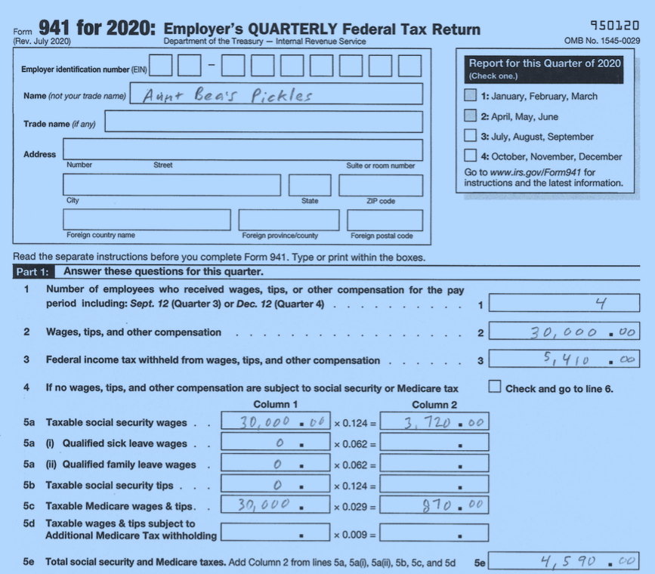
Example (Cont.) Form 941

Slide 483
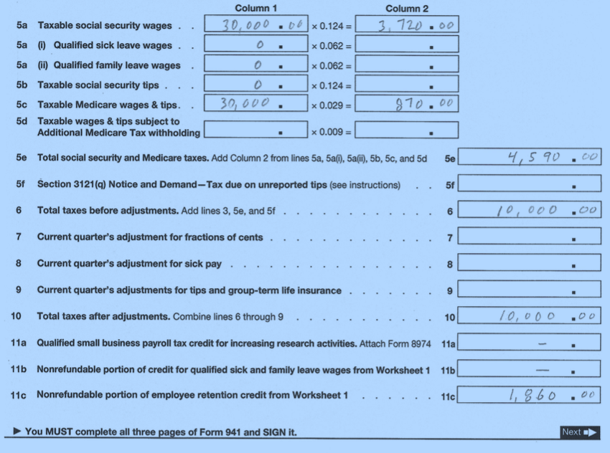
Example Form 941

Slide 484
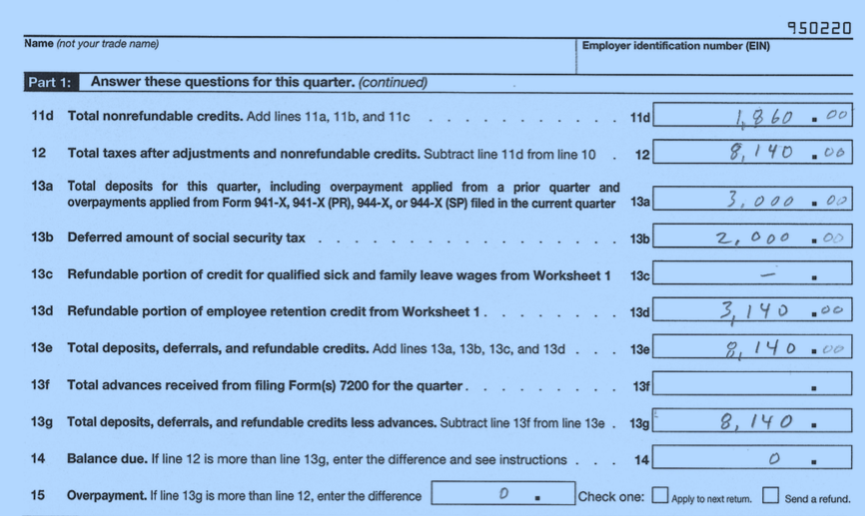
Example (Cont.) Form 941

Slide 485
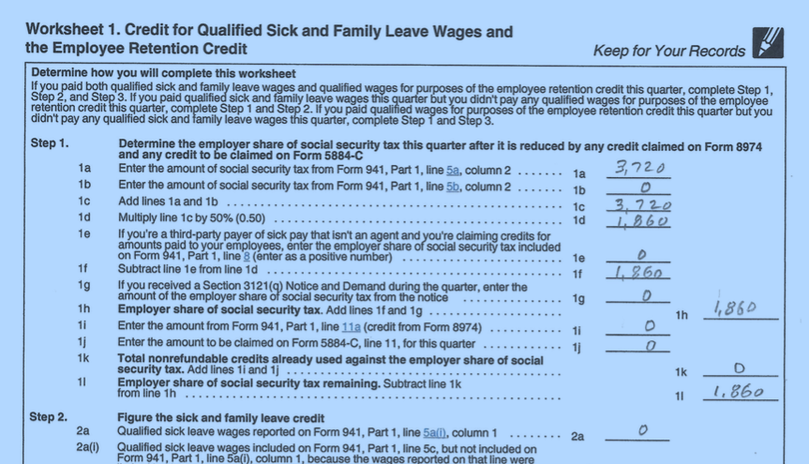
Example (Cont.) Form 941

Slide 486
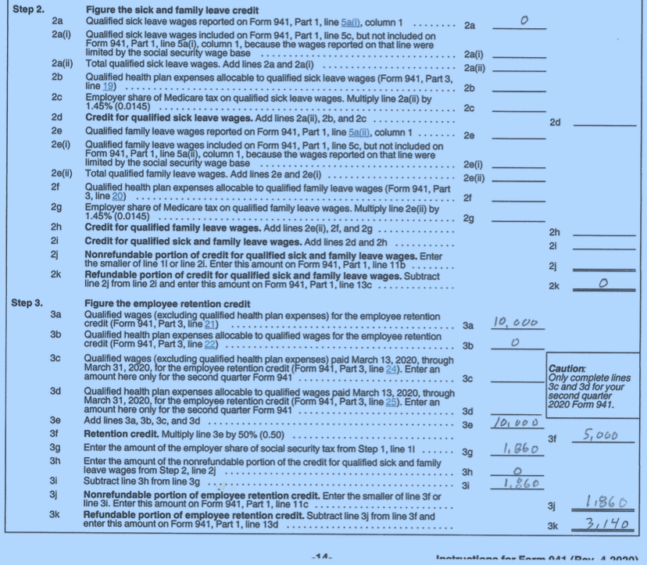
Example (Cont.) Form 941

Slide 487
IRS Is Behind Processing Payroll Tax Returns
RIA Checkpoint announced on 05/25/21 that IRS published on its webpage of 05/21/21 that
IRS has (as of 05/06/21) 1.9M unprocessed Form 941 in its pipeline (200,000 of which received before 2021)
IRS is shipping via truck 941s from busier service centers to less busy service centers
Cincinnati and Ogden have special Covid 941 processing staff
IRS has (as of 05/07/21) has 100,000 Forms 941-X unprocessed (waiting on underlying Forms 941 to be processed)

Slide 488
Common Costly Errors in Claiming Covid Payroll Tax Credits
IRS: “Common but costly errors employers should avoid when filing taxes or claiming credits” (COVID Tax Tip 2021-64) (05/10/21)
Report advanced credits actually received, not merely requested payments
Complete all lines on amended tax returns
Use Form 7200 to request the advance payment of a credit only, not for claiming the credit
Report # of employees correctly on Form 941 Line 1
Inform third-party payers or reporting agents of requested and received an advance payment of credits
Use fractions of cents line correctly for fractions of cents, due to rounding, re: employee share of Social Security and Medicare taxes

Slide 489
Payroll Tax Credits What if You Missed the Party?

Slide 490
ERC Payroll Tax Return Mechanics
If did not claim ERC originally on Form 941 (missed the party)
File Form 941-X to retroactively claim ERC
File 941-X for each retroactive quarter claimed*
No known special statute of limitations deadline
Too late for Form 7200 if did not file prior to filing 941
* For ERC qualifying wages paid from 03/13/20 – 03/31/21, report and claim ERC on 2Q 2020 Form 941
Note: In this author’s 38+ years of practice (during which I have practiced employment tax somewhat heavily), I have never once experienced an amended employment tax return (Form 941-X) generate an IRS exam

Slide 491
ERC Retroactively Form 941-X (Rev. Oct. 2020)
To claim ERC on Form 941, check the “Claim” box above. Since wages are
not being adjusted (on page 1 of Form 941), do not check box for
“Adjusted employment tax return” above.
Notes:
941-X not revised after Con App 2021

Slide 492
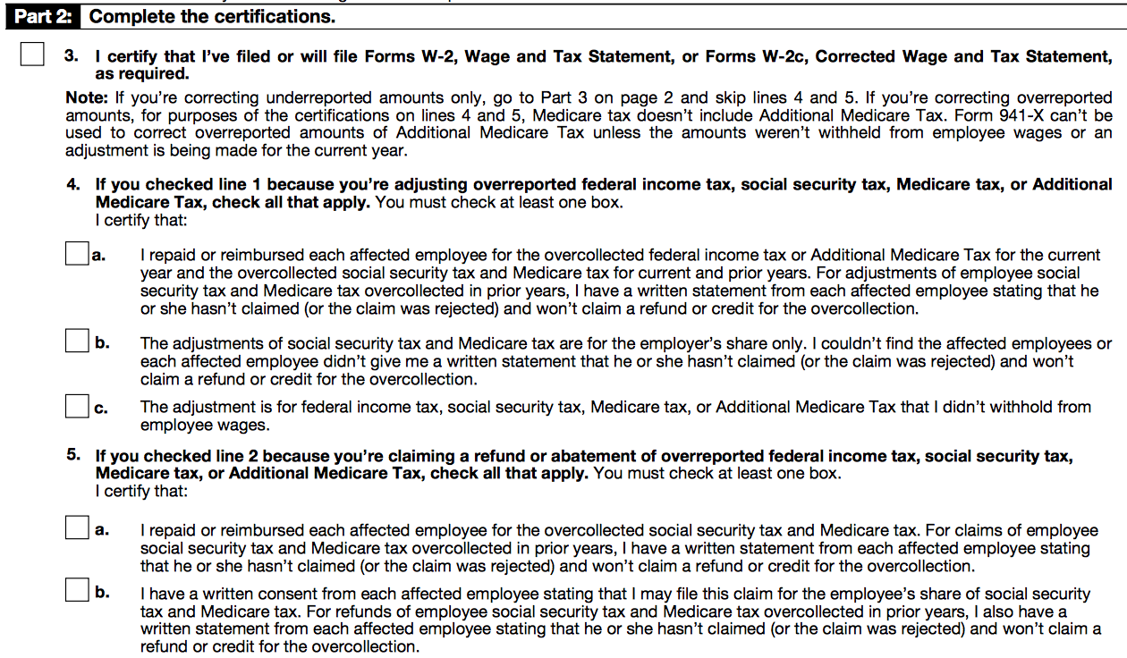
ERC Retroactively Form 941-X (Rev. Oct. 2020)
In completing Form 941-X for an ERC claim, do not complete Part 2 below. Since the
Return is not an “Adjusted Employment Tax Return”, Part 2 below is irrelevant.

Slide 493
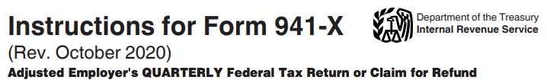
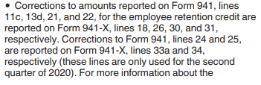
Form 941-X (Rev. October 2020) Instructions

Slide 494
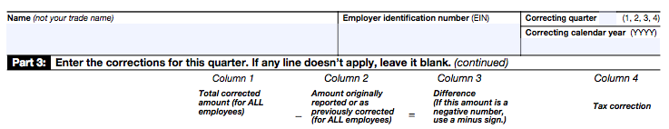
Form 941-X Nonrefundable Portion of ERC
The nonrefundable portion of ERC is limited to employer share of social security tax (OASDI) reported on Form 941, lines 5a and 5b, after being first reduced by any:
Form 8974 research credit for qualified small business payroll tax credit for increasing research activities,
Form 5884-C work opportunity credit for qualified tax-exempt orgs hiring qualified veterans, and/or
Form 941 credit for the nonrefundable portion of the credit for FFCRA qualified sick and family leave wages

Slide 495
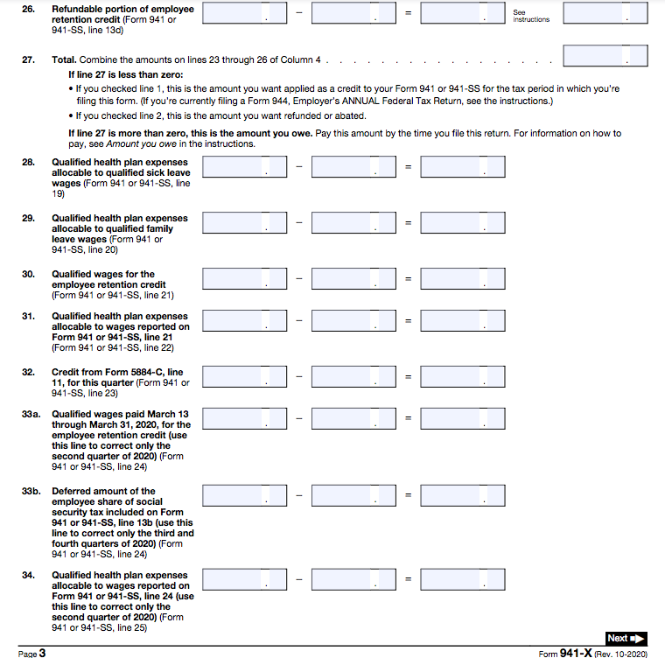
Form 941-X
The refundable portion of the credit (line 26) is allowed after the employer share
of social security tax is reduced to zero by nonrefundable credits

Slide 496
Claiming Covid Payroll Tax Credits Form 941
Form 941 April 2020 https://aboutbtax.com/Rx2
Form 941 Instructions April 2020
https://aboutbtax.com/RHb
Form 941 July 2020 https://aboutbtax.com/Tsk
Form 941 Instructions July 2020
https://aboutbtax.com/Ts4

Slide 497
Form 941-X Example

Slide 498
Form 941-X Example

Slide 499
Form 941-X Example (This page filled out wrong on purpose)

Slide 500
Form 941-X Example

Slide 501
Form 941-X Example

Slide 502
Appendix 5 Harry Truman Decision Model

Slide 503
Harry Truman Decision Model
Facts. Thoroughly discover and develop the facts.
Question / Issue / Problem. Formulate the exact, question, issue, or problem to be resolved. If more than one question exists, write each question on a separate piece of paper. If more than one issue must be resolved, issues must be organized in logical order. Which must be logically answered first, next, and so on? Answer the questions in logical order.
Courses of Action. Outline each possible course of action. Do not leave any out, regardless of however seemingly implausible.

Slide 504
Harry Truman Decision Model
Consequences. Analyze the consequences of each possible course of action. Do so within decision “T” accounts.
Alternative One Alternative Two Alternative Three
_+________- __ _+________-__ _+__________-__

Slide 505
Harry Truman Decision Model
Apply Horse Sense. Apply horse sense*.
Make a Decision. Make a decision.
Don’t Second Guess It. Last, but not least, don’t second guess it.
The reporter asked Harry Truman, “(w)hat is horse sense?” Truman’s reply: “(h)orse sense is something a mule simply does not have.”
The U.S. military adds a step: Examine your assumptions. [Insert as new step 5.]

Slide 506
Appendix 6 Covid ERC vs. Natural Disaster Related ERC

Slide 507
Employee Retention Credit Interaction with Income Tax
Q: For a partnership (or an S Corp), does Covid ERC credit (in its capacity as a credit) flow through on partner’s (or shareholder's) K-1? A: Covid ERC credit does not flow through K-1 as a credit to be entered on partner’s income tax return as a credit
1. There are 2 different types of employee retention credit:
Covid-related ERC (allowed against employment tax); and
Natural disaster-related ERC (e.g., fire or flood) (Form 5884-A) (allowed against income tax)
If you claim the Covid ERC, there's no Form 1065 (or Form 1120-S) Schedules K and K-1 reporting of Covid ERC (and, thus, no Form 5884-A-related flow through reporting on K-1)

Slide 508
Employee Retention Credit Interaction with Income Tax
Q: For a partnership (or an S Corp), does the Covid ERC credit (in its capacity as a credit) flow through on the partner’s (or shareholder's) K-1? A: It does not flow through the K-1* as a credit to be entered on the partner’s income tax return as a credit
Q from a tax preparer: ”I input the Covid ERC credit into Schedule K. It flowed through to Line 13 on partner’s Schedule K-1. Is this correct reporting of the Covid ERC credit on Form 1065? I ask because it’s not accepted on partner's Form 1040, Form 3800, Part 3.”
A: Do not enter Covid ERC into Schedule K input as a credit. Covid ERC is not properly reported on Sch. K or K-1 (or partner’ income tax return) as a credit.
Covid ERC is a partnership level credit against partnership’s employment tax
It’s not allowed on prtnr’s income tax return (it's not a credit against income tax)
* However, the partnership’s income tax deduction for wages is reduced (by amount of ERC claimed) on Form 1065. This will consequently affect the amount of net income (or net loss) (reported on K-1 line 1 (or line 2)) from the pshp.

Slide 509
That’s All Folks

Slide 510
THANK YOU
CPE@CPEWAREHOUSE.COM

